Slide 1
MIDTERM II STUDY GUIDE
MICROBIOLOGY

Slide 2
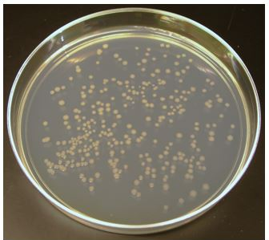
The Bacterial Colony
When bacteria cells are allowed to grow on an agar plate, one single bacterial cell will reproduce via binary fission and give rise to a colony or genetically identical bacteria cells that were all generated from a single parent cell.

Slide 3
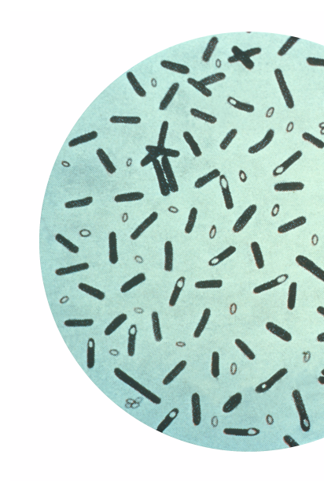
Bacterial Requirements for Growth
The process of metabolism requires 3 things:
A Source of Carbon
A Source of Energy
A Source of Electrons (or Hydrogen Atoms)

Slide 4
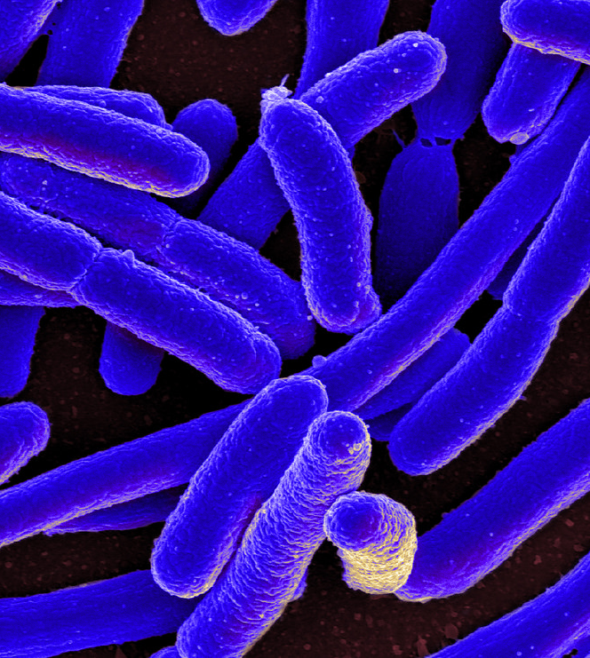
There are 4 classes of organisms based on what they use as a source of carbon and what they can metabolize for energy.
Photoautotrophs -
Carbon Source - carbon dioxide
Energy Source - sunlight energy
Chemoautotrophs -
Carbon Source - carbon dioxide
Energy Source - organic molecules (lipids, carbohydrates and proteins)
Photoheterotrophs -
Carbon Source - organic molecules (lipids, carbohydrates and proteins)
Energy Source - sunlight energy
​Chemoheterotrophs -
Carbon Source - organic molecules (lipids, carbohydrates and proteins)
Energy Source - organic molecules (lipids, carbohydrates and proteins)
This Photo by Unknown Author is licensed under CC BY

Slide 5
There are 4 classes of organisms based on what they use as a source of carbon and what they can metabolize for energy.
Photoautotrophs -
Carbon Source - Carbon Dioxide
Energy Source - Sunlight Energy
Chemoautotrophs -
Carbon Source - Carbon Dioxide
Energy Source - Organic Molecules
Photoheterotrophs -
Carbon Source - Organic Molecules
Energy Source - Sunlight Energy
Chemoheterotrophs -
Carbon Source - Organic Molecules
Energy Source - Organic Molecules
The best way to understand the classifications of organisms (based on energy and carbon sources) is to break down the word.
For example, each of these terms begins with either “photo-” or “chemo”.
So here’s the rule. The first word is going to define the ENERGY source for that class or organisms.
The word “photo-” means “light”.
This means that organisms classified as PHOTOautotrophs or PHOTOheterotrophs will use sunlight or photons (packets of light energy) as their ENERGY source!

Slide 6
There are 4 classes of organisms based on what they use as a source of carbon and what they can metabolize for energy.
Photoautotrophs -
Carbon Source - Carbon Dioxide
Energy Source - Sunlight Energy
Chemoautotrophs -
Carbon Source - Carbon Dioxide
Energy Source - Organic Molecules
Photoheterotrophs -
Carbon Source - Organic Molecules
Energy Source - Sunlight Energy
Chemoheterotrophs -
Carbon Source - Organic Molecules
Energy Source - Organic Molecules
The word “chemo-” means “chemical”, but for our purposes I want to think of chemo- more specifically as “organic chemical compounds”.
This means that organisms classified as CHEMOautotrophs or CHEMOheterotrophs will use organic chemical compounds as their ENERGY source!
Organic Chemical Compounds include: Proteins, Lipids and Carbohydrates.

Slide 7
There are 4 classes of organisms based on what they use as a source of carbon and what they can metabolize for energy.
Photoautotrophs -
Carbon Source - Carbon Dioxide
Energy Source - Sunlight Energy
Chemoautotrophs -
Carbon Source - Carbon Dioxide
Energy Source - Organic Molecules
Photoheterotrophs -
Carbon Source - Organic Molecules
Energy Source - Sunlight Energy
Chemoheterotrophs -
Carbon Source - Organic Molecules
Energy Source - Organic Molecules
$$CO2$$
$$CO2$$
Next, let’s look at the second word, which is the word that sits somewhat in the middle of these classifications.
Each of these terms has either “auto-” or “hetero-” in it.
So here’s the rule. The first word is going to define the ENERGY source for that class of organisms. The second is going to define the CARBON source for that class of organisms.
The word “auto-” means “self”. These are “autotrophs” that we know make their own food. They do not need to consume organic matter like heterotrophs do.
This means that organisms classified as photoAUTOtrophs and chemoAUTOtrophs will use the inorganic chemical compound, carbon dioxide as their CARBON source!

Slide 8
There are 4 classes of organisms based on what they use as a source of carbon and what they can metabolize for energy.
Photoautotrophs -
Carbon Source - Carbon Dioxide
Energy Source - Sunlight Energy
Chemoautotrophs -
Carbon Source - Carbon Dioxide
Energy Source - Organic Molecules
Photoheterotrophs -
Carbon Source - Organic Molecules
Energy Source - Sunlight Energy
Chemoheterotrophs -
Carbon Source - Organic Molecules
Energy Source - Organic Molecules
$$CO2$$
$$CO2$$
The word “hetero-” means “other”. These are “heterotrophs” which means “eat other”. These organisms must consume organic matter to live.
This means that organisms classified as photoHETEROtrophs and chemoHETEROtrophs must consume organic molecules to use as their CARBON source!
Organic molecules include proteins, lipids and carbohydrates.

Slide 9
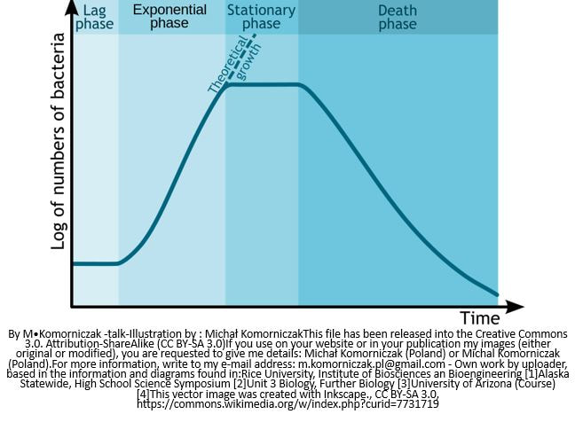
Phases of Bacterial Growth
When we analyze bacterial growth, it is convenient to create a graph of the number of bacteria versus time. This type of graph is called a "growth curve".
Bacterial Growth Curve
The Lag Phase
The Log Phase
The Stationary Phase
The Death Phase

Slide 10
Phases of Bacterial Growth
Bacterial Growth Curve
The Lag Phase
The Lag Phase
The lag phase of the growth curve is generated from the bacteria adjusting to their new environment. The cells will not undergo binary fission until they have adapted to the new habitat.
This Photo by Unknown Author is licensed under CC BY-SA

Slide 11
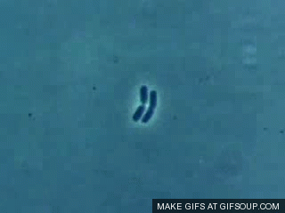
Phases of Bacterial Growth
Bacterial Growth Curve
The Log or Exp. Phase
The Log or Exponential Phase
The log or exponential phase of the growth curve reveals the “active growth” of bacteria in the population.

Slide 12
Phases of Bacterial Growth
Bacterial Growth Curve
The Stationary Phase
The Stationary Phase
The growth will level off when the population of bacteria begins to run out of space and nutrients and/or when toxins are built up in the culture, the log phase will give way to the stationary phase. In the stationary phase, the number of bacteria cells in the population will remain fairly consistent due to the fact that the number of cells being created will be roughly equal to the number of cells dying.

Slide 13
Phases of Bacterial Growth
Bacterial Growth Curve
The
Death
Phase
The Death Phase
After some time, the depletion of nutrition and space and the buildup of toxins in the culture, will cause more cells to be dying than cell being produced. This is the death phase of the growth curve.
This Photo by Unknown Author is licensed under CC BY-NC-ND

Slide 14
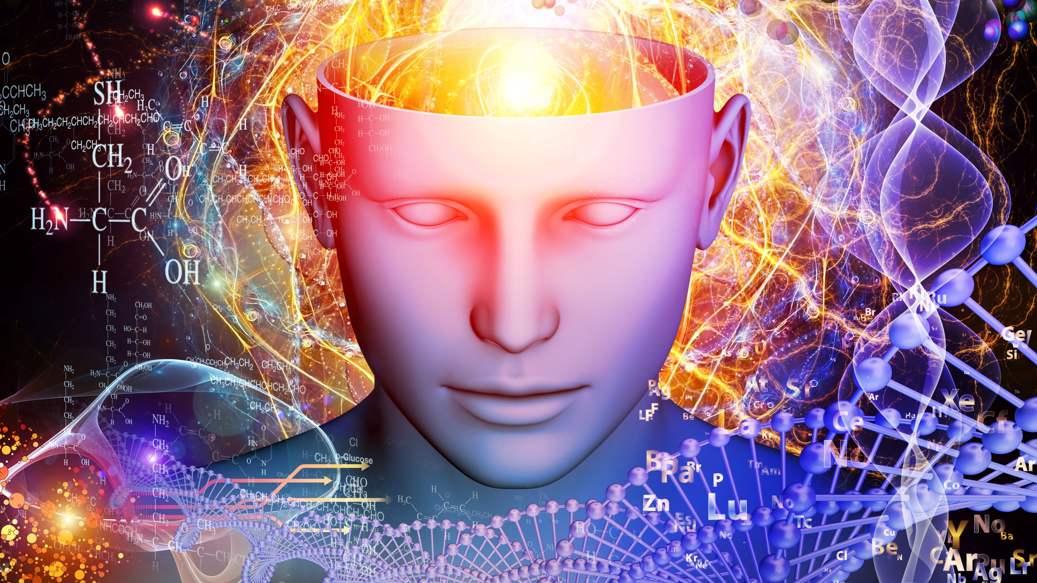
The 2 Functions of DNA
Autocatalytic Function
It Directs its Own Synthesis
Heterocatalytic Function
It Directs the Synthesis of RNA and Proteins

Slide 15
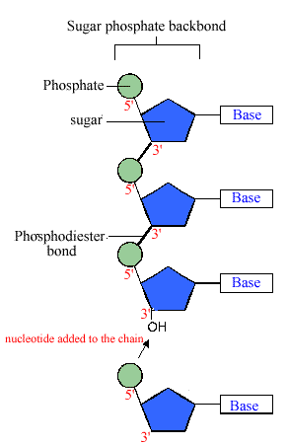
Structure of DNA
NUCLEIC ACID
DNA is Composed of a String of Nucleic Acids
An individual nucleic acid is composed of the following:
A Phosphate Group
A Ribose Sugar
A Nitrogenous Base

Slide 16
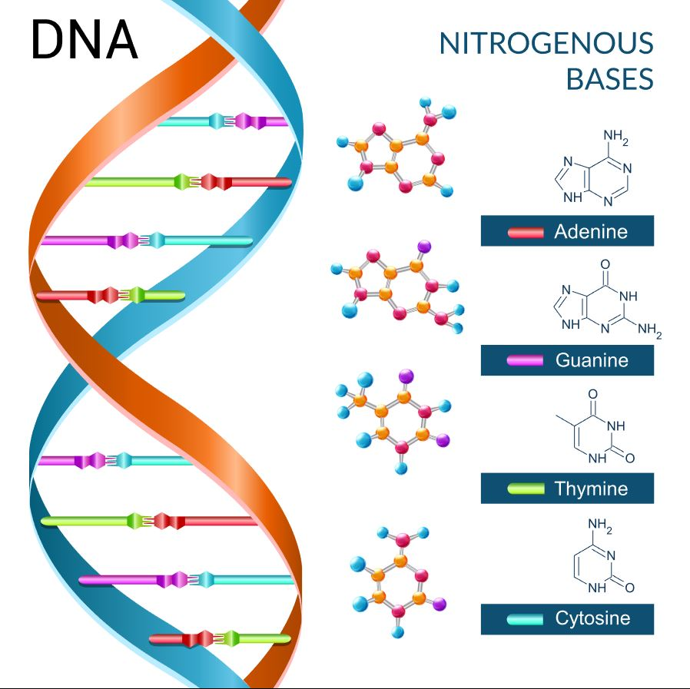
​There are only 4 nitrogenous bases found in DNA
Adenine (A)
Guanine (G)
Cytosine (C)
Thymine (T)

Slide 17
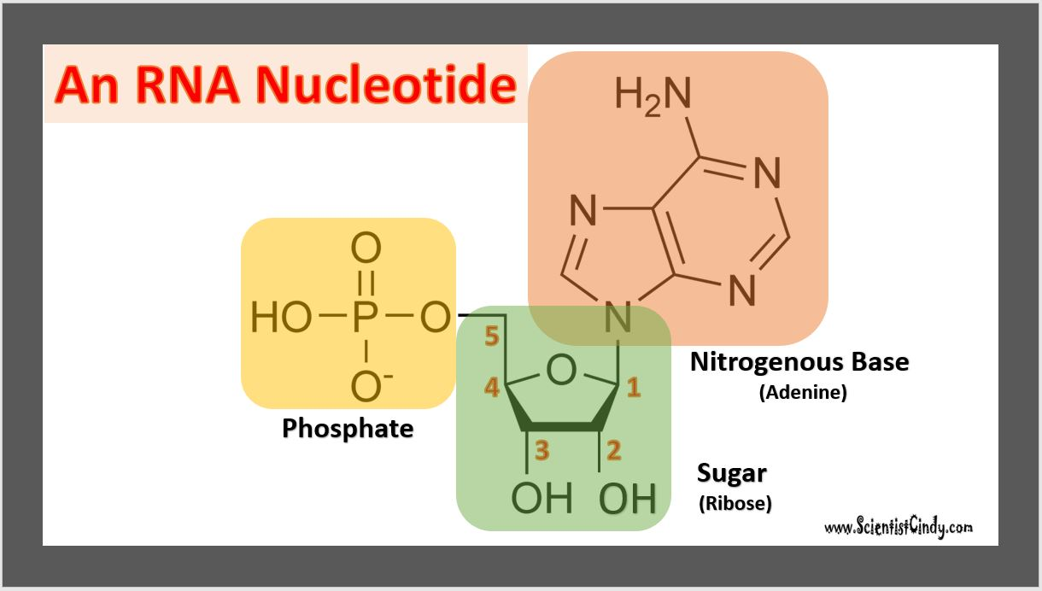
DNA Nucleotide vs RNA Nucleotide
Nucleic acids are the building blocks for both DNA and RNA in living organisms.
RNA and DNA Nucleotides Both Contain a Phosphate Group

Slide 18
DNA Nucleotide vs RNA Nucleotide
Nucleic acids are the building blocks for both DNA and RNA in living organisms.
RNA and DNA Nucleotides Both Contain A Sugar Molecule
DNA Nucleotide have a Deoxy-Ribose Sugar Molecule
RNA Nucleotide have a Ribose Sugar Molecule
This is why DNA stands for Deoxyribonucleic Acid
And RNA stands for Ribonucleic Acid

Slide 19
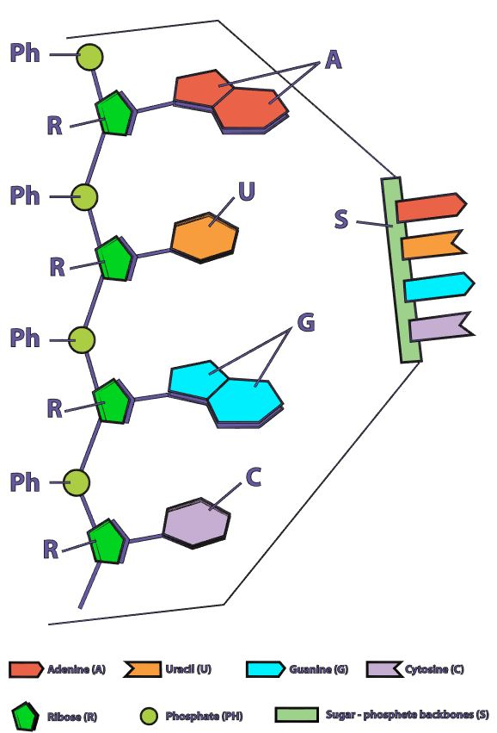
DNA Nucleotide vs RNA Nucleotide
Nucleic acids are the building blocks for both
DNA and RNA in living organisms.
The 4 Nitrogenous Bases in DNA are
Adenine (A)
Cytosine (C)
Guanine (G)
Thymine (T) in DNA ONLY
The 4 Nitrogenous Bases in RNA are
Adenine (A)
Cytosine (C)
Guanine (G)
Uracil (U) in RNA ONLY

Slide 20
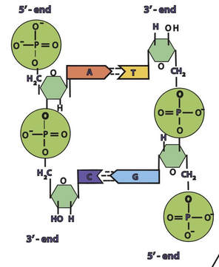
The Sugar-Phosphate Backbone of DNA
Phosphate
Sugar
Sugar
Phosphate
In a molecule of DNA or RNA, individual nucleotides are linked together to make a sugar-phosphate backbone.
Phosphate
Sugar
Sugar
Phosphate

Slide 21
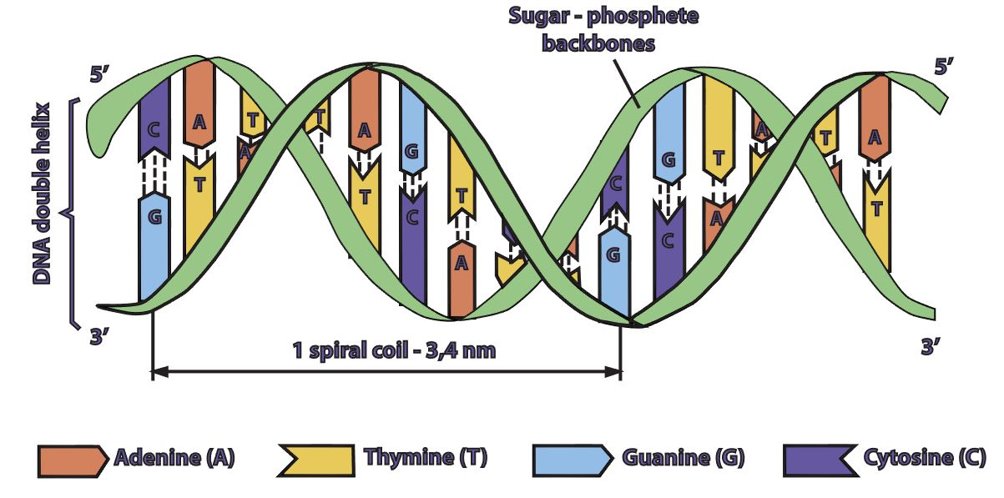
Base Pairing in DNA
DNA is double stranded.
Each strand of DNA is connected to the other DNA strand though hydrogen bonding.
This hydrogen bonding occurs between the nitrogenous bases on opposing DNA strands.
​A can only pair with T
Creates 2 hydrogen bonds
C can only pair with G
Creates 3 hydrogen bonds

Slide 22
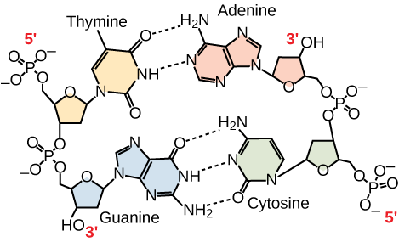
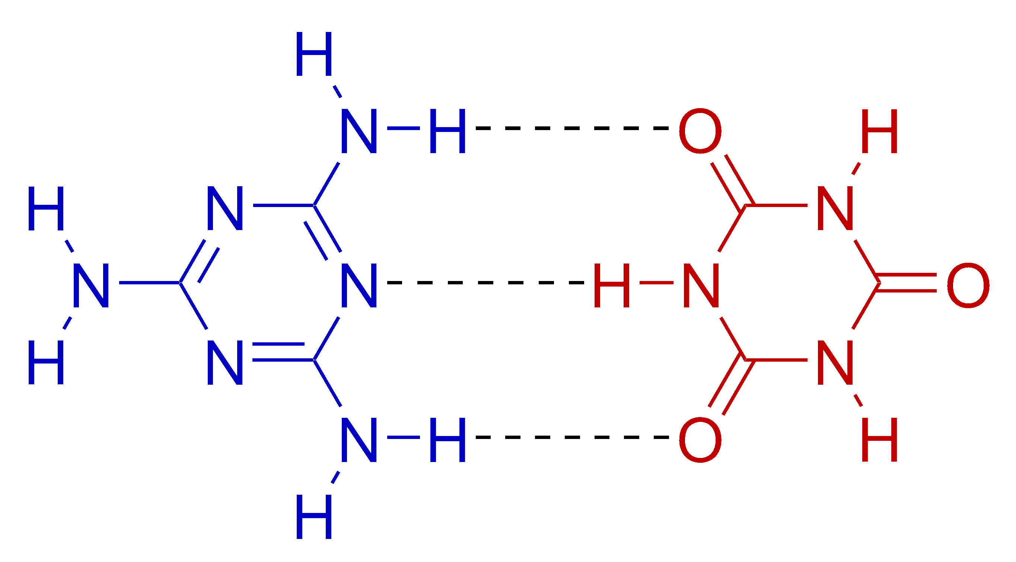
Hydrogen Bonding in DNA
Hydrogen bonds are relatively weak.
It is important for the hydrogen bonds to be able to be broken when the cell needs access to the individual DNA strands.
For example, the two DNA strands need to be separated for DNA replication during reproduction and to make the mRNA template during transcription.

Slide 23
Central Dogma Of Molecular Biology
The central dogma of molecular biology explains how the information encoded in DNA sequences (genes) is expressed as proteins in a two-step process:
Step One) Transcription
Transcription involves making mRNA using DNA as a template.
Step Two) Translation.
Translation then translates the mRNA sequence into an amino acid sequence to form a protein.

Slide 24
DNA Strands are Antiparallel
The DNA strands are oriented antiparallel to one another. The ends of the DNA molecule are different. One end of the DNA molecule is designated 3' (stated as 3 prime) and the other as 5' (stated as 5 prime). They are names according to the carbons in the ribose sugar molecule of the DNA backbone. In a molecule of DNA, one strand will be oriented from 3' to 5', and the other from 5' to 3'.

Slide 25
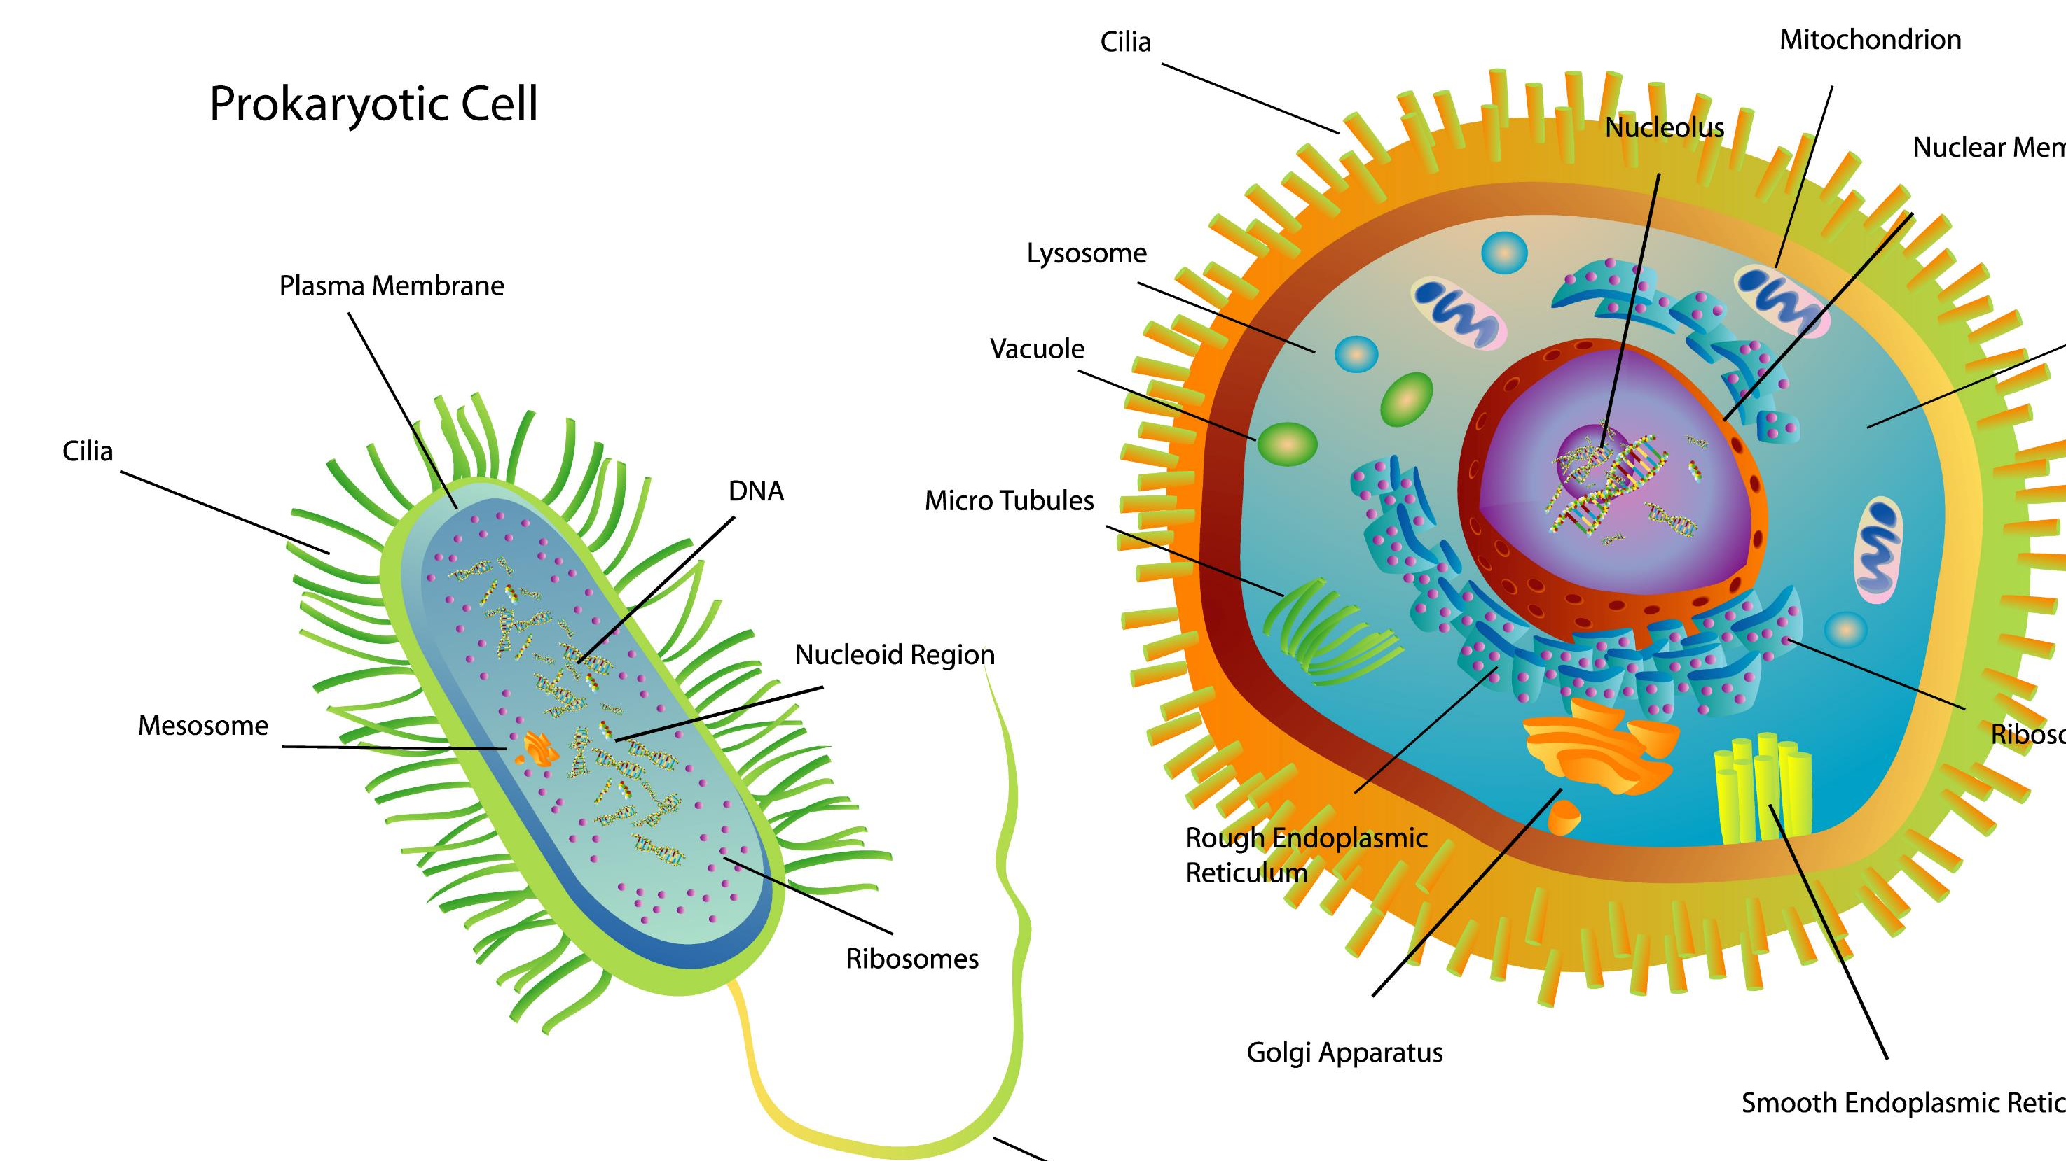
DNA in Eukaryotes
In eukaryotic cells, the genetic material (DNA) is in the nucleus of the cell.
DNA holds the instructions for all of the proteins the cell may required.
These instruction are encoded as the sequence of base pairs on the individual nucleic acids that make up the cell. ​

Slide 26
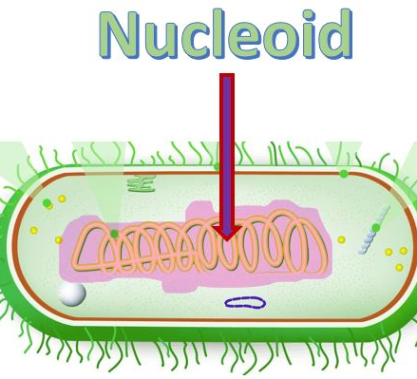
DNA in Prokaryotes
Bacteria cells are prokaryotic
They are much smaller than the eukaryotic cell.
They do not have any membrane-bound organelles.
They do not have a nucleus.
The DNA in prokaryotic cells is found in a region called the nucleoid.

Slide 27
DNA Replication
In order for reproduction to occur, the DNA must be replicated. This process is simply called DNA Replication.

Slide 28
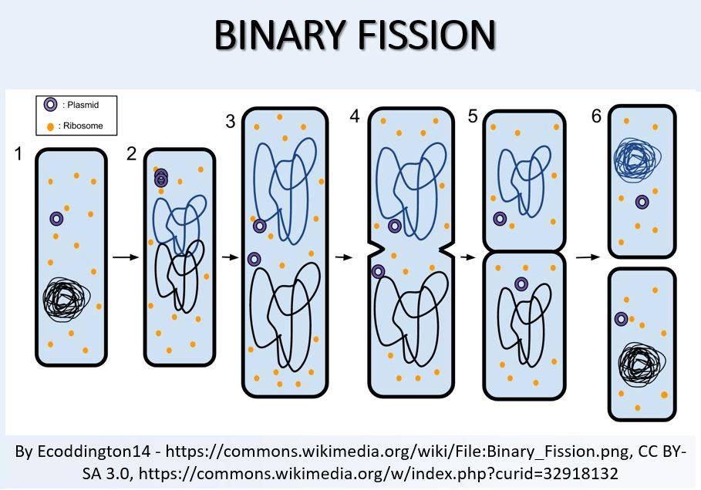
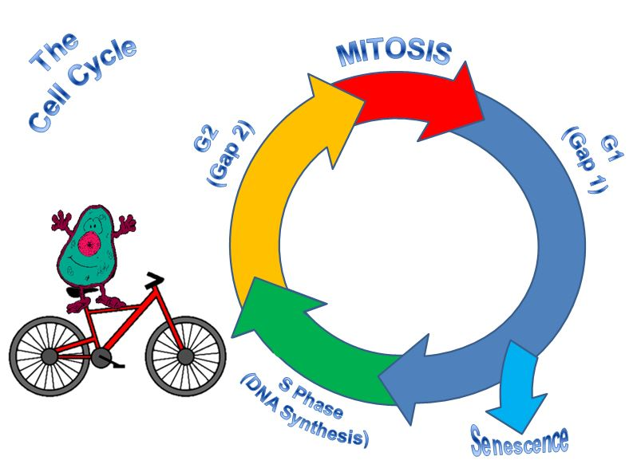
DNA Replication

Slide 29
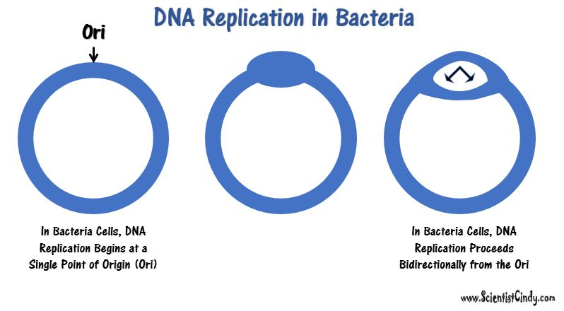

Slide 30
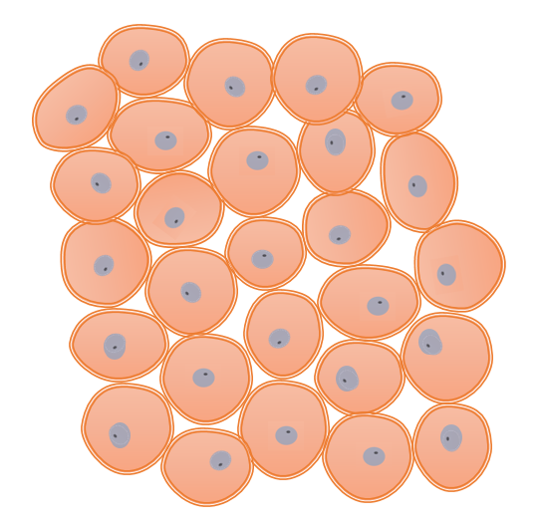
Bacteria VS Animal Cells
The bacterial genome consists of a small single circular chromosome.
DNA is Replicated Quickly rate of ~ 1000 nucleotides per second.
Bacteria are HAPLOID.
Asexual Reproduction via Binary Fission – no genetic recombination.
Large linear chromosomes
Multiple chromosomes
Replication of DNA is slower
Reproduction is sexual – genetic recombination occurs
Animal Cells are DIPLOID.
One full set of chromosomes from each parent. (2 sets total).

Slide 31
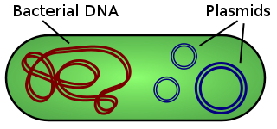
PLASMIDS
What is a PLASMID?
Interestingly, these plasmids do not carry any of the genes essential for normal life processes.
Plasmid do alter the sensitivities or abilities of the bacteria that possess them.
These non-essential genes are classified as accessory genes.
For example, some plasmids carry genes that allow for
antibiotic resistance
habitat tolerance
bacterial conjugation which allows the exchange of genetic material between bacterial cells
Some species of bacteria have additional small extra-chromosomal circular DNA loops in their cytoplasm, called plasmids.

Slide 32
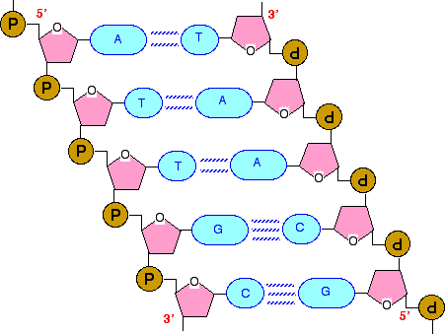
DNA Polymerase III (DNA Pol III)
DNA Pol III is the enzyme required for DNA synthesis (a.k.a. DNA Replication) in bacteria.
DNA pol III adds the individual nucleotides according to their complementary base.
Adenine (A) is the complementary base of Thymine (T)
Cytosine (C) is the complementary base of Guanine (G)

Slide 33
Same Names… Different Processes!
CAUTION AHEAD
!
The Process of DNA Replication Proceeds in 3 Steps:
Initiation
Elongation
Termination
The Process of Transcription (DNA → mRNA) Proceeds in 3 Steps:
Initiation
Elongation
Termination
The Process of Translation (mRNA → protein) Proceeds in 3 Steps:
Initiation
Elongation
Termination

Slide 34
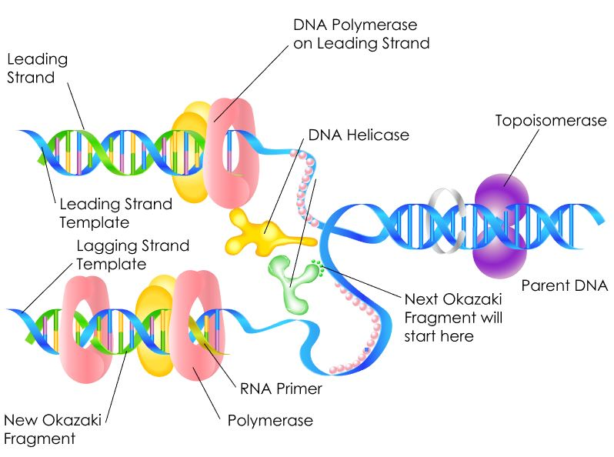
INITIATION STEP (in DNA Replication)
Initiation begins at a specific nucleotide sequence called the origin of replication (Ori).
Topoisomerase II (a.k.a. gyrase) uncoils the DNA.
Helicase then separates the DNA strands by breaking the hydrogen bonds between the nitrogenous base pairs.
Two replication forks are formed at the origin of replication creating a replication bubble.
The DNA near each replication fork is coated with single-stranded binding proteins to prevent the single-stranded DNA from rewinding into a double helix.

Slide 35
ELONGATION STEP (in DNA Replication)
DNA Polymerase III can only synthesize DNA in the 5’ to 3’ direction.
DNA is double stranded with one strand oriented in the 5’ to 3’ direction and the other stand oriented in the 3’ to 5’ direction.
The consequence of this antiparallel configuration, coupled with the factor that DNA Pol III can only synthesize DNA in the 5' to 3' direction, is that one of the DNA strands will be replicated continuously, but the other will not!

Slide 36
ELONGATION (of DNA Replication)
Leading Strand - The parent strand of DNA which runs in the 3' to 5' direction toward the replication fork. It has the ability to be replicated continuously by DNA polymerase. Lagging Strand - This is the parent strand of DNA which runs in the 5' to 3' direction toward the fork, and it's replicated discontinuously. ​

Slide 37
Steps of Elongation (in DNA Replication)
DNA Helicase opens up the replication fork
On the Leading Strand, DNA Polymerase III follows helicase and adds on nucleotides according to complementary bases in the 3' to 5' direction. This is considered continuous replication.
On the Lagging Strand, DNA Polymerase III will replicate short portions of DNA at a time, called Okazaki Fragments. This is considered discontinuous replication.
DNA Ligase is the enzyme that functions to connect the Okazaki Fragments together for the copy of the lagging strand. The word "ligate" in Latin means "to tie together."
This Photo by Unknown Author is licensed under CC BY-SA

Slide 38
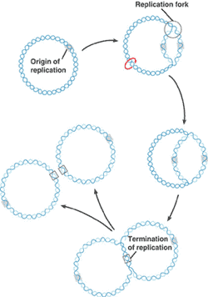
Termination of DNA Replication
Since the bacterial genome consists of a single circular chromosome, at the end of the elongation step of DNA replication, you end up with 2 interlocking circles of DNA that must be separated.

Slide 39
Termination of DNA Replication
Steps of TERMINATION
Bacterial Topoisomerase IV induces a double-strand break into each of the DNA molecules, allowing them to separate from each other (becoming un-concatenated).
Bacterial Topoisomerase IV then reseals each DNA molecule back together again creating 2 separate, un-linked chromosomes.
FREEDOM AT LAST!

Slide 40
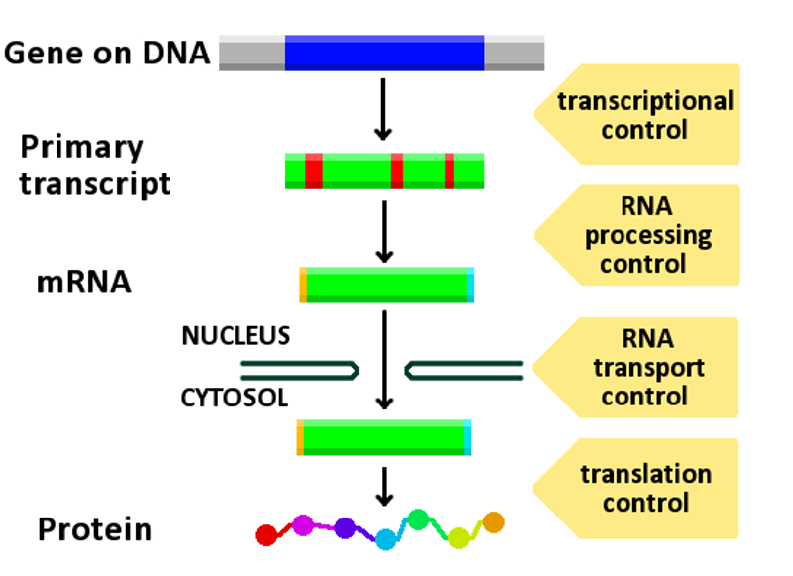
Gene Expression
Genes are segments of nucleic acid sequences that will code for proteins that exhibit a specific genetic trait.
The process by which the genetic sequence gets expressed into protein is a two-step process.
The first step is transcription. In short, transcription involves using the DNA molecules as a template to form messenger RNA (mRNA).
The second and final step of this process is called translation. Translation is the process by which the mRNA sequence will be translated into an amino acid sequence which makes up a protein.

Slide 41
Transcription in Bacteria is a 3-Step Process
INITIATION
Elongation
Termination

Slide 42
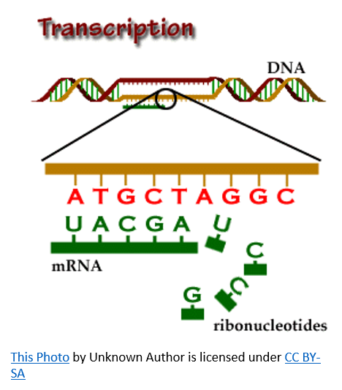
RNA Transcription
RNA transcription in bacteria is done in the cytoplasm, not in the nucleus like in eukaryotic cells.
Transcription in bacteria is done using an enzyme called RNA polymerase.
RNA Polymerase adds nucleotides according to their complementary bases using a free 3’-OH group of the growing nucleotide chain. ​

Slide 43
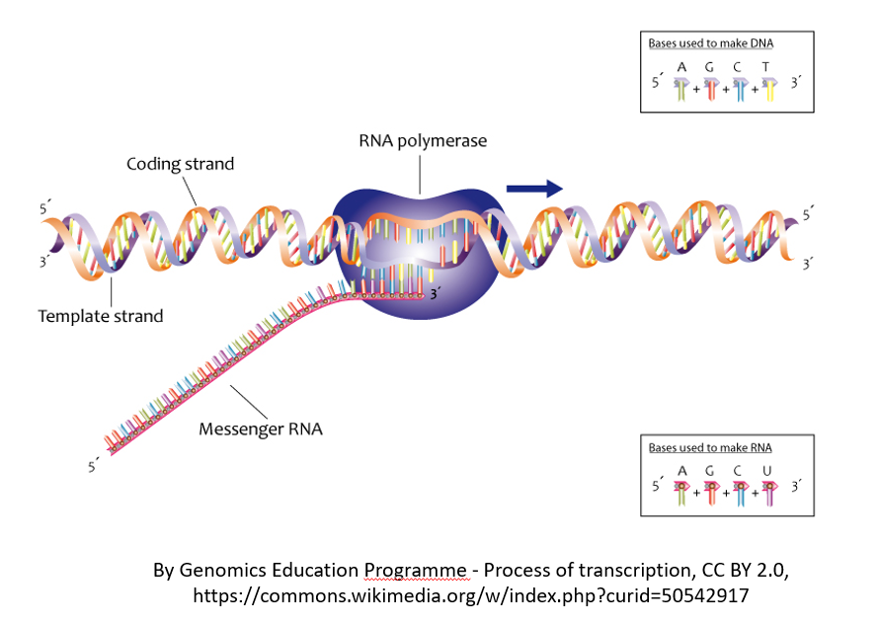
INITIATION (of RNA Transcription)
RNA transcription requires a promoter.
A promoter is a DNA sequence that transcription factors bind to.
Promoters are located “upstream” from the sequences that code for proteins.
The nucleotides that code for proteins would be considered to be located “downstream” from the initiation site (which is where transcription begins).

Slide 44
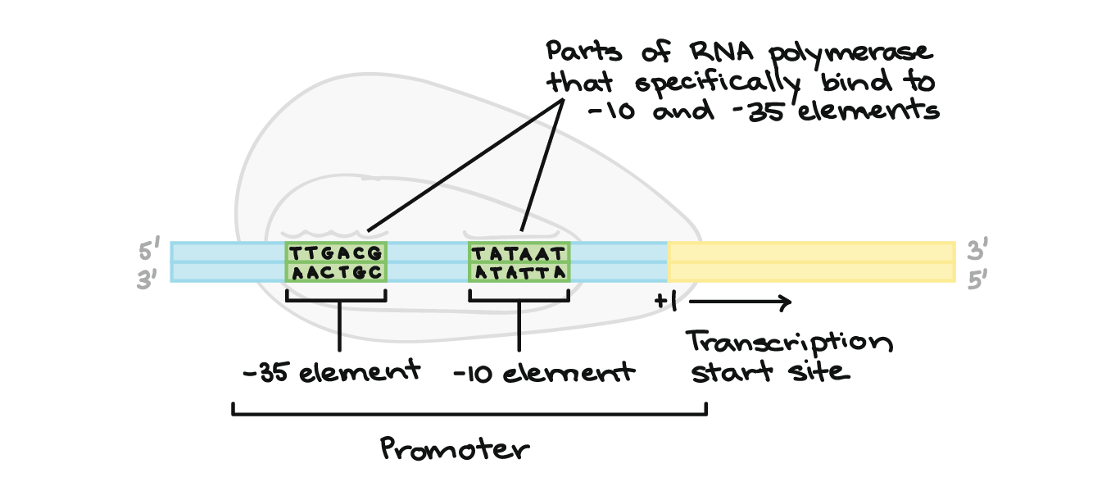
Promoters in Bacteria
Promoters are usually located between –10 and –35 bases upstream from the initiation site (designated +1).
All species of bacteria have two nucleotide sequences that have been conserved, known as "consensus sequences".
The 2 consensus sequences are as follows:
The –10 consensus sequence, called the TATA box, is TATAAT.
The –35 sequence is recognized and bound by Sigma.
https://www.khanacademy.org/science/biology/gene-expression-central-dogma/transcription-of-dna-into-rna/a/stages-of-transcription

Slide 45
ELONGATION (of RNA Transcription)
Once all of the relevant transcription factors have bound to the promoter, the elongation in transcription phase begins. In this part of RNA transcription, the sigma subunit of the RNA polymerase falls off which allows RNA transcription to begin.
The RNA nucleotides are added in a complementary fashion to the DNA template in a 5’ to 3’ direction at a rate of approximately 40 nucleotides per second.
RNA does not have thymine (T), so when the DNA template contains a nucleotide with an adenine (A) base, it will add a nucleotide with Uracil (U) instead.

Slide 46
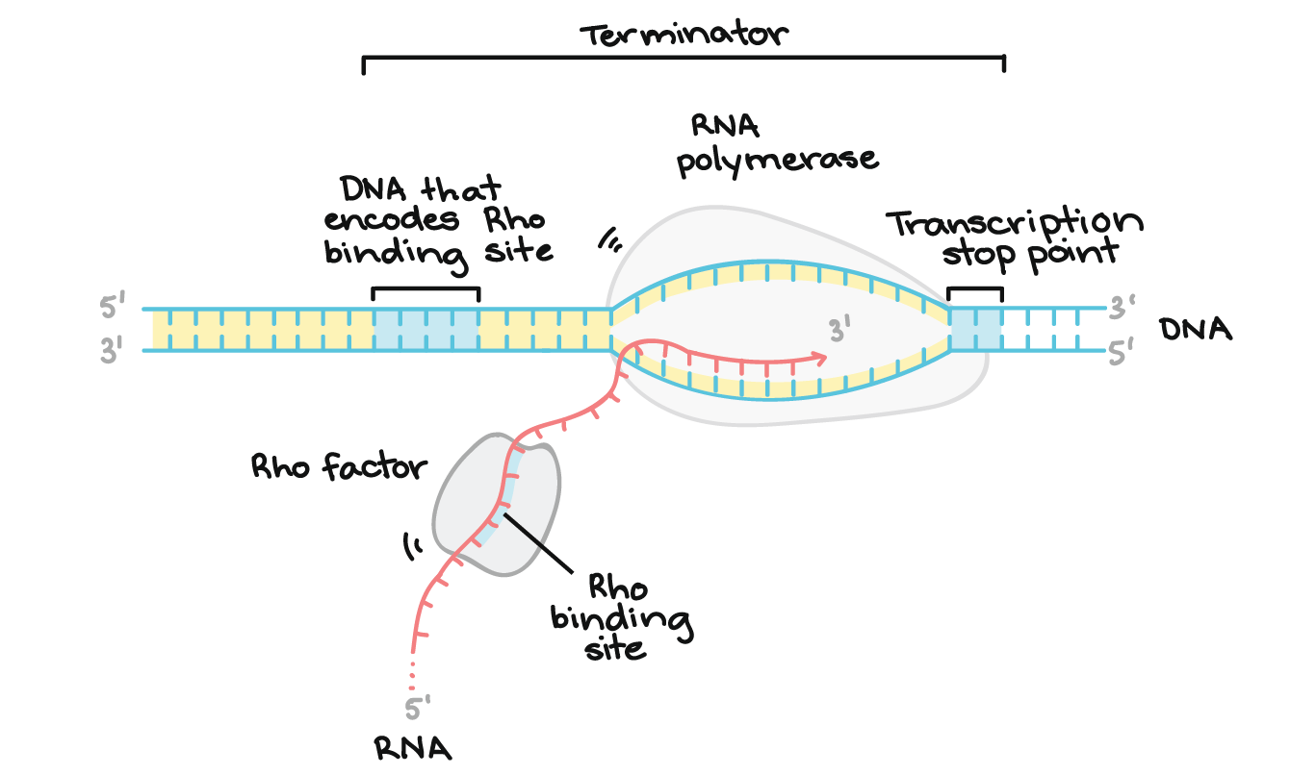
Transcription of RNA is terminated when the bacterial RNA polymerase dissociates from the DNA template and releases the newly made RNA.
This is accomplished through a terminating sequence (a repeated nucleotide sequence) that signals the RNA polymerase to terminate the process.
TERMINATION (of RNA Transcription)

Slide 47
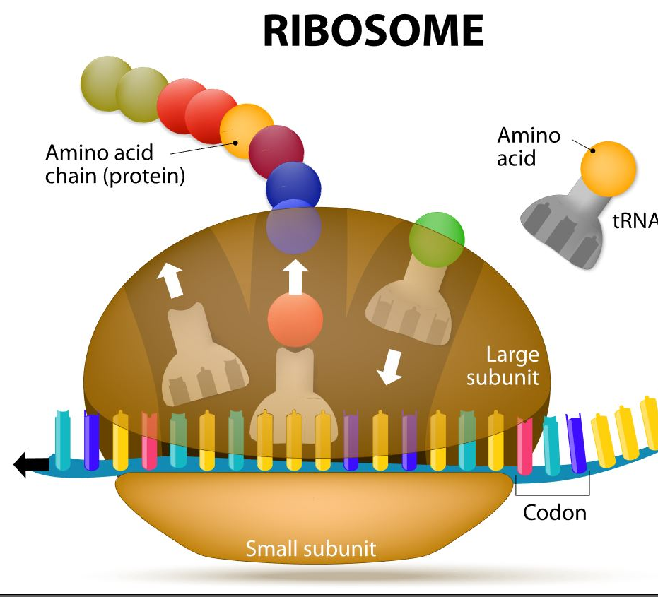
INITIATION (of Translation)
In bacteria, translation of mRNA into an amino acid sequence begins with the formation of an initiation complex.
The initiation complex is formed when the mRNA, the tRNA, and the first amino acid all come together within the ribosome.

Slide 48
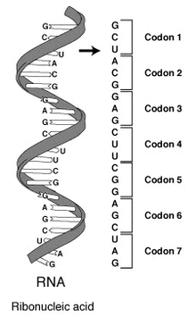
ELONGATION (of Translation)
The nucleotide sequence of mRNA is read in triplets called codons.
All translation begins with what is called "the start codon" which is AUG.
This means that the first 3 bases on the mRNA are Adenine (A), Uracil (U) and Guanine (G) = AUG.
The AUG codon codes for the amino acid methionine.

Slide 49
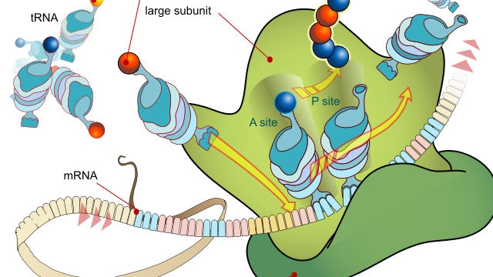
TERMINATION (of Translation)
Termination of protein synthesis occurs at the stop codon. There are three different codons which are considered stop codons (UAA, UAG and UGA).
When one of these stop codons reaches the ribosome, the last amino acid will break free from the ribosome and from the tRNA. The protein is now complete.

Slide 50
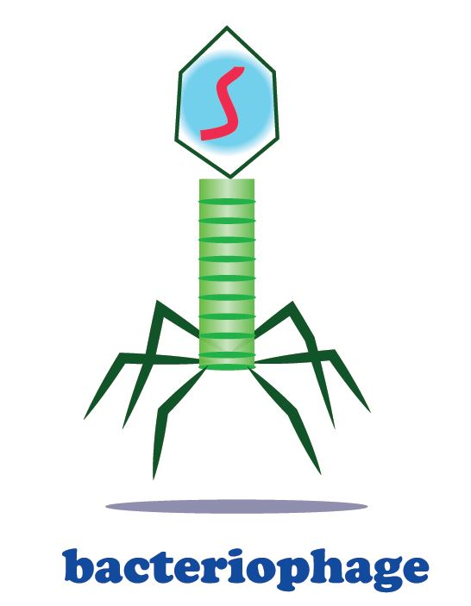
Genetics of Viruses
Bacteriophages are viruses that infect bacteria cells.
Viruses are not made of cells.
They can have DNA or RNA.
Not Considered Alive.
Cannot Reproduce without a Host.

Slide 51
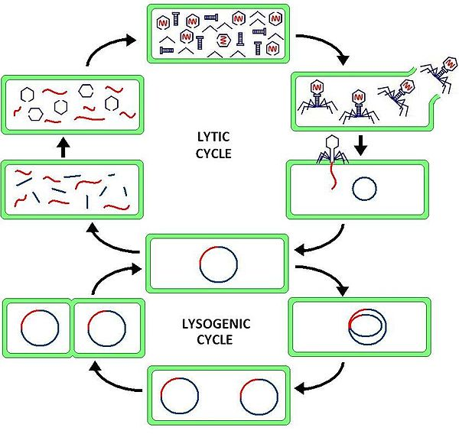
Genetics of Viruses
There are two types of reproductive cycles that a bacteriophage can enter;
1) the lytic cycle and
2) the lysogenic cycle.. The lytic cycle results in lysis of the host cell, which ends in death. In the lysogenic cycle, the viral genome enters the nucleus and inserts itself into the host genome, keeping the host cell alive.

Slide 52
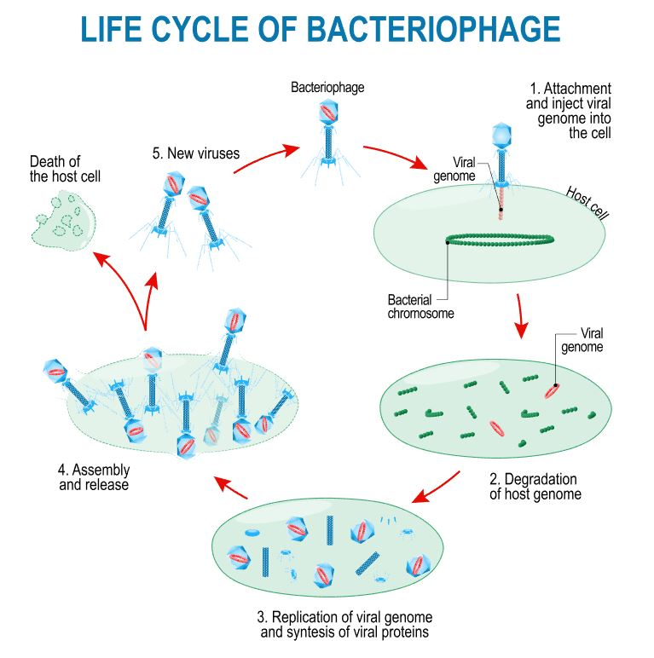
The Lytic Cycle
The lytic cycle results in lysis (bursting open) of the host cell, which ends in death.
The virus attaches to the host and inserts its genetic material (RNA or DNA).
The viral genome hijack’s the host cell’s machinery to produce itself (proteins and genome).
Viral copies are self-assembled and leave the host resulting in lysis of the host cell.

Slide 53
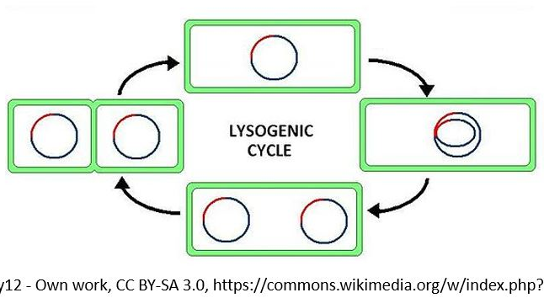
The Lysogenic Cycle
In the lysogenic cycle, the viral genome enters the nucleus of the bacterial host and inserts itself into the host genome.
The host cell will be kept alive for some time.
The genome of the virus will get inserted into the genome of the host cell.
Each time the infected bacteria cell reproduces itself, it will also reproduce the viral DNA as well.
After some time has past, the prophage will exit the host cell's genome and the virus will begin to undergo the deadly lytic cycle.

Slide 54
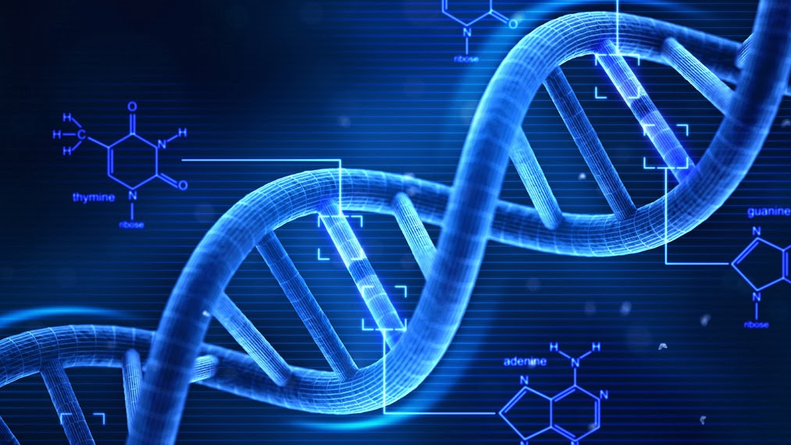
GENETIC RECOMBINATION IN BACTERIA
THE THREE METHODS BY WHICH BACTERIA CAN UNDERGO GENETIC RECOMBINATION ARE AS FOLLOWS:
TRANSFORMATION
TRANSDUCTION
CONJUGATION
This Photo by Unknown Author is licensed under CC BY-NC-ND

Slide 55
Transformation: A Method of Genetic Recombination in Bacteria
Transformation is when a bacteria takes in plasmids from their environment.
In order to take in a plasmid from the environment, microbiologists must "induce competency".
There are several methods used in laboratories to induce competency.
One of the most popular and easiest ways to induce competency in bacteria, is the "heat shock" method.

Slide 56
Transformation: A Method of Genetic Recombination in Bacteria
Heat shocking involves exposing the bacteria to a moderately high temperature for a brief amount of time.
Immediately following the heat exposure, the culture is then put on ice.
This extreme temperature change causes specialized surface proteins on the cell membrane to allow the plasmids to pass through.
The bacteria are able to internalize the plasmids and they can express the genes on those plasmids in the form of proteins. ​

Slide 57
Transduction: A Method of Genetic Recombination in Bacteria
Phages can "accidentally" transfer genetic material from one bacterium to another.
There are two forms of transduction.
Generalized Transduction
the phage uses the lytic cycle
Specialized Transduction
The phage uses the lysogenic cycle

Slide 58
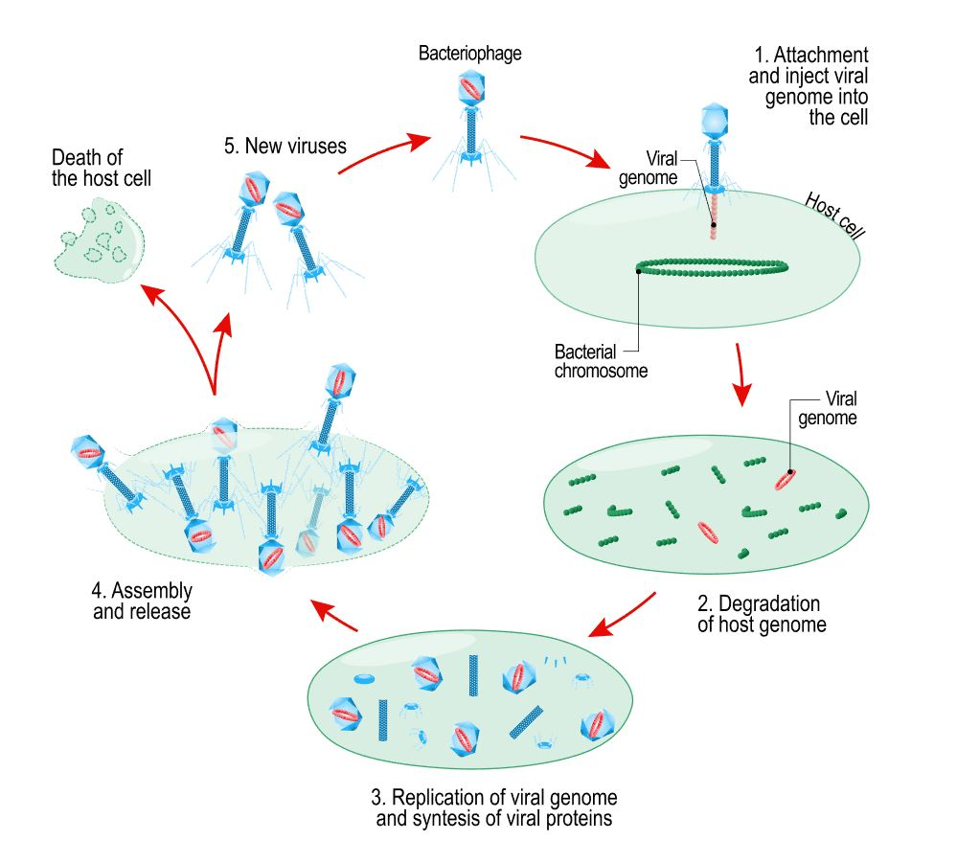
Transduction: A Method of Genetic Recombination in Bacteria
Steps of Generalized Transduction
The phage is going to land on a bacteria cell (or bacterium).
The phage inserts its genetic information.
The bacteria's machinery is used to form new phages.

Slide 59
Transduction: A Method of Genetic Recombination in Bacteria
Steps of Generalized Transduction
The new phages leave the host cell.
Occasionally, some phages may have some of the bacteria's DNA inside of it when the exit the host cell.
These phages will bring the bacterial DNA with it when it infects the next host cell.
This time, when the phage goes to inject its DNA into the host cell, the bacterial DNA will be transferred to the host cell instead!

Slide 60
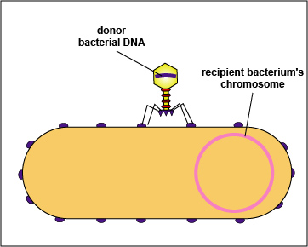
Transduction: A Method of Genetic Recombination in Bacteria
Steps of Specialized Transduction The process is the same as generalized except that the phage is going to utilize the lysogenic cycle.
The prophage is going to leave the bacteria cell.
The prophage will contain a small piece of bacterial DNA
This bacterial DNA will get transferred to any new host cell the virus infects next.

Slide 61
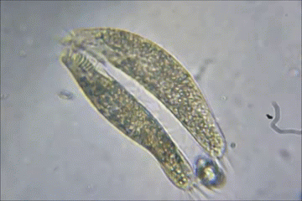
Bacterial Conjugation: A Method of Genetic Recombination in Bacteria
In bacterial conjugation, bacterial cells are able to exchange their genetic material!
This is NOT done as a part of their reproductive process.

Slide 62
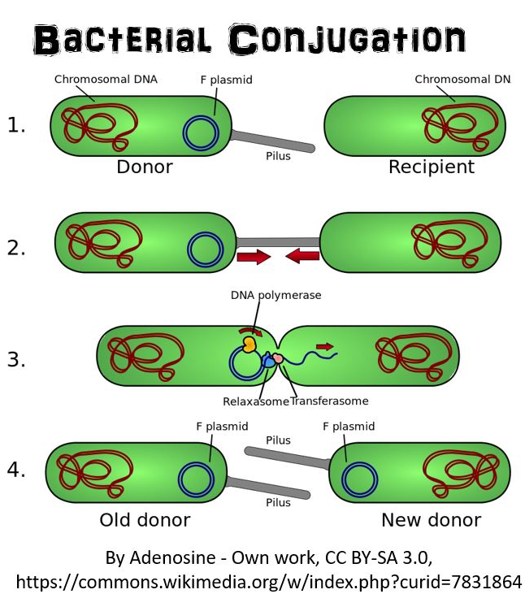
Bacterial Conjugation: A Method of Genetic Recombination in Bacteria
Conjugation is made possible by the "F plasmid".
The F plasmid is the "fertility plasmid".
The F plasmid contains genes that allow bacteria to form a sex pilus (pili is plural) which is a protrusion that can penetrate the cell wall and membrane of another bacterium.
The sex pilus allows the bacteria to form a cytoplasmic bridge with another bacteria.
Once that cytoplasmic bridge forms, the F plasmid is then replicated and the copy of the plasmid will be transferred to the other bacterium.
When the bacteria receives its copy of the F plasmid, it then has the ability to now create its own sex pili and can go give copies of its F plasmid to other bacteria. ​

