Slide 1
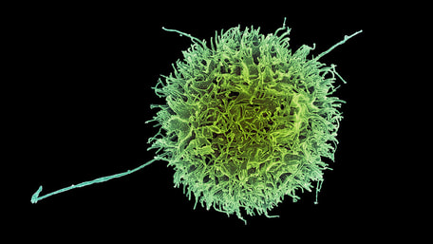
HOST DEFENSES
By Scientist Cindy

Slide 2
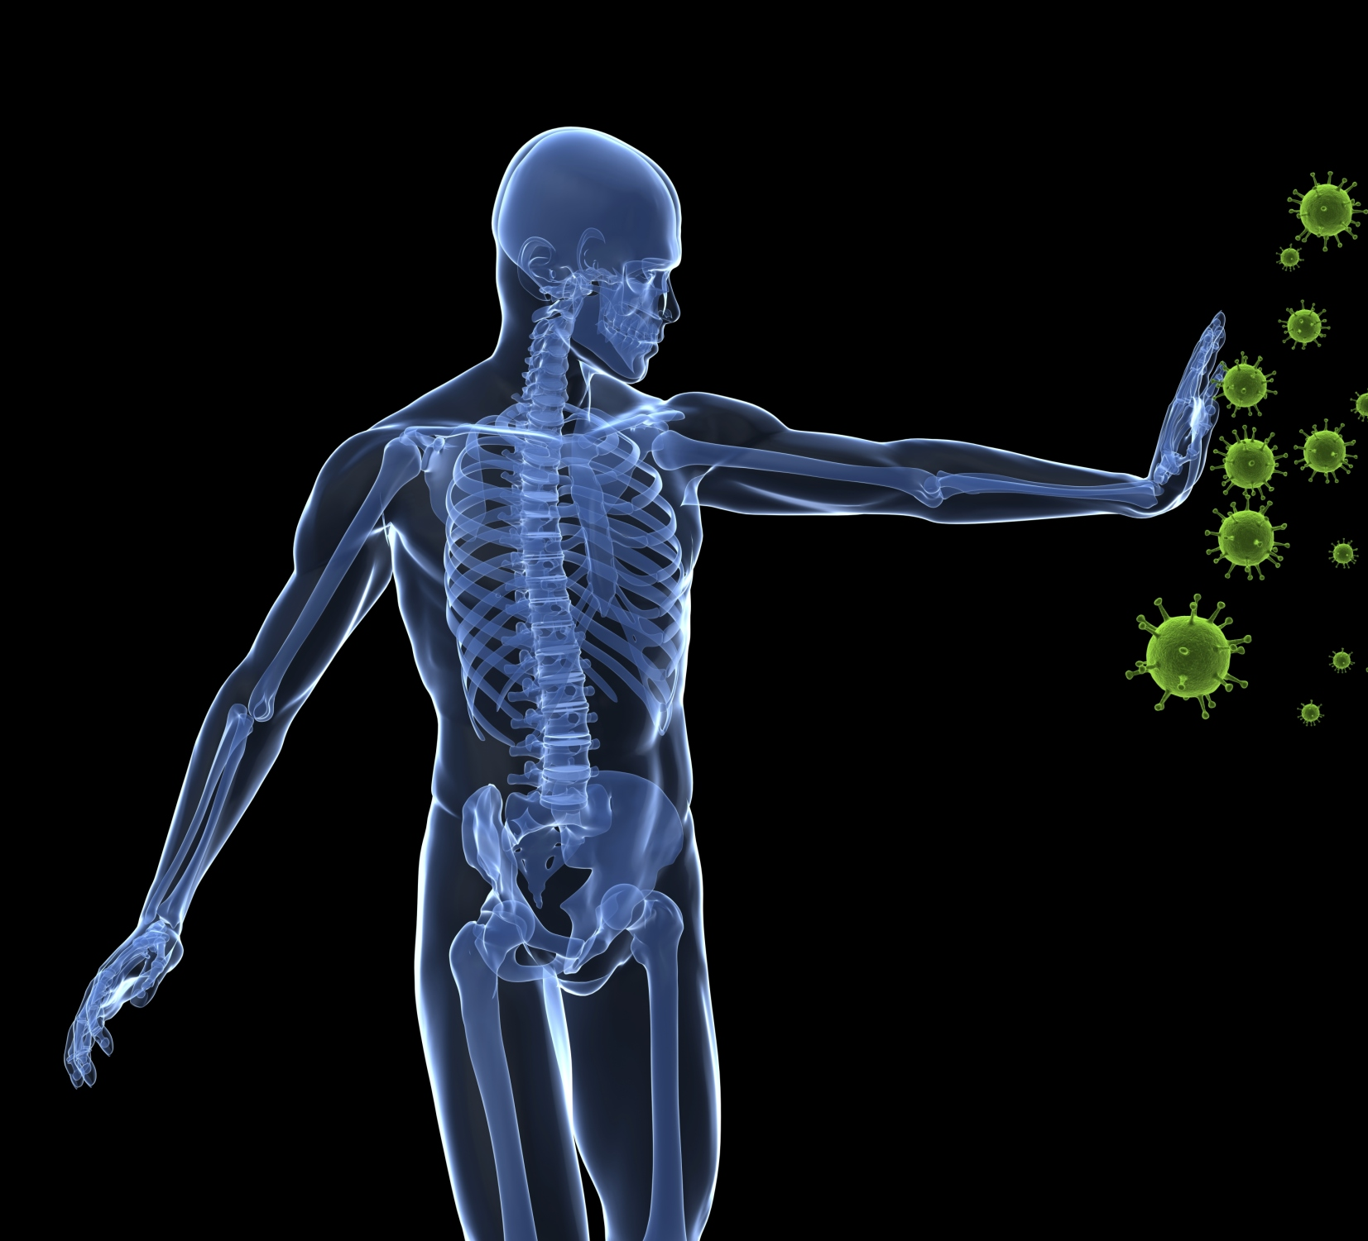
The Functions of the Immune System
Scavenge dead, dying body cells
Destroy abnormal (cancerous)
Protect from pathogens & foreign molecules: parasites, bacteria, viruses
This Photo by Unknown Author is licensed under CC BY-SA

Slide 3
The Immune System has 3 Lines of Defense Against Foreign Pathogens:
Physical and Chemical Barriers– The first line of defense
Nonspecific Resistance (Innate Immunity) - The second line of defense
Specific Resistance (Adaptive Immunity) - The third line of defense

Slide 4
THE FIRST LINE OF DEFENSE - Prevention
The Physical and Chemical Barriers are the First Lines of Defense.

Slide 5
THE FIRST LINE OF DEFENSE - Prevention
Physical Barriers of the Body
Skin
Mucous Membranes
Chemical Defenses
Sweat
Acidic Environments
Lysozyme

Slide 6
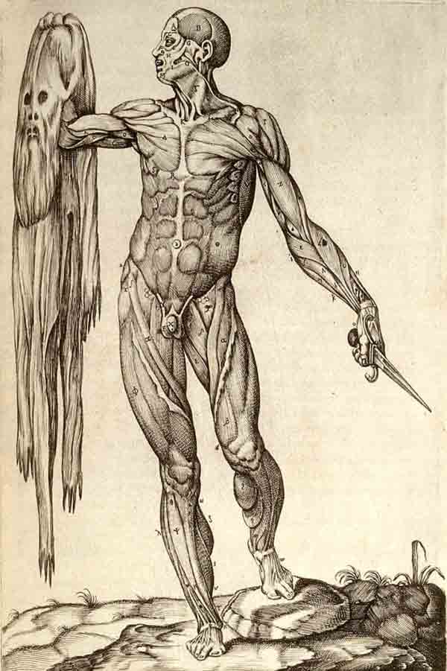
THE SKIN
Skin provides a physical barrier as a first line of defense against infection.
bacteria and viruses cannot penetrate the tightly knit cells of the skin.

Slide 7
Tight Junctions, Desmosomes and Gap Junctions Hold Epithelial Cells Tightly Together Creating a Preventative Barrier.

Slide 8
THE FIRST LINE OF DEFENSE - Prevention
2 Types of Defenses
Physical Barriers of the Body
Skin
Mucous Membranes
Chemical Defenses
Sweat
Acidic Environments
Lysozyme

Slide 9
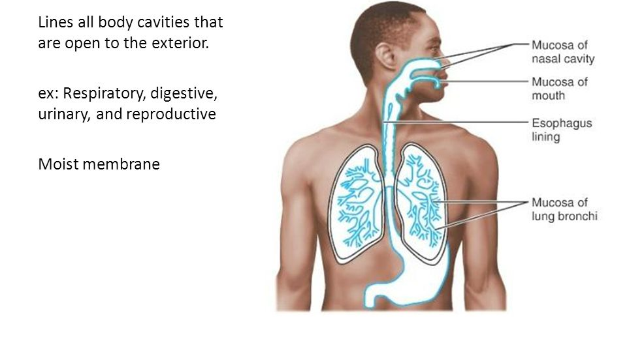
Mucous membranes:
Linings of the Respiratory System
Linings of the Digestive System
Urogenital Tracts
Especially the mouth, nose, eyelids, trachea, lungs, stomach, intestines, ureters, urethra, and urinary bladder.

Slide 10
Mucous membranes are made up of goblet cells and ciliated epithelial cells.
THE GOBLET CELLS SECRETE MUCUS.
MUCUS FUNCTION TO…
Cover And Protect Cells
Combat Pathogens With Antimicrobial Peptides
Trap Pathogens

Slide 11
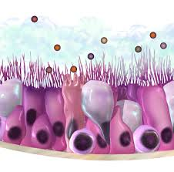
Mucous membranes are lined with ciliated epithelial cells.
Cilia function to sweep away pathogens caught in the mucus.
The mucus is then expelled from the body through coughing up or swallowing the pathogen and the mucus it is trapped in.
http://www.epithelium3d.com/images/cilia-movement-2%20(2).gif?crc=125337232

Slide 12
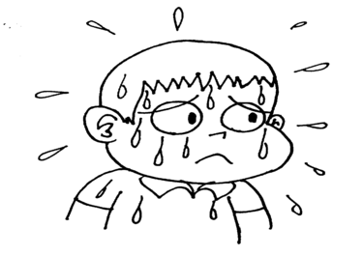
THE FIRST LINE OF DEFENSE - Prevention
2 Types of Defenses
Physical Barriers of the Body
Skin
Mucous Membranes
Chemical Defenses
Sweat
Acidic Environments
Lysozyme

Slide 13
The Great Assalt of 2012…
SWEAT
The skin has sweat glands that secrete sweat which has high concentrations of sodium.
During perspiration, high levels of sodium can kill certain types of bacteria.
SALT
MICROBE

Slide 14
THE FIRST LINE OF DEFENSE - Prevention
2 Types of Defenses
Physical Barriers of the Body
Skin
Mucous Membranes
Chemical Defenses
Sweat
Acidic Environments
Lysozyme

Slide 15
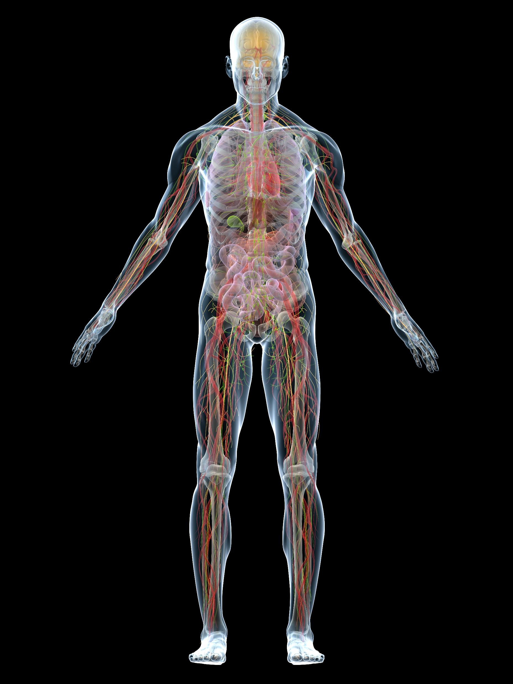
ACIDIC ENVIRONMENTS
The acidic environments of urinary tract, stomach and vagina discourages microbial growth.

Slide 16
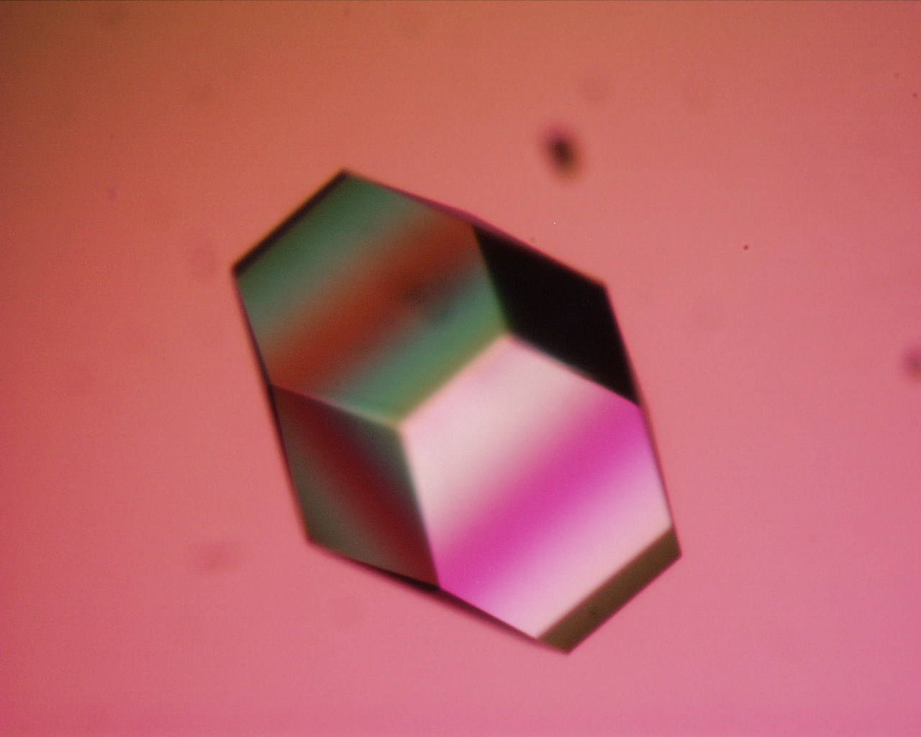
THE FIRST LINE OF DEFENSE - Prevention
2 Types of Defenses
Physical Barriers of the Body
Skin
Mucous Membranes
Chemical Defenses
Sweat
Acidic Environments
Lysozyme

Slide 17
Lysozyme
Saliva and tears contains an enzyme called lysozyme that functions to block the synthesis of the bacterial cell wall.
When the bacterial cell wall cannot be synthesized or repaired, the bacteria dies soon after.
This Photo by Unknown Author is licensed under CC BY-NC-ND

Slide 18
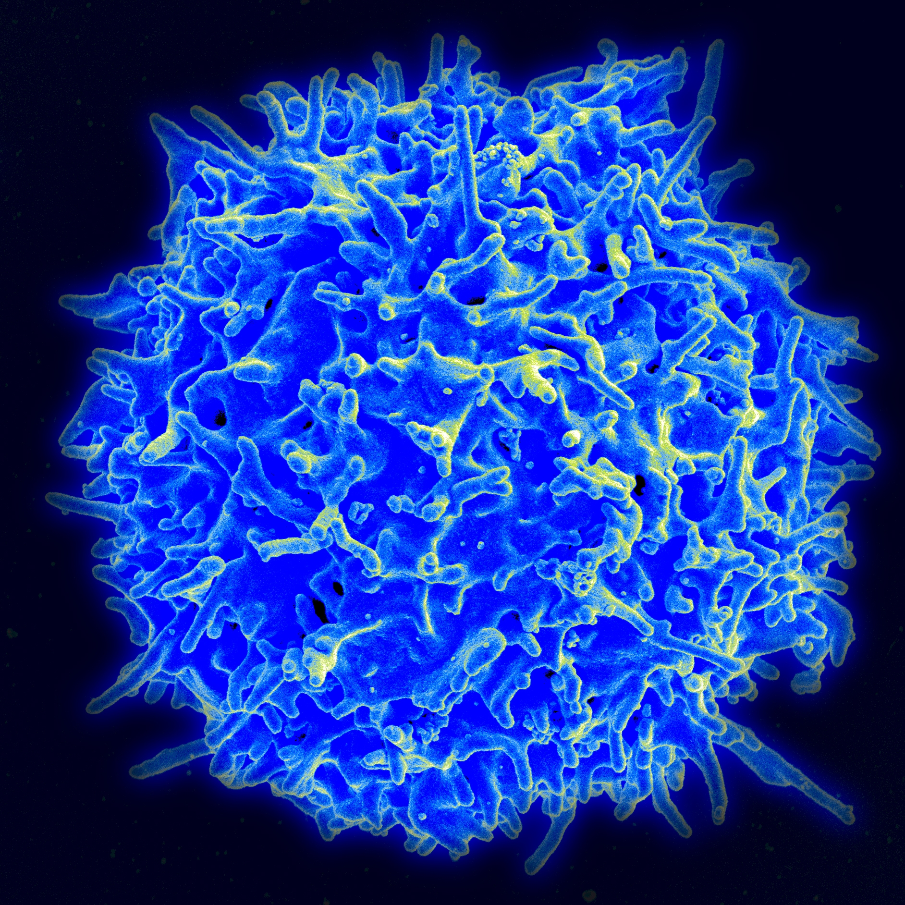
Nonspecific Resistance (Innate Immunity) - The Second Line of Defense

Slide 19
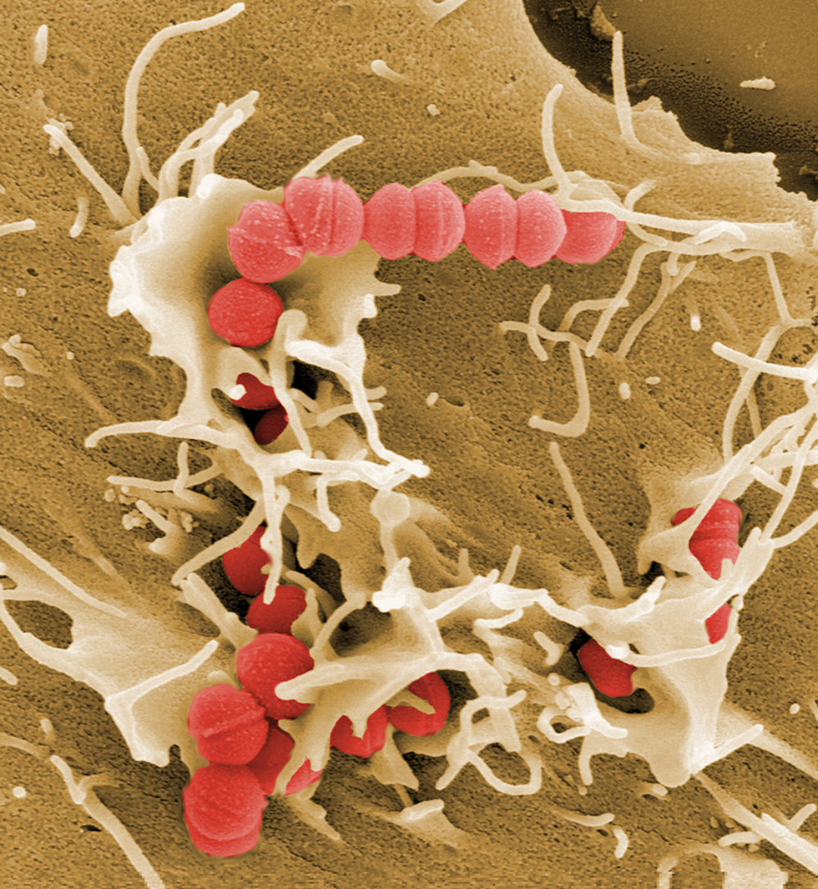
INVASION!
Sometimes the body’s physical and chemical barriers are not enough to keep pathogen out of the body.
When a pathogen or other suspicious substance is found inside our body, the second line of defense goes into action!
This Photo by Unknown Author is licensed under CC BY-ND

Slide 20
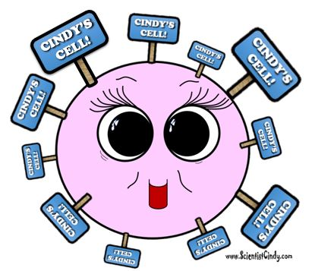
How Are Intruders Identified?
Step One: Identifying "Self" from "Non-self“
The cells of each person's body has a unique molecular marker that tells the cells of their immune system that it belongs there and should not be destroyed.

Slide 21
Major Histocompatibility Complexes (MHC)
CINDY’S CELL!
These molecular markers are called Major Histocompatibility Complexes (MHC or MHC-I)
Only identical twins have identical MHCs.

Slide 22
In fact, when a tissue or organ donor is being tested as a possible “match”,
it is the similarity of the MHCs that determines a compatible match!

Slide 23
Recognizing Invaders
The immune system is constantly screening the cells of the body and checking these MHC molecules for signs of danger.
Immune cells can use the MHCs to know if a cell is one of the following potential threats
A Foreign Invader
A Damaged Cell
An Infected Cells
A Mutated or Cancerous Cell
NOT CINDY’S CELL!
The
PO PO

Slide 24
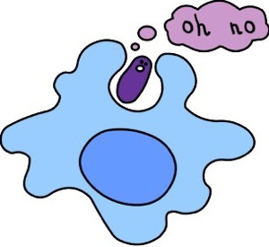
THE SECOND LINE OF DEFENSE
THE SECOND LINE OF DEFENSE
These defenses are the
internal cellular and
chemical defenses
of the body that kick into action if the pathogen enters the body.

Slide 27
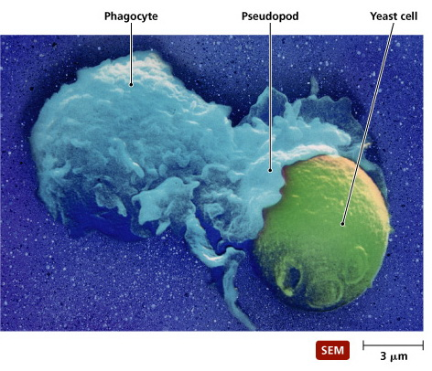
PHAGOCYTES
Defensive cells are white blood cells called phagocytes that "eat" unwanted invaders of the body, as well as dead or damaged cells.
The term phagocytes comes from the words for "phage" which means "to eat", and "cyte" which means "cell".
So phagocytes will "eat" unwanted entities.

Slide 28
PHAGOCYTOSIS
So phagocytes will "eat" unwanted entities found in the body by engulfing them and chemically breaking them down in a process called phagocytosis.
Phagocytes are nonspecific and will get rid of pathogenic organisms, as well as dead or damaged cells or unwanted debris found in the body.
In a sense, they are the body's janitorial service. ​

Slide 29
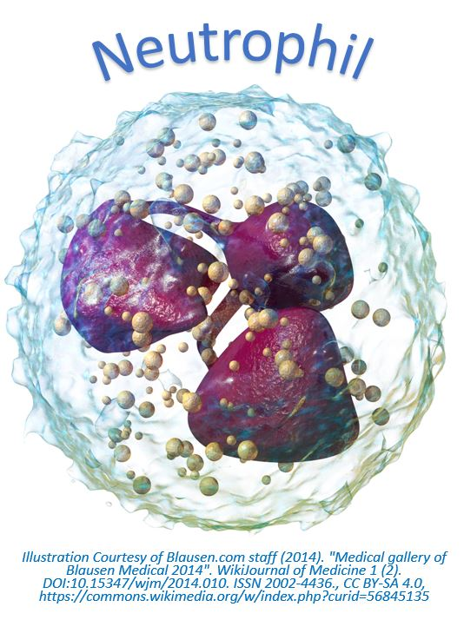
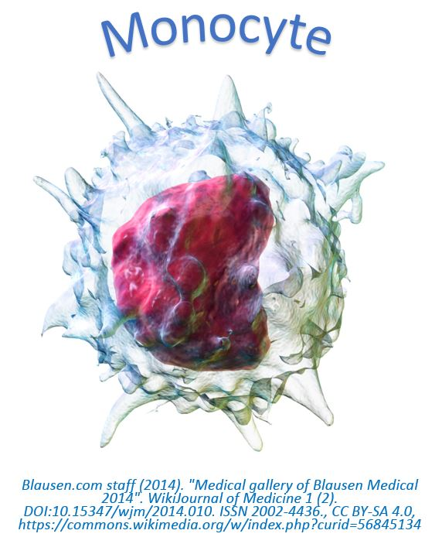
THE TWO TYPES OF PHAGOCYTES
The human body has two types of phagocytes;
Neutrophils
Monocytes (Macrophages).
Both of these are types of white blood cells, but they have unique morphology, physiology and different mechanisms of action.

Slide 30
Neutropenia
Neutropenia is a medical condition in which the patient has an abnormally low concentration of neutrophils.
Neutrophils are particularly important in fighting off bacterial infections. Patients with significant neutropenia of less than 500 neutrophils per microliter are at risk of getting sick from the normal flora of the mouth and digestive tract.

Slide 31
Neutropenia
Cancer treatments like chemotherapy are the most likely cause of neutropenia.

Slide 33
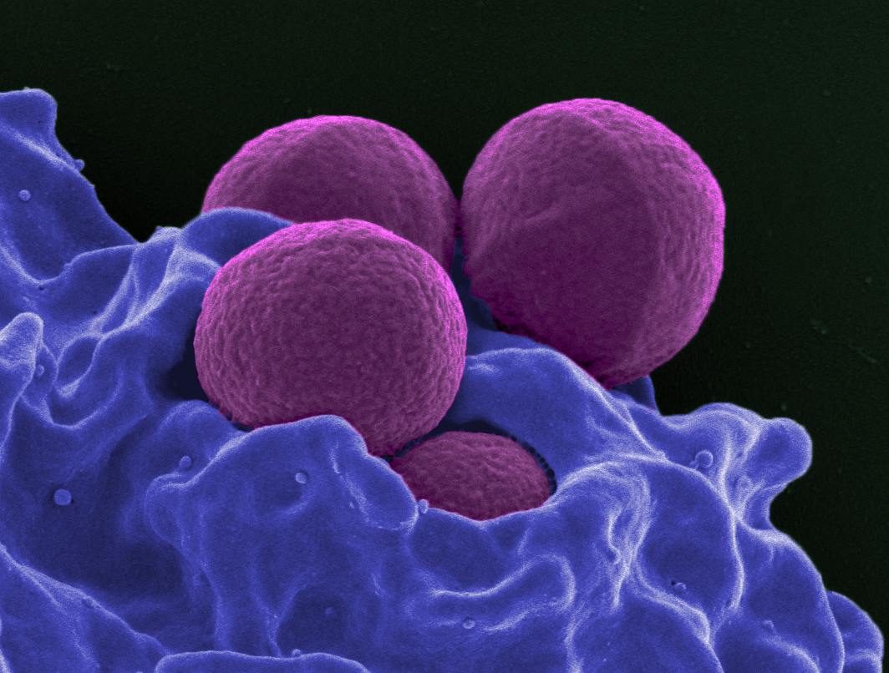
THE NEUTROPHILS
​ The neutrophils are one of the two types of white blood cells categorized as phagocytes..
They are the first responders.
This Photo by Unknown Author is licensed under CC BY-SA

Slide 35
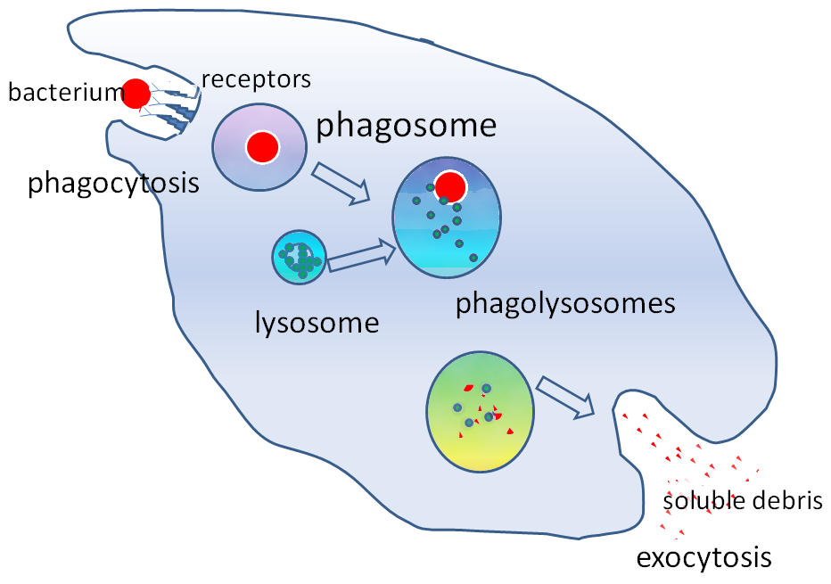
Monocytes (macrophages)
Monocytes (macrophages) are the other types of white blood cells that are categorized as phagocytes.
Live in lymphatic fluids
They are able to consume large particles of debris
Can consume large amounts.
Eats a larger variety of things than neutrophils.

Slide 36
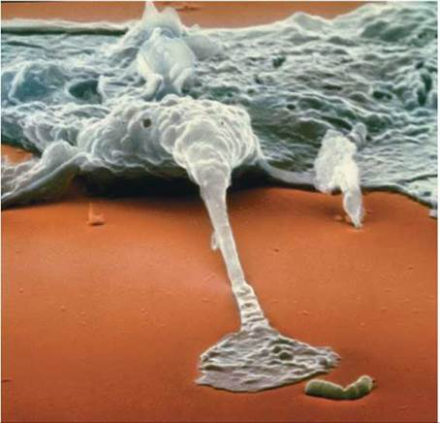
Monocytes (macrophages)
A macrophage ingesting a bacterium (the rod-shaped structure).
The bacterium will be pulled inside the cell within a membrane-bound vesicle and quickly killed. –
http://schoolbag.info/biology/humans/17.html

Slide 38
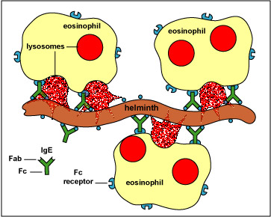
EOSINOPHILS
The eosinophils specialize in attacking pathogens that are too large for the macrophages to engulf, such as parasitic worms.
This Photo by Unknown Author is licensed under CC BY-NC-SA

Slide 39
EOSINOPHILS
Eosinophils function by positioning themselves close to the pathogen and releasing enzymes that kill the organism and break it down into smaller pieces.
At this point, the macrophages can remove the smaller pieces using phagocytosis. ​

Slide 41
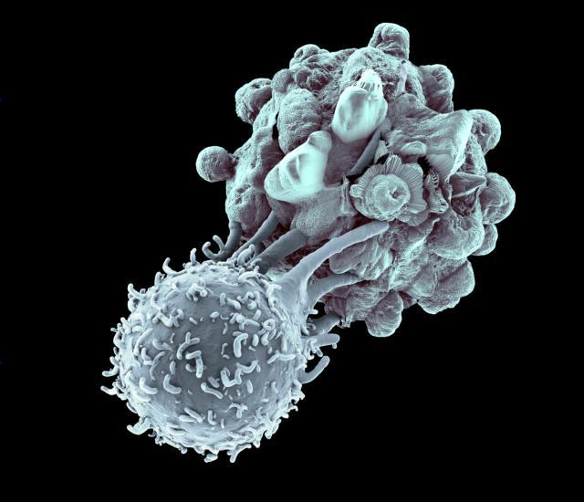
Natural Killer Cells
NATURAL KILLER CELLS induce APOPTOSIS or KILL virus-infected or tumor cells.
Natural killer cells function in cell-mediated, cytotoxic innate immunity

Slide 42
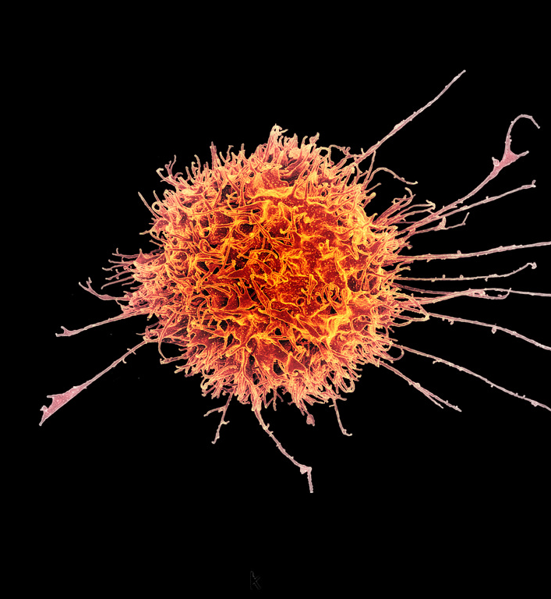
Natural killer cells
Natural killer cells are constantly on patrol seeking out any suspicious characters it finds in the body.
Natural killer cells (NK cells) will indiscriminately kill anything that it perceives as "abnormal".
This means that the NK cells will not only destroy foreign invaders, but will also destroy the body's own cells that may show signs of mutation, or infection or disease.
This Photo by Unknown Author is licensed under CC BY

Slide 43
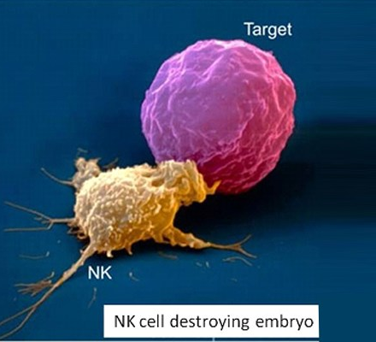
Natural Killer Cells are Indiscriminate Killers
OH NO!
For example, host cells that have become cancerous or that have become infected with a virus are likely targets for the NK cells.
The natural killer cells destroy their target by coming into direct contact with the suspicious cell and secreting proteins that degrade the structural integrity of its membrane until the cell dies.
invader

Slide 45
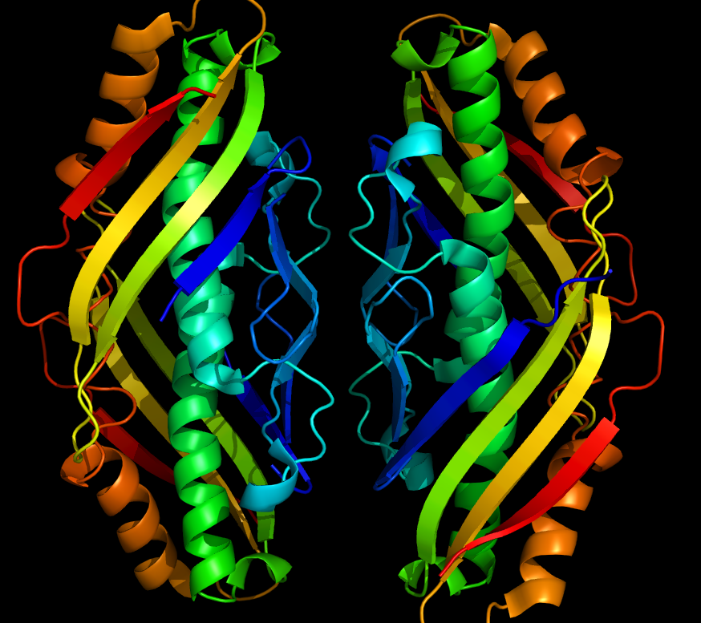
Defensive Proteins
The second line of defense also includes the action of defensive proteins, such as
interferon
the complement system ​
This Photo by Unknown Author is licensed under CC BY

Slide 47
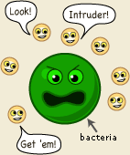
Interferon
Interferons are proteins which act to slow down the process of viral reproduction.
Once a cell has become infected with a virus, its days are numbered.
Cells infected with a virus will secrete small proteins called interferons that will interfere (hence the name) with the ability of the virus to spread to nearby cells.

Slide 49
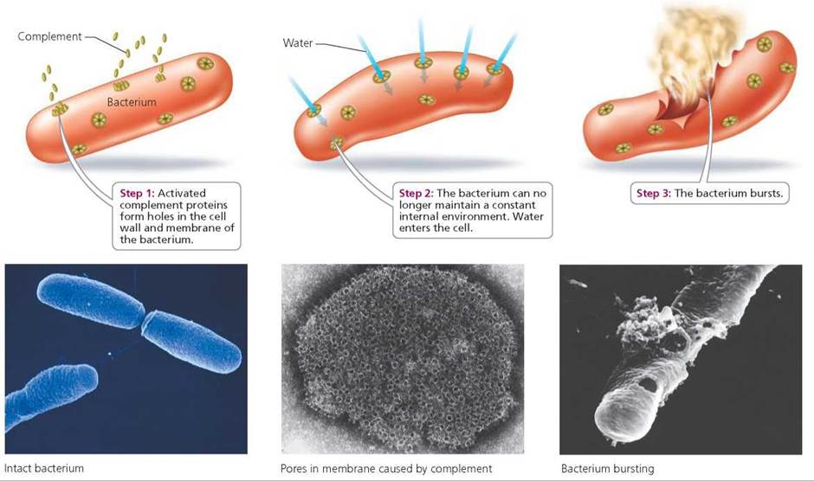
THE COMPLEMENT SYSTEM
The complement system refers to a large group of proteins that work to "complement" or enhance the effects of body's other defense mechanisms.

Slide 50
THE COMPLEMENT SYSTEM
Destroying the pathogen. Pokes holes in a pathogen's membrane, which leads to cell bursting.

Slide 52
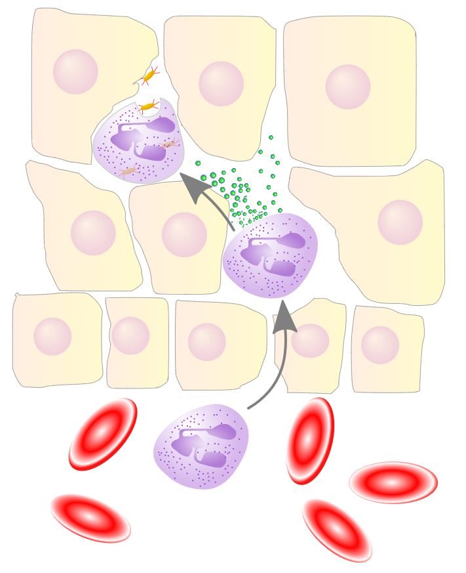
Inflammation
Inflammation occurs as the result of some sort of internal injury or damage to the tissues.
The inflammatory response is characterized by four signs:
Redness
Heat
Swelling
Pain

Slide 53
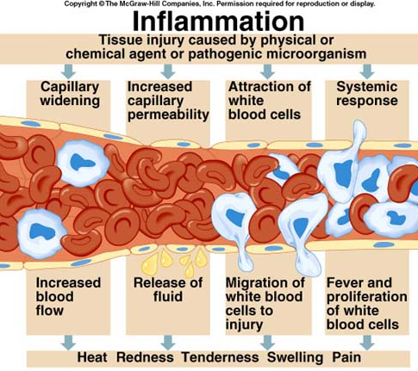
Inflammation – RED APPEARANCE
What causes the red appearance of the inflammatory response?
​Damaged cells release histamine
Histamines widen capillaries
Increases blood flow to the area
Causing redness.

Slide 54
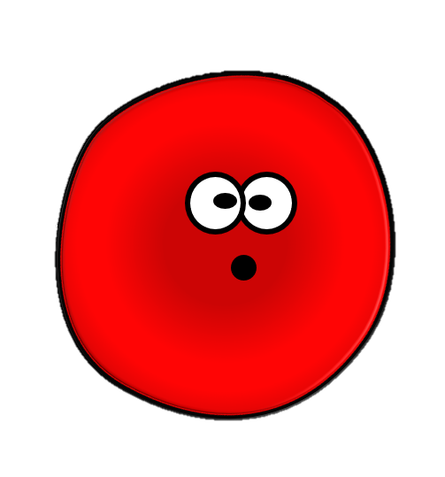
Inflammation – RED APPEARANCE
The widening of the capillaries assists the healing process, because the increased blood flow to the injured area allows defensive cells and proteins to gain access to the area more easily.

Slide 55
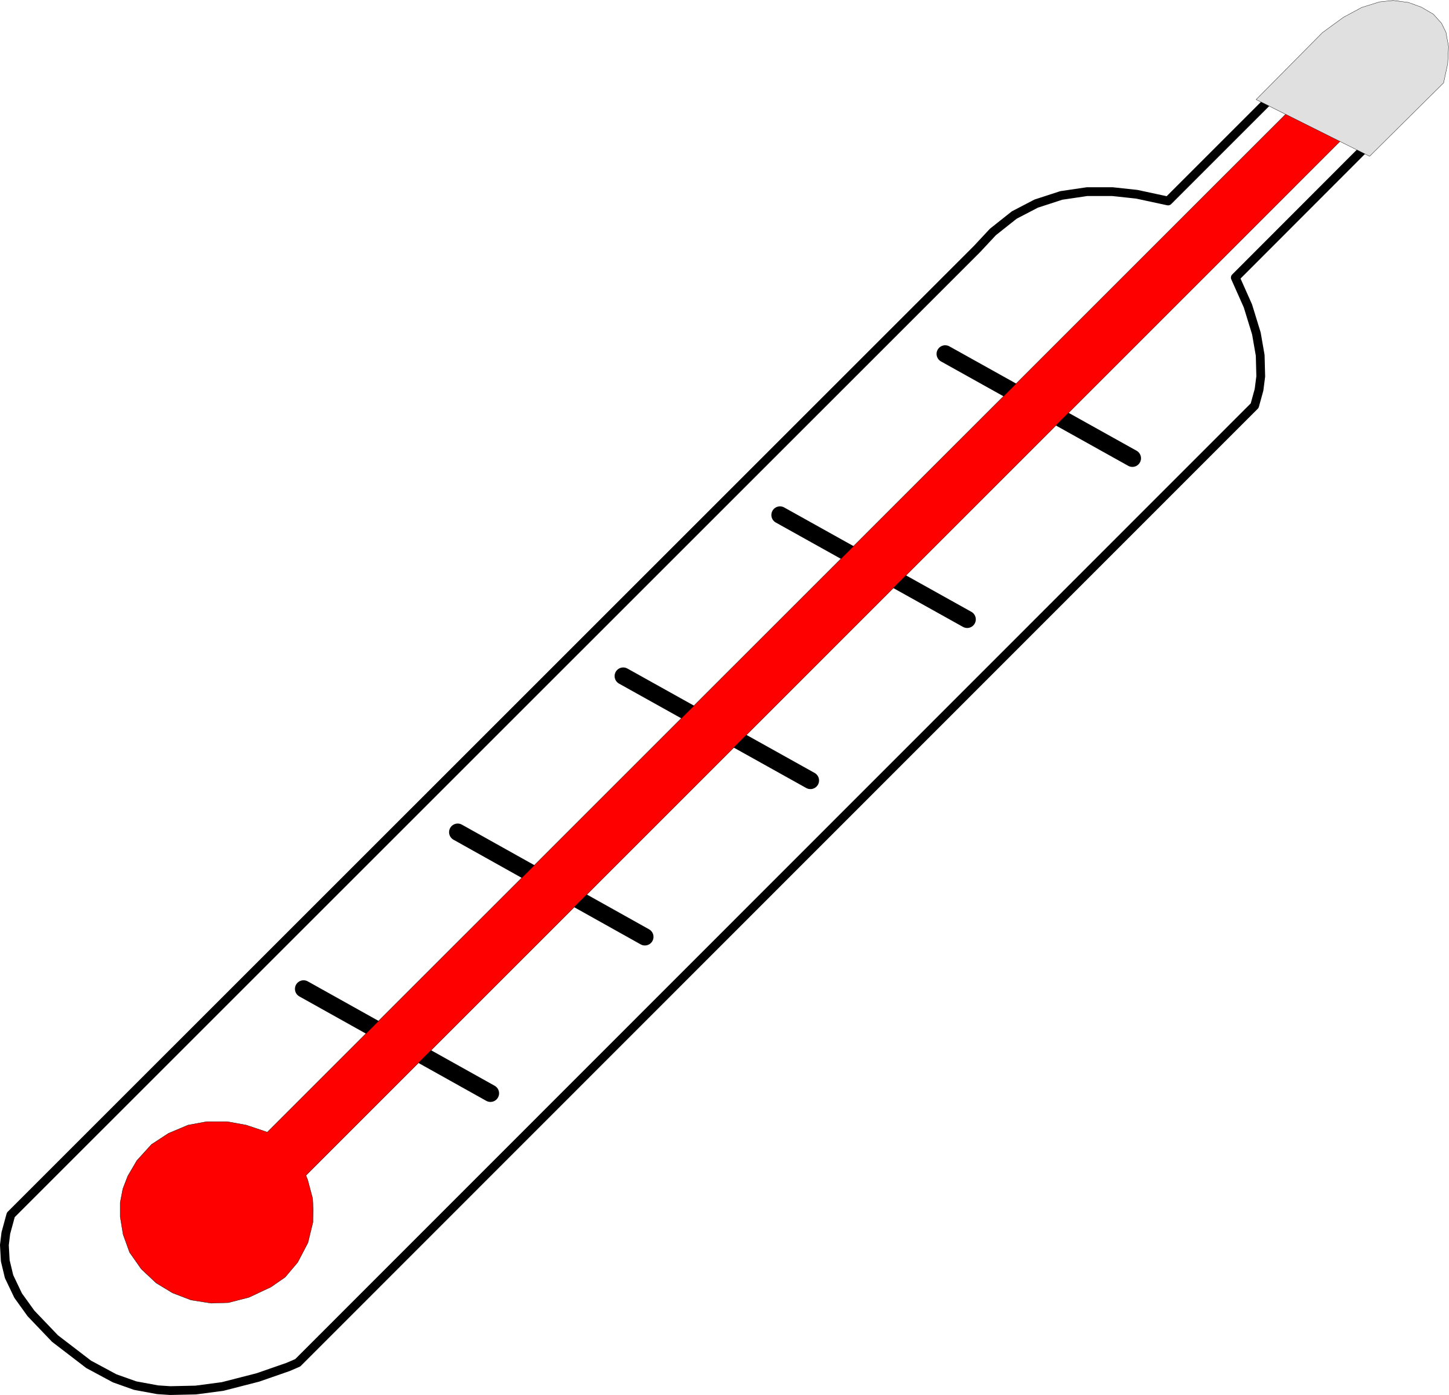
Inflammation – Warm to the Touch (Heat)
​Increased blood flow also elevates the temperature in the area of injury.
The increased temperature also increases the metabolic rate of the host cells in the region which promotes healing.

Slide 56
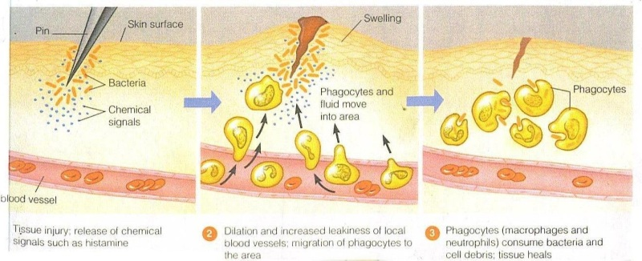
Inflammatory Response - Swelling
​The histamines in the area cause the small blood vessels (the capillaries) to become more permeable.
This allows more fluids and substances to pass from the bloodstream to the tissues, which causes swelling.
However, the swelling brings in vital nutrients and liquids from the blood stream that promote healing.

Slide 57
Inflammatory Response - Pain
Pain often accompanies inflammation due to excessive fluid that may have pressed on nerves.
Pain can also be experienced due to toxins released by bacterial or by prostaglandins.
Pain is unpleasant, but it is protective.
It is your body's way of letting you know something is wrong and needs attention.
Pain also causes a person to protect the area from additional injury.

Slide 59
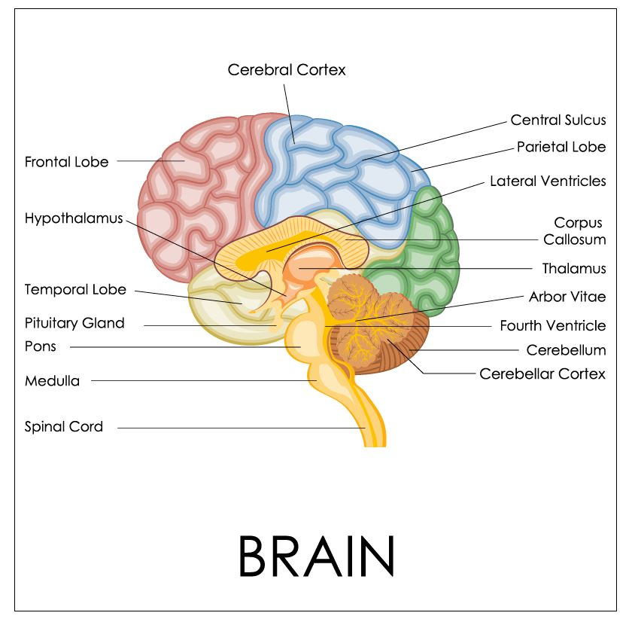
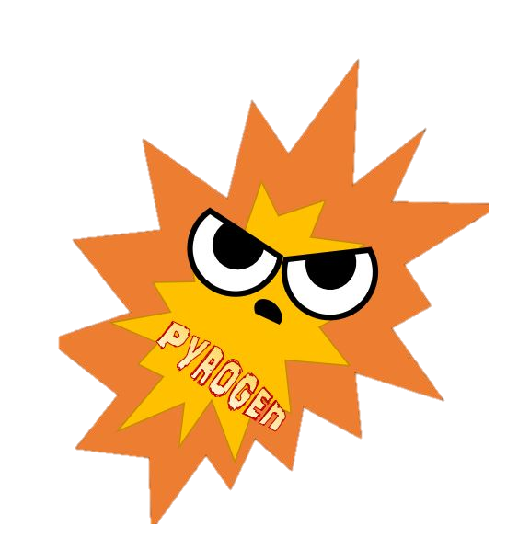
FEVER and Pyrogens
A fever is defined as an abnormally high body temperature.
Fevers are caused by chemicals classified as "pyrogens".
The word "pyrogen" comes from the words "pyro", meaning "fire" and "gen", meaning "generator".
Pyrogens function to stimulate the hypothalamus to raise the internal temperature of the body.

Slide 60
Pyrogens
Pyrogens can come from the one of 2 different sources.
Pyrogens can comes from the body as one of the second lines of defense against disease
Pyrogens can come from toxins produced by certain bacteria.
Regardless of the source of the pyrogen, the result is the same.

Slide 61
In What Ways Do FEVERS Help the Body Fight Pathogen and Heal from Disease?
Way #1) By Slowing Down the Growth of Pathogens
Fevers cause the liver and spleen to remove iron from the blood.
Since many bacteria require iron to reproduce, the reproductive process is slowed down while the fever is present.
Fe²⁺
Fe²⁺
Fe³⁺

Slide 62
In What Ways Do FEVERS Help the Body Fight Pathogen and Heal from Disease?
Way #2) By Increasing the Metabolic Rate of Cells.
Increasing the metabolic rate of defensive cells makes them “turbo charged” where they can work faster than usual.

Slide 63
TOO MUCH OF A “GOOD THING”?
However, there is definitely the possibility of having too much of a good thing when it comes to a fever.
Fevers that go over 105°F in adults can be life-threatening due to the denaturing of enzymes needed for metabolic processes.

Slide 64
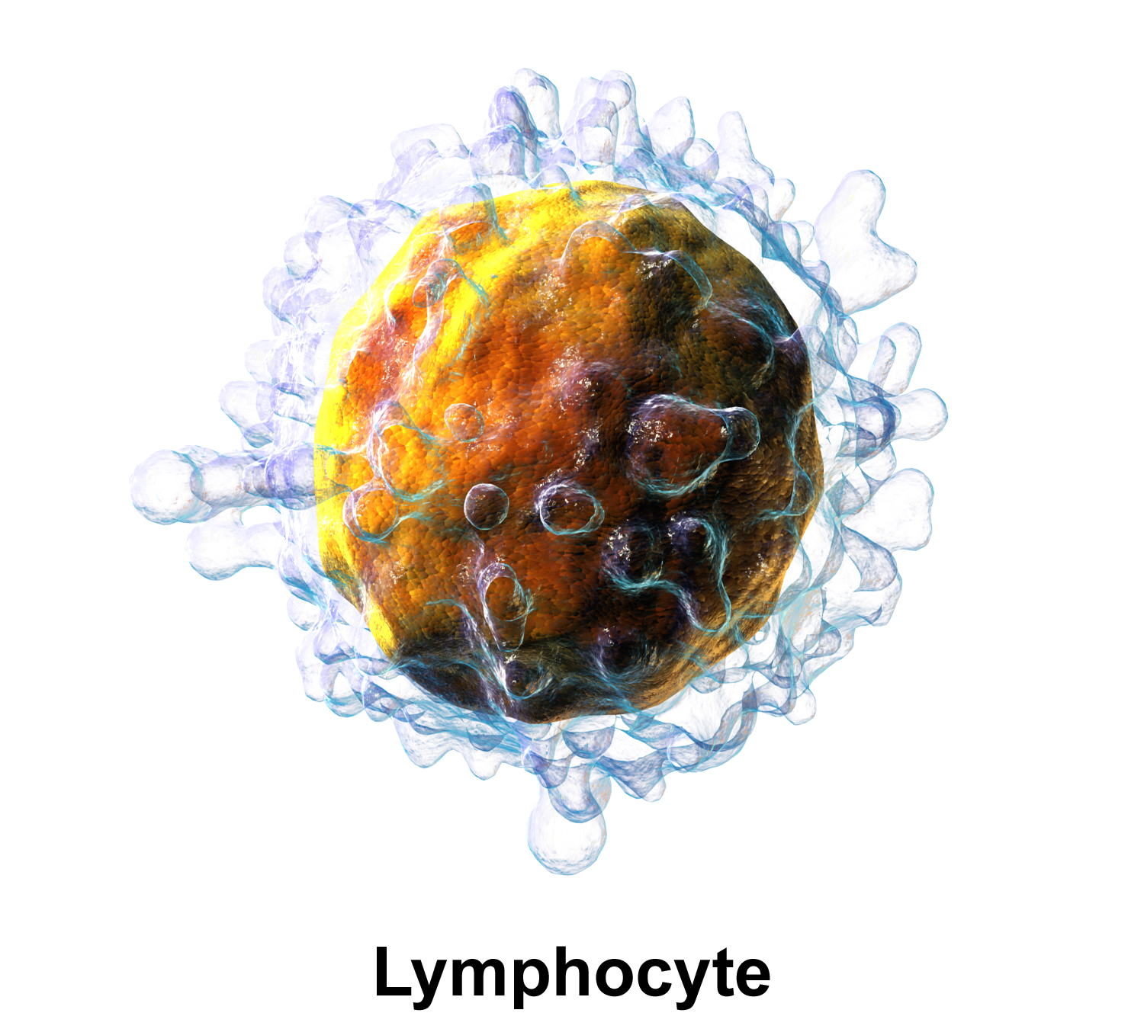
THE THIRD OF DEFENSE = the adaptive immune response
THE THIRD LINE OF DEFENSE - Destroy - Destroy the invading pathogen.
This is the third line of defense and it is accomplished as the adaptive immune response.

Slide 65
Adaptive (Specific) Immune System
Innate (Nonspecific) Immune System
vs.
Includes the First and Second lines of defense
Also called non-specific immune responses - Attacks only based on the identification of general threats
Innate (born with it)
Responds more quickly to infection and injury
Ready to fight at all times
Includes the Third line of defense only
Uses specific antigens to strategically launch an immune response.
Acquired after birth (from exposure to pathogens)
Much slower to respond to threats and infections
Is NOT ready to fight at all times. Becomes activated only after there has been an exposure to pathogens
Uses an immunological memory to learn about the threat and enhance the immune response accordingly.

Slide 66
Innate Immunity in a Nutshell

Slide 67
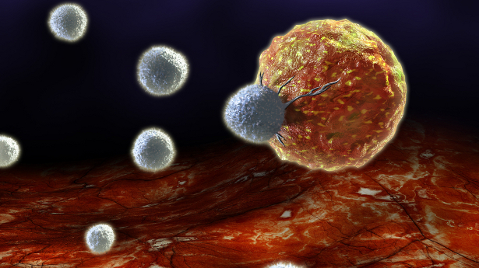
The adaptive immune response involves…
B cells and T cells
Recognizing Antigens and Producing Antibodies
This Photo by Unknown Author is licensed under CC BY-NC-ND

Slide 68
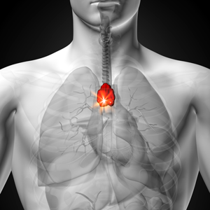
The cells of the adaptive immune system
THYMUS GLAND
Both B cells and T cells are lymphocytes.
B-cells and T-cells are derived from hematopoietic stem cells, in red bone marrow.
B-CELLS MATURE IN THE BONE MARROW
T-CELLS MATURE IN THE THYMUS GLAND
hematopoietic stem cell
Lymphocytes
B-Cell
T-Cell

Slide 69
B-Cells Moving Out!
B-cells mature in the bone marrow.
Once mature, they move out and into the lymphatic system to reside in the secondary lymphatic organs.

Slide 70
Secondary Lymphatic Organs _____ The B-Cells Stay in the Secondary Lymphatic Organs and Wait to be Activated by the presence of an ANTIGEN
Tonsils
Adenoids
Lymph Nodes
Thymus
Spleen

Slide 71
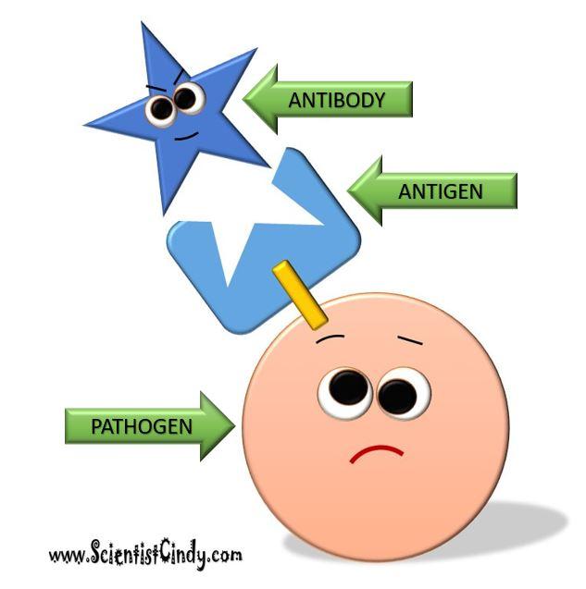
ANTIGENS and ANTIBODIES
ANTIGENS are defined as anything that has the ability to provoke an immune response
Antigens can be viruses, bacteria, or other molecules.
ANTIBODIES (immunoglobulins) are the proteins produced by the immune system to specifically bind to specific antigens.

Slide 72
B-Cells PURPOSE IN LIFE!
The whole purpose in a B-cell’s life is to…
IDENTIFY ANTIGENS
ALERT THE IMMUNE SYSTEM THAT AN ANTIGEN HAS BEEN FOUND
SECRETE ANTIBODIES
B-Cell

Slide 73
B-Cells Have Antibodies
B-Cells produce antibodies (or immunoglobulins) that they place on their cell’s surface.
The membrane-bound antibodies act like KEYS and are able to bind to an antigen, because they fit with it, kind of like as if it were a LOCK.
B-Cell

Slide 74
B-CELL CARRYING ANTIBODIES meets a PATHOGEN with ANTIGENS
Each B-Cells contains antibodies (like a key) that are specific to only one antigen.
A pathogen can have many antigens, but the B-Cell has only key to one antigen.

Slide 75
THE INVASION!
When an antigen invades the body, it will encounter many B-Cells.
Since, each B-Cell is specific to only one antigen, the antigen may come across a multitude of B-Cells that it does not bind with… before it comes across a B-Cell that DOES!
Oh! Umm.. I was.. Umm.. just passing through officer.

Slide 76
B-CELL CARRYING ANTIBODIES
The B cell will keep trying different keys (antibodies) until it finds a MATCH!

Slide 77
Once the B-Cell Finds a Match, it takes the antigen
“B” Stands for “BULLY” !!!
B-Cell
Into itself Using Endocytosis

Slide 78
The Antigen is Fragmented
Once the antigen is inside of the B-Cell, the B-Cell will break down the antigen molecule into smaller fragments.
Umm… That Doesn’t Sound Good!

Slide 79
MHC-II Molecules
The B-Cell then uses these fragments to create MHC-II molecules that are displayed on the B-Cells Surface.
At this stage, the B-Cell can also be called an “antigen-presenting cell”.
MHC-II

Slide 80
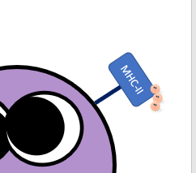
The T-Cells
The T cell will then bind to the MHC-II complex and become activated.
The activated T cell releases cytokines that causes the B cells to undergo rapid cell division.
cytokines

Slide 81
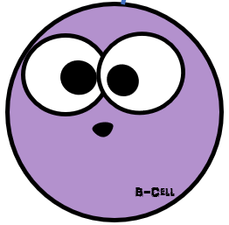
B-Cell Activation → Proliferation
Activated B Cell
CYTOKINES
The B-Cell begins to proliferate
The B cell proliferates to form specialized
memory B cells
effector B cells
Effector B Cell
Memory B Cell

Slide 82
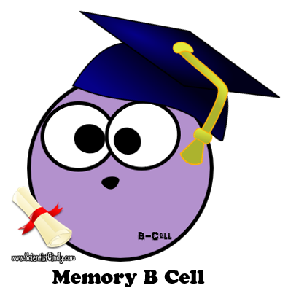
MEMORY CELLS
Memory cells are involved in the secondary immune response.
This means that if this same antigen invades the body again in the future, thousands of memory B-Cells will be all ready to go and will quickly jump into action to destroy the invader!

Slide 83
Effector B-cells (Plasma Cells)
The effector B-Cells (plasma cells) secrete millions of antibodies.
These antibodies are able to bind to the antigen that caused the immune response.

Slide 84
The Originally Activated B-cell
The originally activated B-Cell Leaves the Secondary Lymphatic Organ that it has been residing in.
The activated B-Cell then will circulate throughout the body’s humors in search of more of these same antigens that it can bind to.
When the B-Cell encounters an antigen, the B-Cell will lock onto it and act in a variety of ways that ultimately leads to the death of the invader.

Slide 85
THANK YOU FOR WATCHING
By Scientist Cindy

