Slide 1
The Appendicular Skeleton

Slide 2
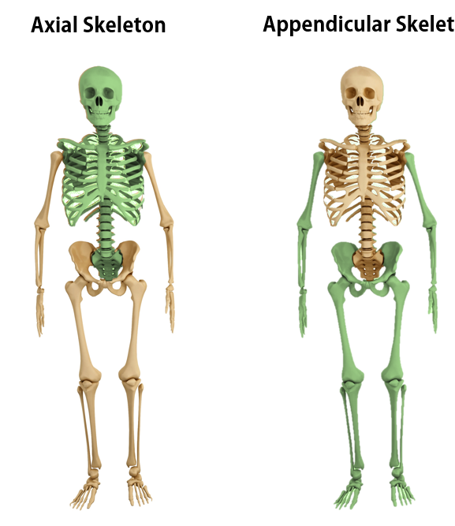
Regions of the Skeleton
Axial skeleton – 80 named bones
bones of the skull, vertebral column, and rib cage
Appendicular skeleton – 126 named bones
bones of the upper and lower limbs, pectoral (shoulder) girdle, and pelvic (hip) girdle
There are 206 bones in the adult human

Slide 4
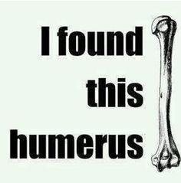

Slide 5
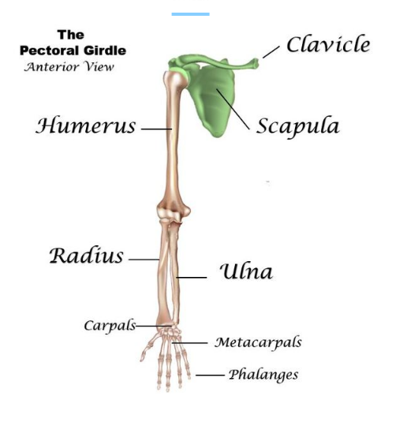
The pectoral girdle
The pectoral girdle region of the skeleton consists of the following bones: 1. Clavicle (collar bone) 2. Scapulae (shoulder blade)

Slide 7
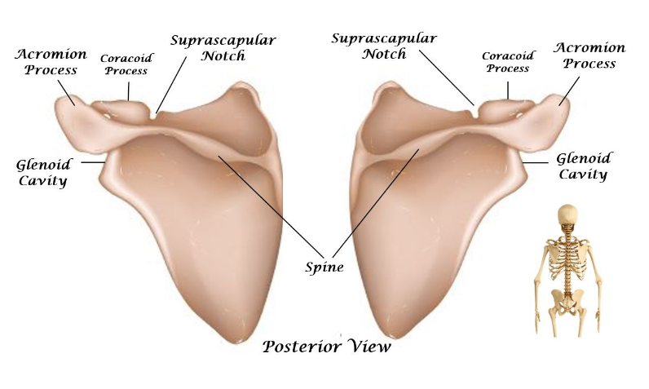
The Scapulae

Slide 8
The Scapula has 4 Structures You Need to Know.
​ 1) The Acromion Process
2) The Coracoid Process
3) The Glenoid Cavity
4) The Spine of the Scapula

Slide 9
The Scapula has 4 Structures You Need to Know.
3. The Acromion Process - The acromion process articulates with the clavicle (collar bone).
4. The Coracoid Process - The coracoid process looks like a bent finger sticking out. This surface attaches to the biceps (upper arm muscles).

Slide 10
The Scapula has 4 Structures You Need to Know.
The Glenoid Cavity - The glenoid cavity is the socket or cavity that articulates with the humerus bone to form the shoulder joint.
The Spine of the Scapula - The spine is the raised portion that can be felt through your skin. This acts as a surface for back muscle attachment.

Slide 11
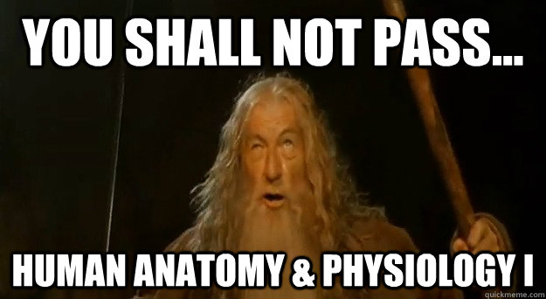

Slide 12
The Anatomy of the Upper Extremities

Slide 13
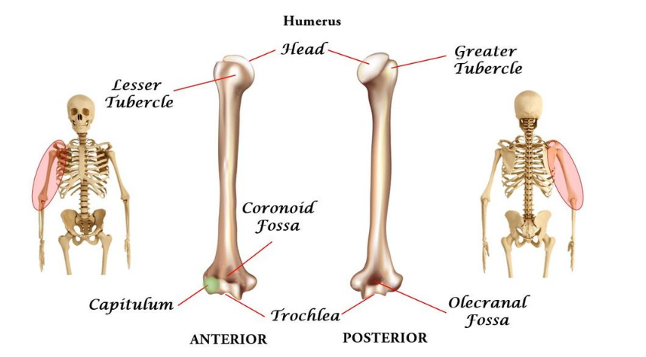

Slide 14
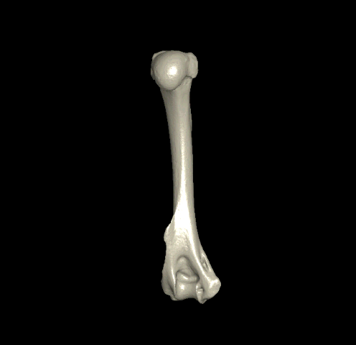
The Humerus has 7 Structures You Need to Know. ​ 1) The Head 2) The Trochlea 3) The Capitulum 4) The Olecranal Fossa 5) Coronoid Fossa 6) The Greater Tubercle 7) The Lesser Tubercle

Slide 15
​ The Head - The head of the humerus is the larger rounded part at the anterior end of the humerus. The head of the humerus articulates with the glenoid cavity of the scapula to form the shoulder joint.

Slide 16
The Trochlea - This is the medial condyle that articulates with the ulna (lower arm bone at the "pinky" side). The trochlea looks like a spool of thread.

Slide 17
The Capitulum - This is the lateral condyle of the humerus. The word "condyle" is used as a general term for a rounded, upraised area (protrusion) that acts as a point of articulation for a joint needing a "gliding" surface. The capitulum appears like a small "bald head". In fact, the name "capitulum" comes from the Latin word for "tiny head". For me, the word "decapitation" reminds me that the little bald head structure is called the capitulum.
The capitulum articulates with the radius.

Slide 18
The Coronoid Fossa - The coronoid fossa is the groove that is at the front (anterior) part of the lower (inferior) portion of the humerus (near elbow joint). The coronoid fossa articulates with the ulna (at the coronoid process of the ulna).

Slide 19
The Olecranal Fossa - The olecranal fossa is the groove that is at the back (posterior) part of the lower (inferior) portion of the humerus (near elbow joint). The coronoid fossa articulates with the ulna (at the coronoid process of the ulna).

Slide 20
The Greater Tubercle - The greater tubercle is one of the attachment sites for the rotator cuff muscles (shoulder muscles).
​The Lesser Tubercle - The lesser tubercle is the other site of attachment for the rotator cuff muscles (shoulder muscles)

Slide 21
The Kiwi Bird

Slide 22
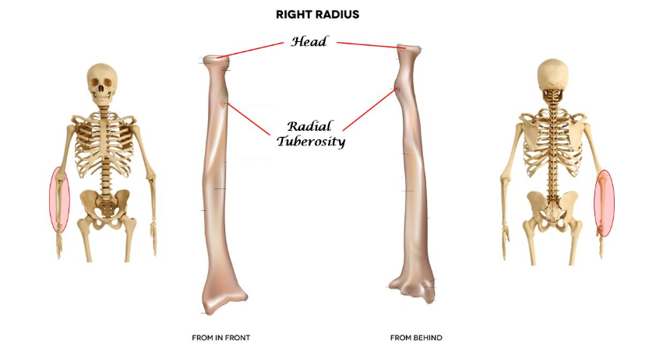
The radius is one of the 2 lower arm bones. The radius is slightly longer than the other lower arm bone, which is called the ulna. The radius is oriented on the same side as your thumb. I think of "thumbs up" as being "rad".

Slide 23
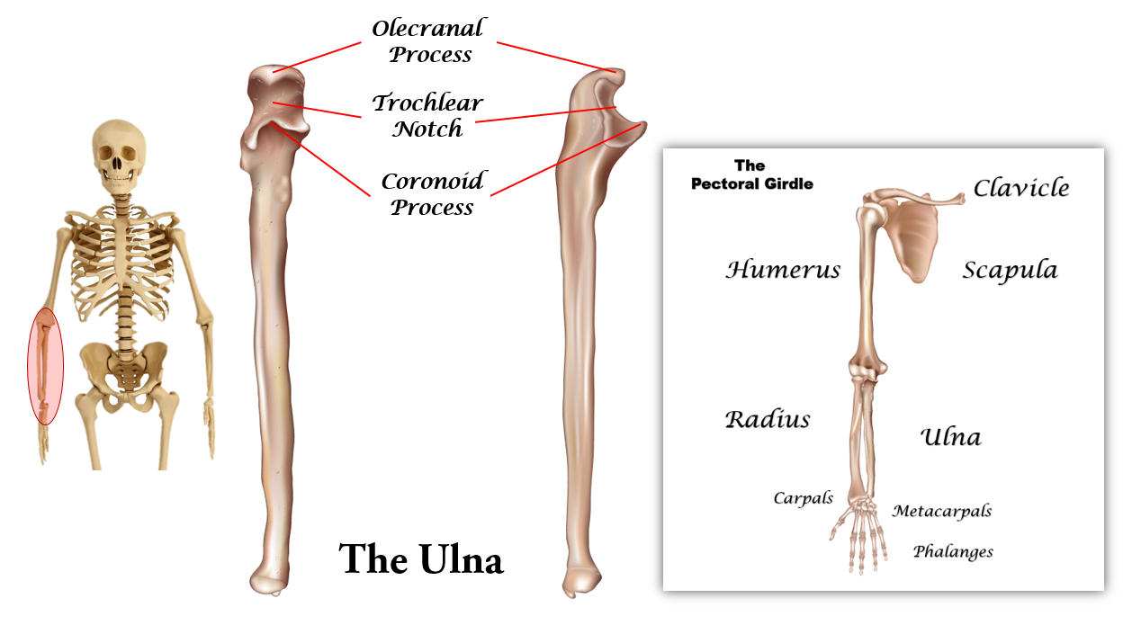
The ULNA has 3 structures that you need to know. ​ 1) The Olecranal Process 2) The Coronoid Process 3) The Trochlear Notch.

Slide 24
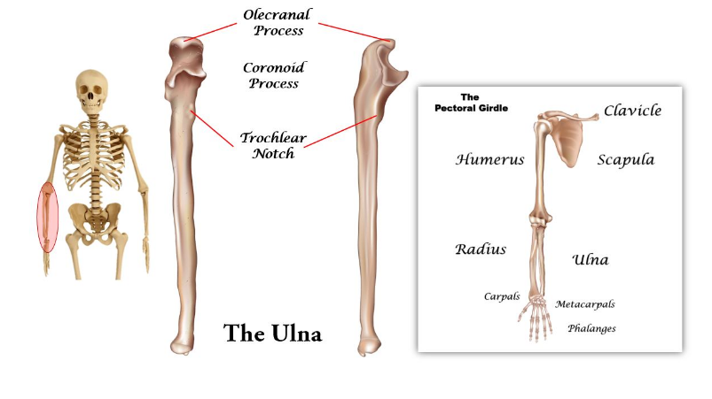
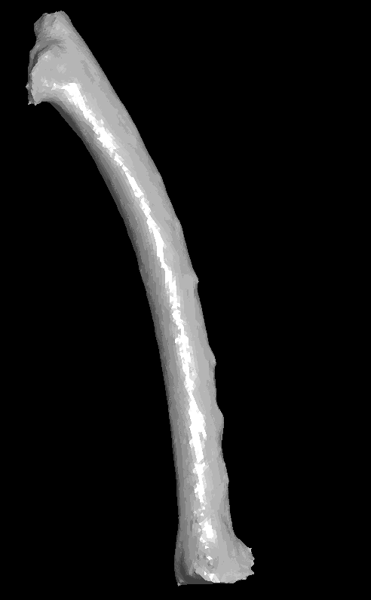
The ULNA has 3 structures that you need to know. ​ 1) The Olecranal Process 2) The Coronoid Process 3) The Trochlear Notch.

Slide 25
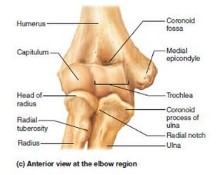
The ULNA has 3 structures that you need to know. ​ 1) The Olecranal Process 2) The Coronoid Process 3) The Trochlear Notch.
Humerus
Radius
Ulna

Slide 26
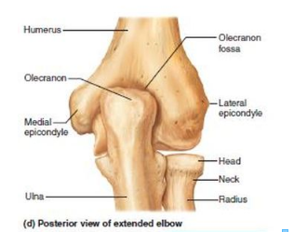
The ULNA has 3 structures that you need to know. ​ 1) The Olecranal Process 2) The Coronoid Process 3) The Trochlear Notch.
Humerus
Radius
Ulna

Slide 27
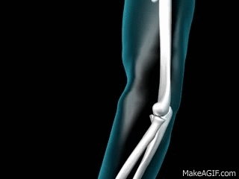
The ULNA has 3 structures that you need to know. ​ 1) The Olecranal Process 2) The Coronoid Process 3) The Trochlear Notch.
Humerus
Radius
Ulna

Slide 28
Don't be deceived! The skeleton looks like it has really long fingers, BUT don't forget that metacarpals are making up part of what looks like those long fingers.

Slide 30
The coxal bone (or hip bone / pelvic bone / os coxae) is actually 1 bone that is formed from the fusion of 3 bones, called the illium (top / superior portion), the pubis (medial, anterior portion, and the ischium (lower / inferior portion)

Slide 31
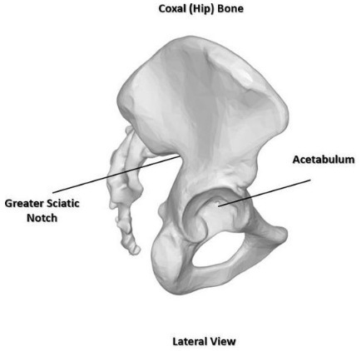
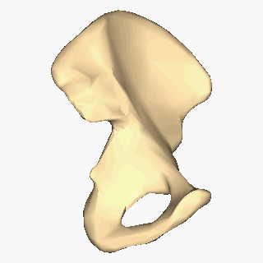
Coxal (Hip) Bone Lateral View
The Acetabulum is the socket for the femoral head (only viewable laterally).

Slide 32
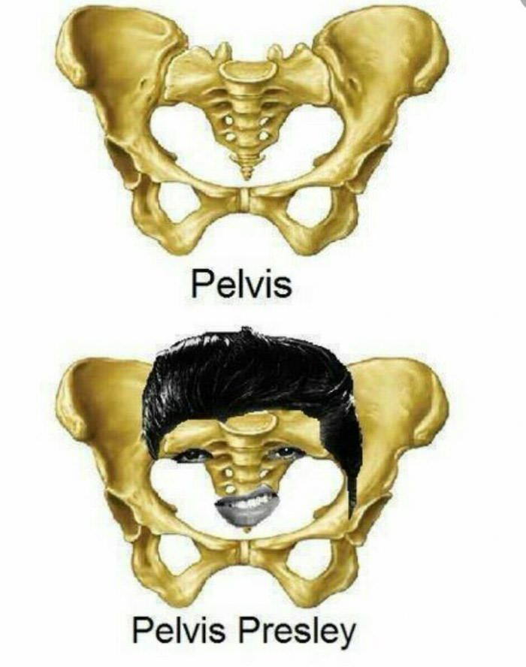

Slide 33
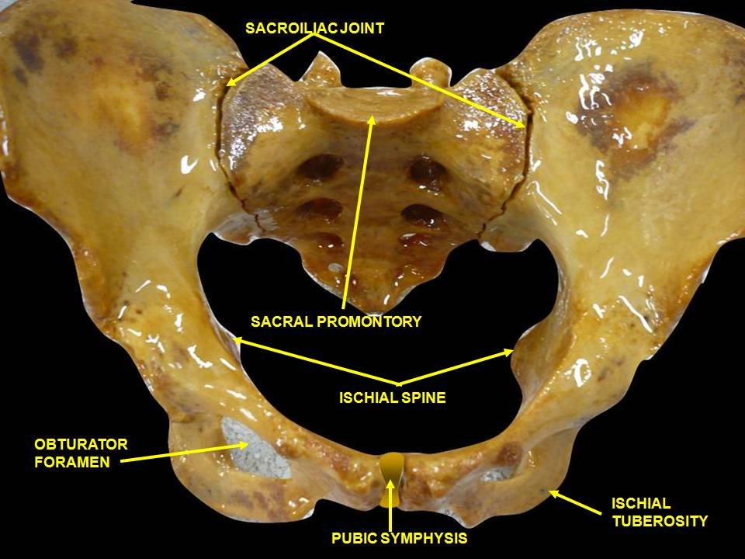

Slide 34
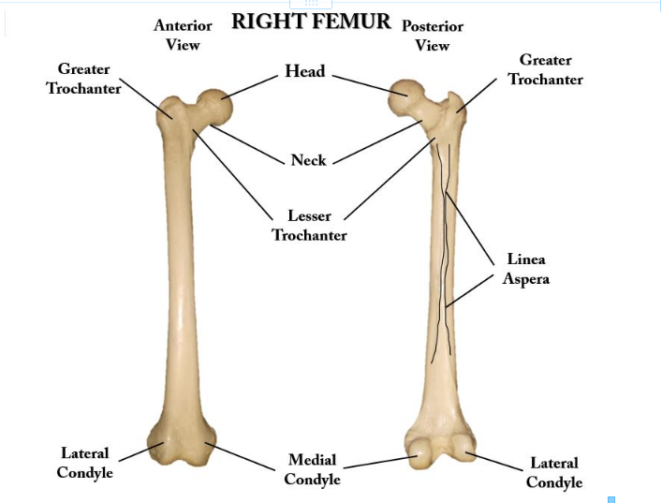
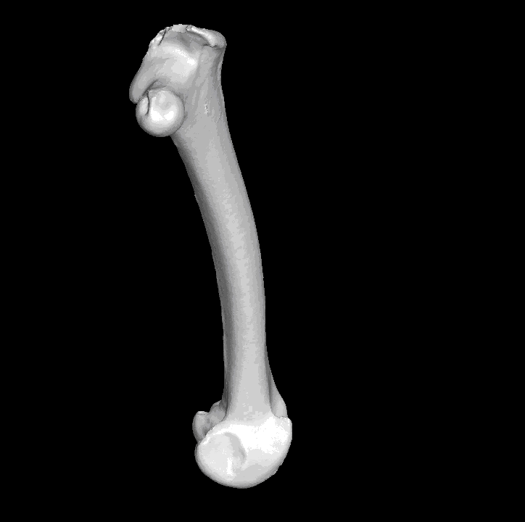
The FEMUR Has 7 Structures You Need To Know. 1) Head 2) Neck 3) Greater Trochanter 4) Lesser Trochanter 5) Medial Condyle 6) Lateral Condyle 7) Linea Aspera

Slide 35
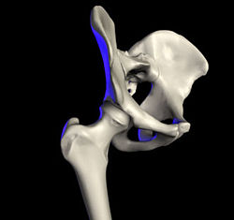
The FEMUR Has 7 Structures You Need To Know. 1) Head 2) Neck 3) Greater Trochanter 4) Lesser Trochanter 5) Medial Condyle 6) Lateral Condyle 7) Linea Aspera
Head - The head of the femur is a large round knob at the medial proximal end of the femur. The head of the femur articulates with the acetabulum of the coxal (hip boe) to make the hip joint.

Slide 36
The FEMUR Has 7 Structures You Need To Know. 1) Head 2) Neck 3) Greater Trochanter 4) Lesser Trochanter 5) Medial Condyle 6) Lateral Condyle 7) Linea Aspera
Neck - The neck is the narrowed area that holds the head.
The Greater Trochanter - The higher rounded protrusion that functions as a surface for muscles to attach to.
The Lesser Trochanter - The lower rounded protrusion that functions as a surface for muscles to attach to.

Slide 37
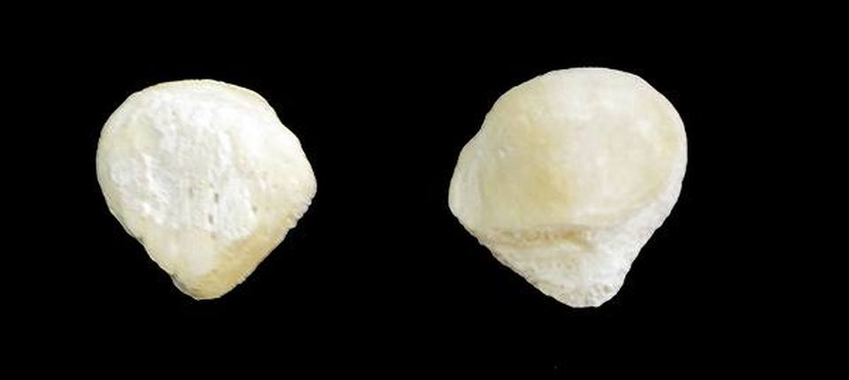
Patella
The patella is known as the kneecap. It is categorized as a sesamoid bone, because it is embedded in a tendon. The patella is a thick, circular-triangular bone which articulates with the femur (thigh bone) and covers and protects the knee joint.

Slide 39
THE TIBIA (SHIN BONE) AND FIBULA
The TIBIA has 3 structures that you need to know. 1) The Medial Condyle 2) The Lateral Condyle 3) Medial Malleolus
​The Medial and the Lateral Condyles lie at the proximal portion of the tibia and join with the femur to form part of the knee joint. The Medial Malleolus is the prominence on the inner side of the ankle. This can be felt through the skin.

Slide 40
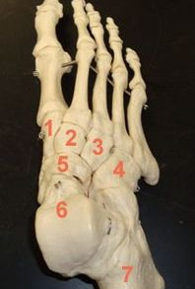
The Foot (Tarsus) has 5 Structures that You Need to Know. 1) The Tarsals 2) The Calcaneus 3) The Talus 4) The Metatarsals 5) The Phalanges
The Tarsals (General Term for the 7 "Foot Bones") – The term tarsals refers to the 7 bones of the foot as a group. The tarsals are labeled numbers 1 - 7 in the photo. Each of these bones has a name. Don't worry though, you will only need to know the name of a 2 of these bones (the calcaneus (heel) bone and the talus (ankle).

Slide 41
The Foot (Tarsus) has 5 Structures that You Need to Know. 1) The Tarsals 2) The Calcaneus 3) The Talus 4) The Metatarsals 5) The Phalanges
The Calcaneus (Heel Bone) - The calcaneus is the bone that form the heel portion of your foot. It is considered one of the tarsal bones of the foot and is labeled as #6 in the photo.
The Talus (Ankle Bone) - The talus is the bone that form the ankle portion of your foot. It is considered one of the tarsal bones of the foot and is labeled as #7 in the photo.

Slide 42
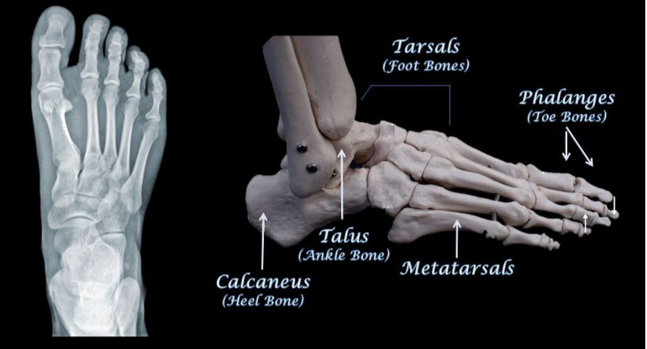
The Metatarsals - The metatarsals are the 5 long bones that make up the front (anterior) part of the foot. The metatarsals are anterior to the tarsals and posterior to the toe bones (phalanges). The Phalanges – The phalanges are the bones of the toes. The big toe has 2 phalanges, while the other toes have 3 phalanges.

