Slide 1
ANATOMY Basics
by Cynthia Anderson

Slide 2
The term anatomy is derived from Greek words meaning “to cut apart.”

Slide 3

Anatomy and Physiology
Anatomy is the study of the structure of the human body.
It is also called morphology, the science of form.
Anatomy is closely related to physiology, the study of body function.

Slide 4
Subdisciplines of Anatomy
Anatomy is a broad field of science consisting of several subdisciplines, or branches.
Each branch of anatomy studies the body’s structures in a specialized way.

Slide 5
Subdisciplines of Anatomy - Gross Anatomy
Gross anatomy (gross = large) is the study of body structures that can be examined by the naked eye—the bones, lungs, and muscles, for example.
  Types of GROSS ANATOMY:
    regional anatomy - all structures in a single body region are examined as a group.
    systemic anatomy - all the organs with related functions are studied together.
    surface anatomy - the study of shapes and markings (called landmarks) on the surface of the body that reveal the underlying organs.

Slide 6


Microscopic Anatomy and Histology (Study of Tissues)
Microscopic anatomy, or histology “tissue study”), is the study of structures that are so small they can be seen only with a microscope.
  These structures include cells and cell parts; groups of cells, called tissues; and the microscopic details of the organs of the body (stomach, spleen, and so on).

Slide 7
Other Branches of Anatomy
Developmental anatomy traces the structural changes that occur in the body throughout the life span and the effects of aging.
Embryology is the study of how body structures form and develop before birth as a fetus.

Slide 8
Other Branches of Anatomy
Pathological anatomy deals with the structural changes in cells, tissues, and organs caused by disease. (Pathology is the study of disease.)
Radiographic anatomy is the study of internal body structures by means of X-ray studies and other imaging techniques.
Functional morphology explores the functional properties of body structures and assesses the efficiency of their design.

Slide 9
the chemical level
At the chemical level, atoms are the fundamental unit of matter. 96% of all living things are made up of 4 atoms: carbon, hydrogen, oxygen, and nitrogen.
Atoms combine to form small molecules, such as carbon dioxide (CO2) and water (H2O), and larger macromolecules (macro = big).
Four classes of macromolecules are important for life: carbohydrates (sugars), lipids (fats), proteins, and nucleic acids (DNA, RNA).

Slide 10
the cellular level
Macromolecules are the building blocks of the structures at the cellular level: Cells are the fundamental units of life.
Cells are the smallest living things in the body, and you have ~ 100 trillion of them.

Slide 11
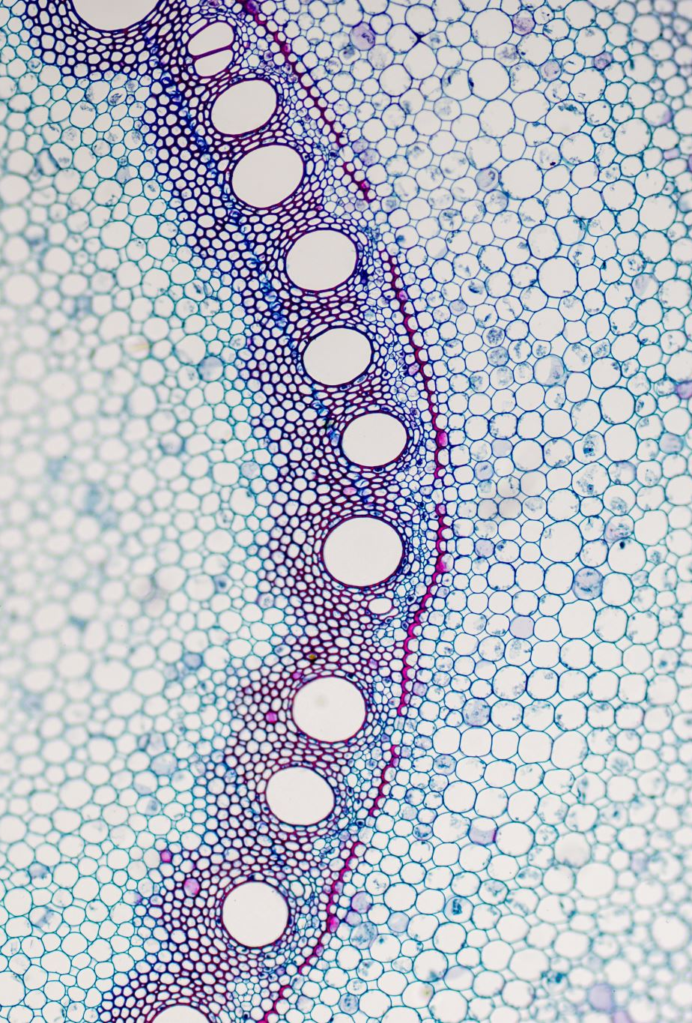
the tissue level
A tissue is a group of similar types of cells that work together to perform a common function.
Only four tissue types make up all organs of the human body:
  epithelial tissue (epithelium)
  connective tissue
  muscle tissue
  Nervous tissue

Slide 12
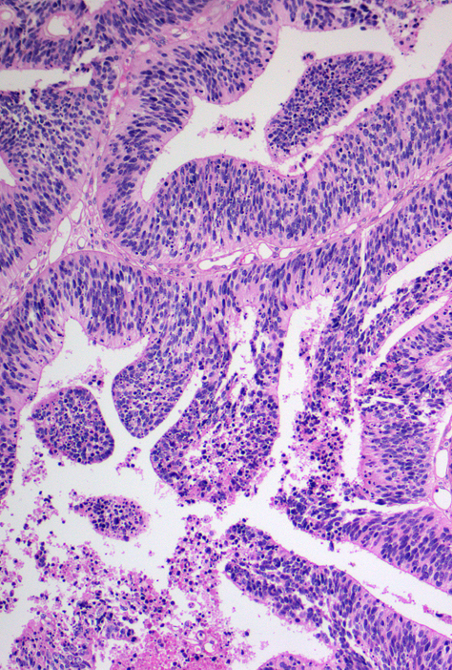
the tissue level
Each tissue plays a characteristic role in the body.
  epithelium covers the body surface and lines its cavities;
  connective tissue supports the body and protects its organs;
  muscle tissue provides movement;
  nervous tissue provides fast internal communication by transmitting electrical impulses.
This Photo by Unknown Author is licensed under CC BY-SA

Slide 13
The organ level
An organ is a discrete structure made up of more than one tissue type.
Most organs contain all four tissues.
The liver, brain, femur, and heart are good examples.

Slide 14
The organ system level
Organs that work closely together to accomplish a common purpose make up an organ system.
For example, organs of the cardiovascular system—the heart and blood vessels—transport blood to all body tissues.
Organs of the digestive system—the mouth, esophagus, stomach, intestine, and so forth—break down the food we eat so that we can absorb the nutrients into the blood.

Slide 15
The organ system level
The body’s organ systems are
  Integumentary (skin) system
  Skeletal system
  Muscular system
  Nervous system
  Endocrine system
  Cardiovascular
  Lymphatic system
  Immune system
  Respiratory system
  Digestive system
  Urinary system
  Reproductive system

Slide 16

the organismal level
The highest level of organization is the organismal level;
  for example, the human organism is a whole living person.
  The organismal level is the result of all of the simpler levels working in unison to sustain life.

Slide 17
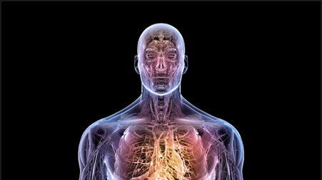
Structure = Function
What a structure can do depends on
its specific form. This key concept is called the principle of
complementarity of structure and function.

Slide 18
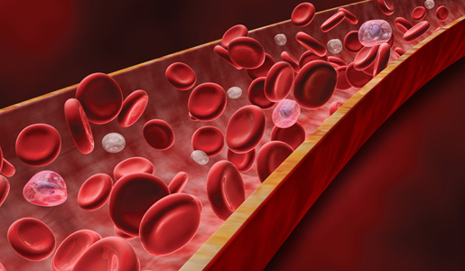
Structure = Function
EXAMPLES of STRUCTURE/FUNCTION
Bones can support and protect body organs because they contain hard mineral deposits.
Blood flows in one direction through the heart because the heart has valves that prevent backflow.

Slide 19
Why Latin? – UNIVERSAL
There was a time where all "standard" communications in scientific disciplines were written in Latin as the "international scientific ​lingua franca."
In the days of the Roman empire, Latin was the main language used in all scientific, civil, diplomatic, legal, and even religious communication across Europe.

Slide 20
Why Latin? – UNCHANGING
Many languages change over time. -- If you read a text written in Old English, you may find it challenging to interpret, even as an English speaker.
Several documents exist today that experts cannot interpret because the language or dialect in which it was written has essentially "died out".
The idea of using a universal language (LATIN) was to preserve important knowledge for future generation.

Slide 21
Why Latin?
Latin as a universal language persisted through the Renaissance Era.
However, the Latin roots in medical terminology and anatomy have remained intact. ​
The idea of Latin as the universal language began to fall out of favor in the 1700's.

Slide 22
LATIN BITS and PIECES!
Prefix: A prefix is placed at the beginning of a word to modify the meaning. Pre means "before."
Root: The root is the central part of a word.
Suffix: The ending part of a word that modifies the meaning of the word.

Slide 23
EXAMPLES
ambi- | Denoting something as positioned on both sides | Ambidextrous
amni- | Pertaining to the membranous fetal sac | Amniocentesis, Amniotic Fluid
amylo- | starchy, carbohydrate-related | Amylophagia
LATIN BITS and PIECES!
LATIN BITS and PIECES!

Slide 24
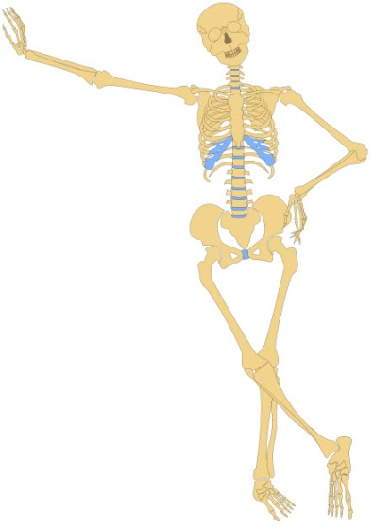
LATIN BITS and PIECES!
Pain terms end with -algia.
Blood terms end in -emia.
Inflammation is -itis.
A breaking down is -lysis.
Relating to disease is -opathy.
Breathing terms end with -pnea.
Fibromyalgia
Anemia
Arthritis
Hemolysis
Neuropathy
Sleep Apnea.

Slide 25
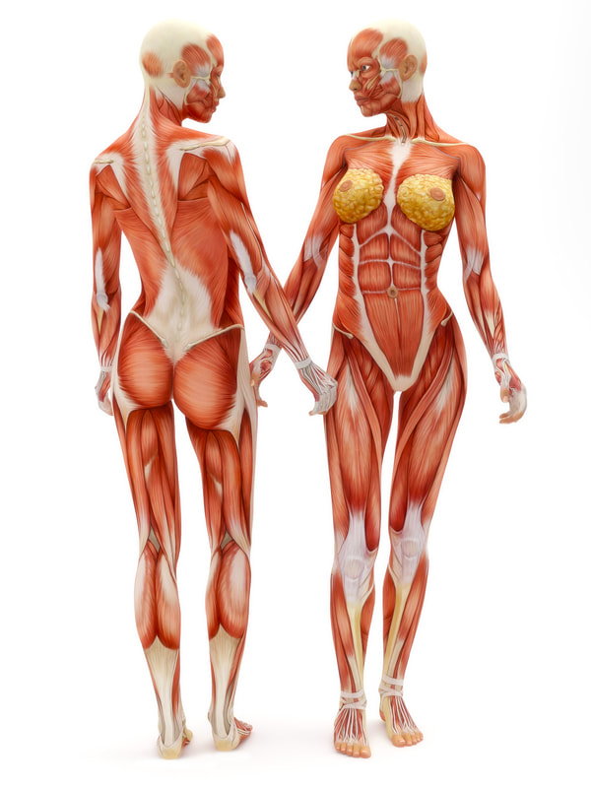
Terms Relating to Areas of the Body
 | Abdominal – Abdomen Cranial – Skull Digital – Fingers and toes Femoral – Thigh Gluteal – Buttock Inguinal – Groin Lumbar – Loin Mammary – Breast Nasal – Nose Pectoral – Chest Thoracis – Chest Ventral – Stomach

Slide 26
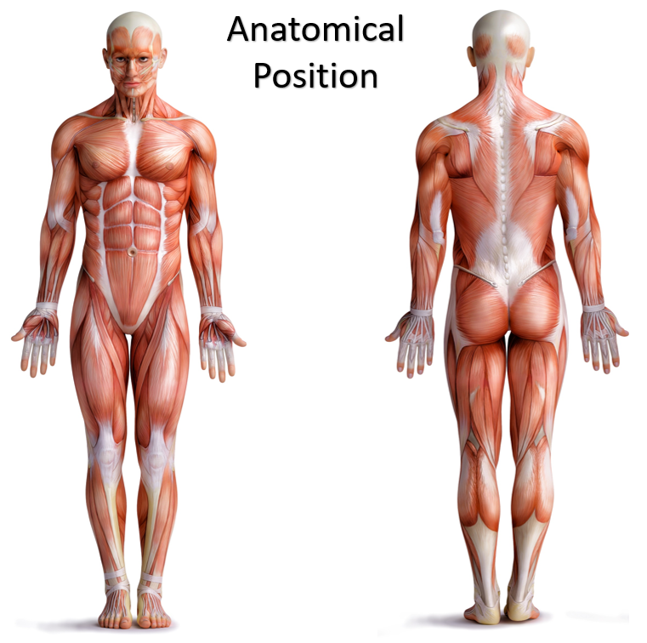
Anatomical position
  All references to the body are made as if the body is in this position so when you describe something as being above something else it is always with respect to the body being in anatomical position.

Slide 27
Anatomical position
Anatomical position is described as the body facing you, feet placed together and flat on the floor.
The head is held erect, arms straight by the side with palms facing forward.

Slide 28
Anatomical position
Also, the “right side” of the body, refers to the patient’s right side. The “left side” of the body, refers to the patient’s left side.
https://time.com/5507319/medical-errors-documentary/

Slide 29
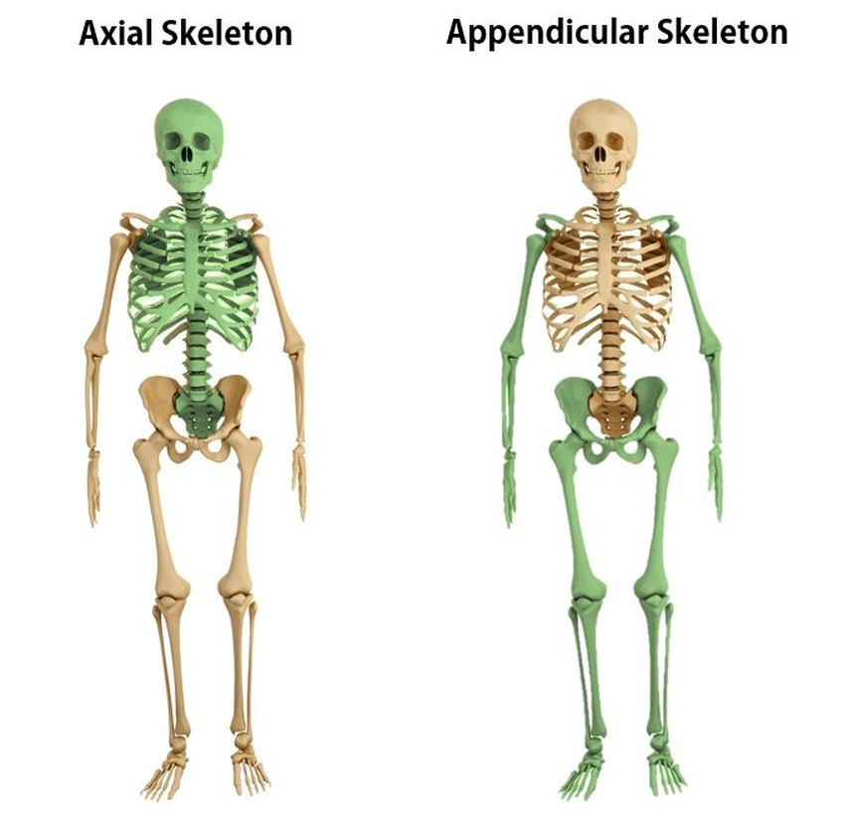
Regional Terms
Regional terms are the names of specific body areas.
The fundamental divisions of the body are
  The axial region - makes up the main axis of the body, consists of the head, neck, and trunk.
    The trunk, in turn, is divided into the thorax (chest), abdomen, and pelvis
    The trunk also includes the region around the anus and external genitalia, called the perineum (per ı˘-neum; “around the anus”).
  The appendicular region - consists of the limbs, which are also called appendages or extremities.

Slide 30
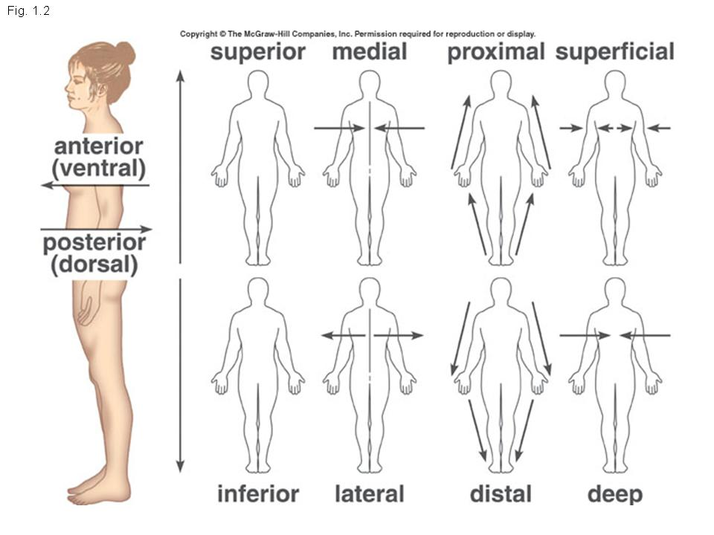
Anatomical
Directions
Anterior (Ventral) – toward the FRONT.
Posterior (Dorsal) – toward the BACK.

Slide 31
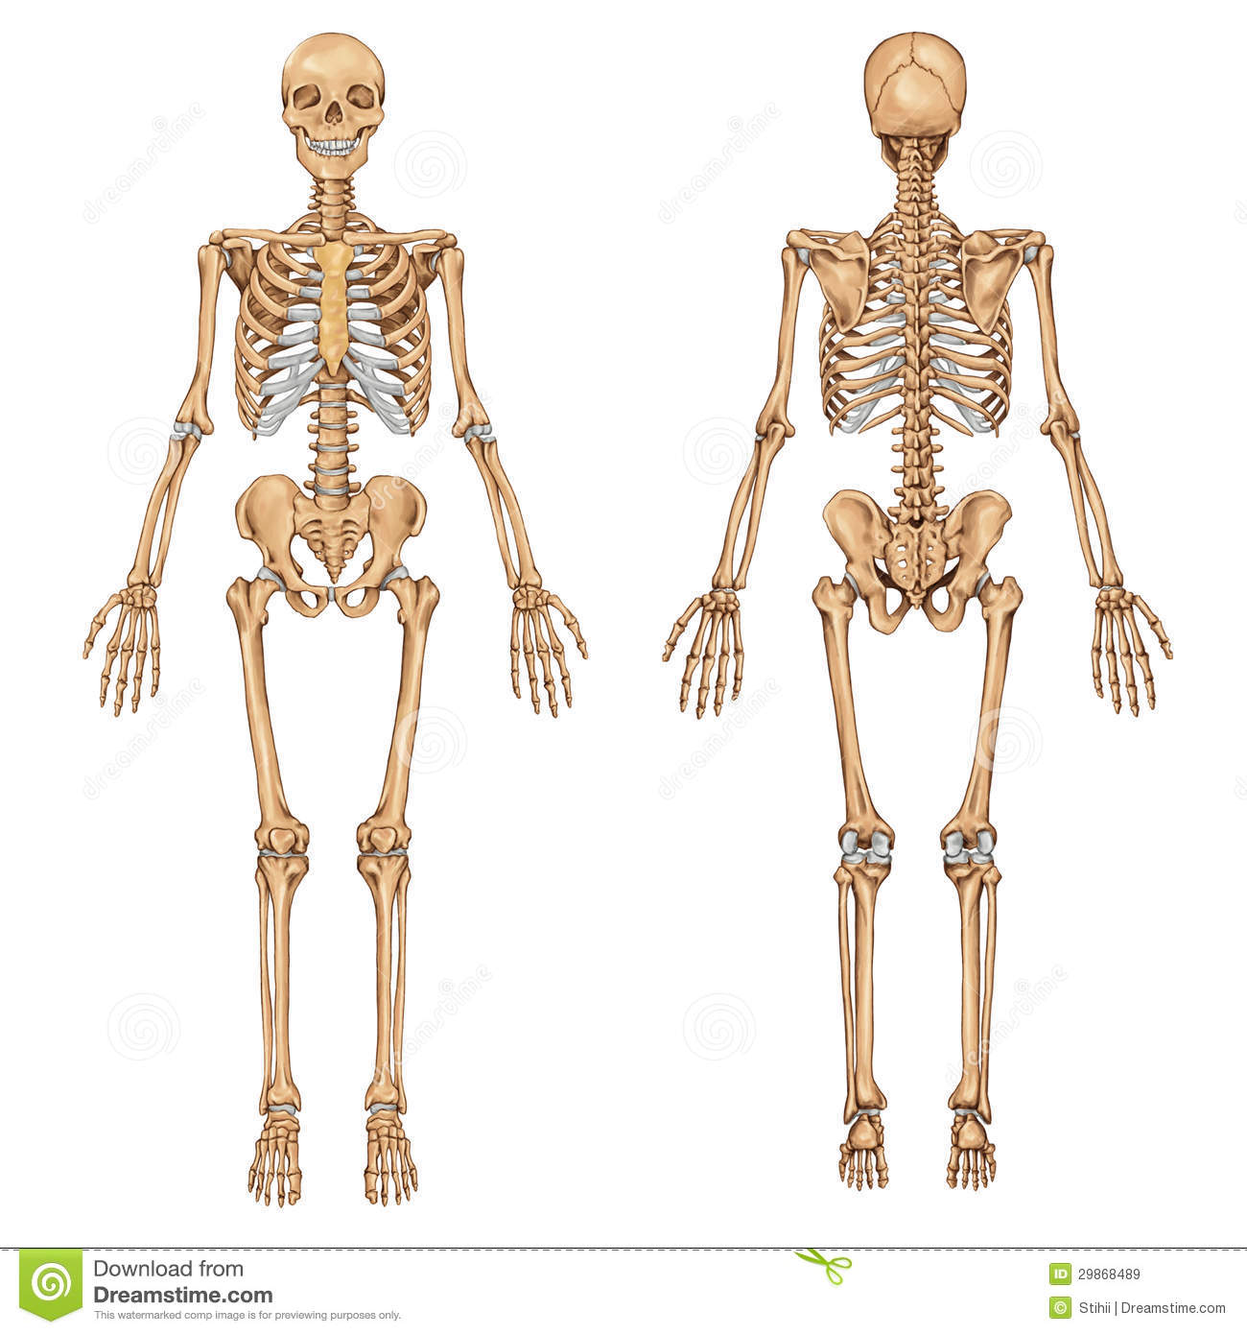
Anatomical Views
Anterior View or Ventral view
Anterior View or ventral view – Viewed from the front
Posterior View or dorsal View – Viewed from the back.
Posterior View or Dorsal View

Slide 32
Anatomical
Directions
Superior (cranial) – toward the TOP.
Inferior (caudal) – toward the BOTTOM.

Slide 33
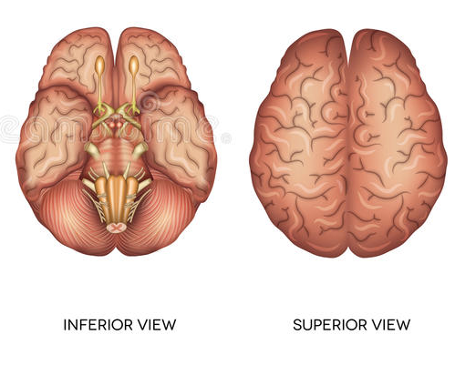
Anatomical
Views
Superior View – Viewed from the TOP.
Inferior View – Viewed from the BOTTOM.

Slide 34
Anatomical
Directions
Proximal – FURTHER AWAY FROM the core of the body (refers to points on a limb).
Posterior – CLOSER TOWARDS the core of the body (refers to points on a limb.

Slide 35
Anatomical
Directions
Superficial is near the surface (surface)
deep means to the core of the body -(internal)

Slide 36
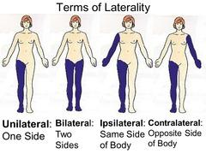
Lateral
Anatomical
Directions
Away from the midline of the body; on the outer side of The thumb is lateral to the pinky.
Unilateral – one side
Bilateral – both sides
Ipsilateral - On the same side
Contralateral – On the opposite side

Slide 37
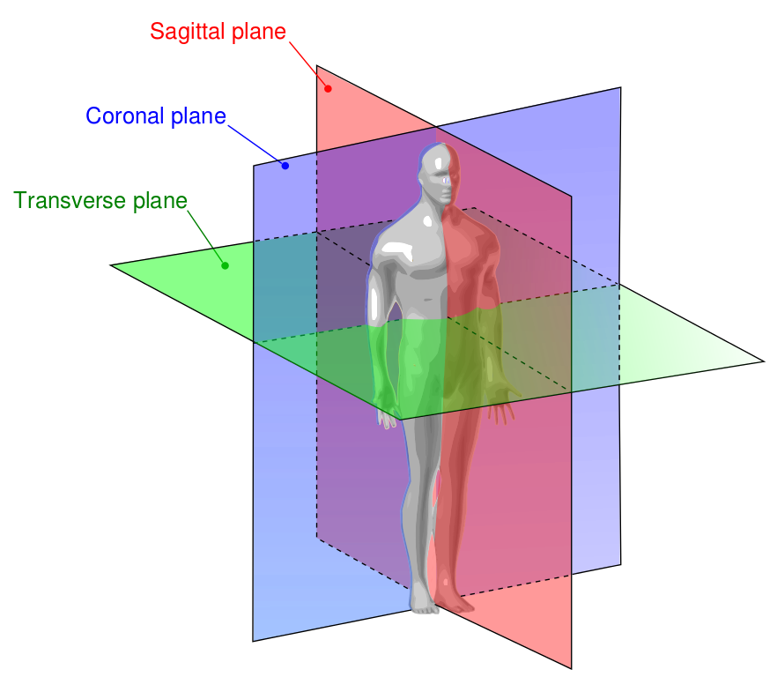
Anatomical Planes
It is important that the direction of the cut is known so that the proper orientation of the specimen is known.
  A heart looks very different if it is cut along its length as opposed to horizontally.

Slide 38
Anatomical Planes – Transverse / Cross Section
A horizontal cut is known as a transverse section or a cross section.

Slide 39
Anatomical Planes – Coronal/Frontal
A cut that divides the body or an organ into anterior (front) and posterior (back) parts is a coronal section or frontal section.

Slide 40
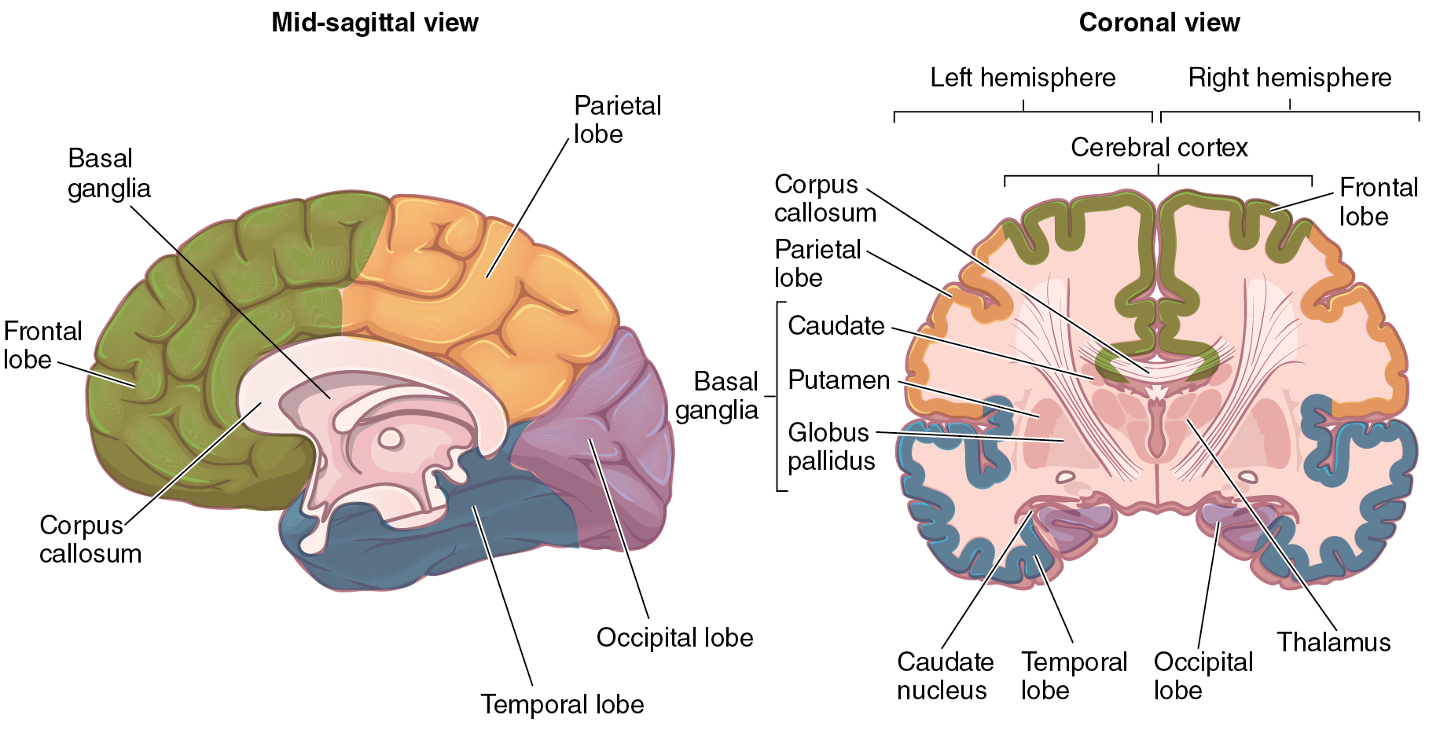
Anatomical Views – Coronal/Frontal View
A Coronal/Frontal View - An interior section viewed from the front.

Slide 41
Anatomical Planes – Sagittal
A cut that divides the body into a RIGHT and LEFT side is a sagittal section.

Slide 42
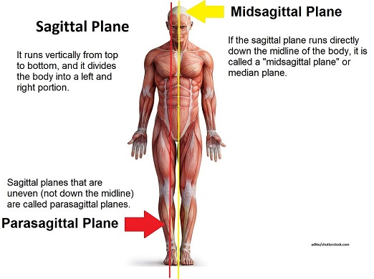
Anatomical Positions – Special/Specific Sagittal Planes
If the body is divided directly down the middle the section is known as a midsagittal section.
A midsagittal section is dividing the body into to equal left and right parts.
Parasagittal Plane is any sagittal plane off to one side (any sagittal plane other than the midsagittal plane).

Slide 43
Anatomical Views – Midsagittal View
A Midsagittal View is an interior midsagittal section viewed from the side.

Slide 44
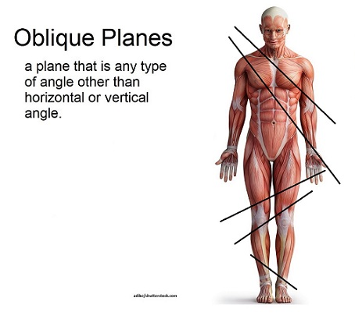
Cuts that lie diagonally between the horizontal and the vertical are called oblique sections.
They are difficult to interpret because the orientation of the view is not obvious. For this reason, oblique sections are seldom used.

Slide 45
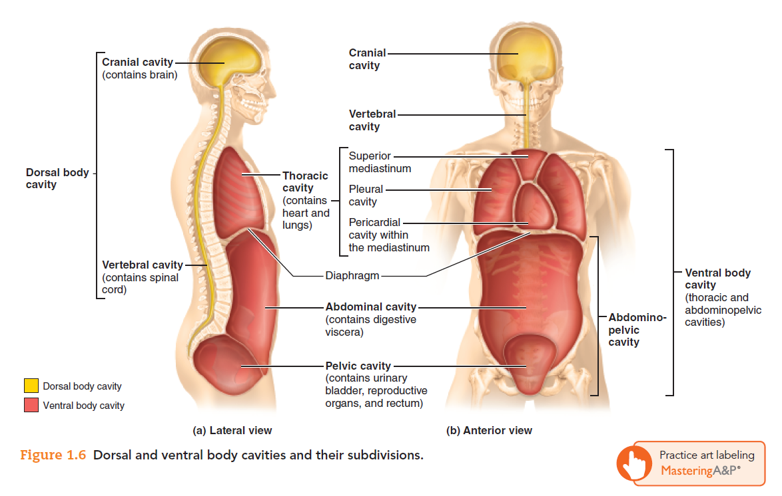
Body Cavities

Slide 46
Dorsal Body Cavity
The dorsal body cavity is subdivided into a cranial cavity, which lies in the skull and encases the brain, and a vertebral cavity, which runs through the vertebral column to enclose the spinal cord.

Slide 47
Ventral Body Cavity
The more anterior and larger of the closed body cavities is the ventral (anterior) body cavity.
The organs it contains, such as the lungs, heart, intestines, and kidneys, are called visceral organs or viscera.

Slide 48
Ventral Body Cavity
The ventral body cavity
has two main divisions:
(1) a superior thoracic cavity,
surrounded by the ribs and the muscles of the chest wall; and
(2) an inferior abdominopelvic cavity, surrounded by the abdominal walls and pelvic girdle.
  The thoracic and abdominal cavities are separated from each other by the diaphragm, a dome-shaped muscle used in breathing.

Slide 49
Thoracic
Cavity
The thoracic cavity has three parts:
(a) two lateral parts, each containing a lung surrounded by a pleural cavity
(b) a central band of organs called the mediastinum
  The mediastinum contains the heart surrounded by a pericardial cavity
  It also houses other major thoracic organs, such as the esophagus and trachea (windpipe).

Slide 50
Abdominopelvic
Cavity
The abdominopelvic cavity is divided into two parts.
The superior part, called the abdominal cavity, contains the liver, stomach, kidneys, and other organs.
The inferior part, or pelvic cavity, contains the bladder, some reproductive organs, and the rectum.

Slide 51
Abdominopelvic
Cavity
The abdominal cavity and the pelvic cavity are continuous with each other
  not separated by any muscular or membranous partition.

Slide 52
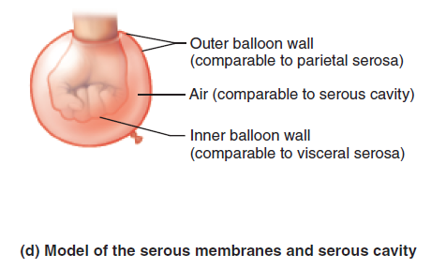
Serous Membranes
The Parietal Serosa - The part that forms the outer wall of the cavity
The Visceral Serosa – The part that forms the inner wall of the cavity and covers the visceral organs.

Slide 53
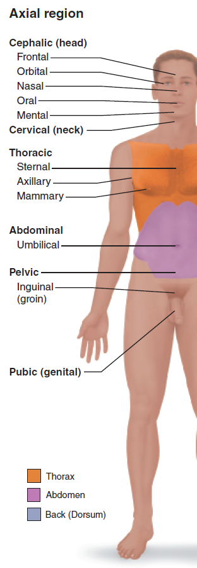
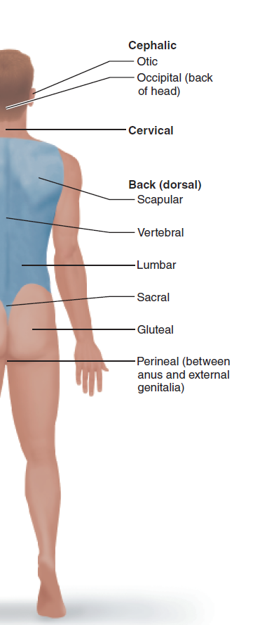

Slide 54
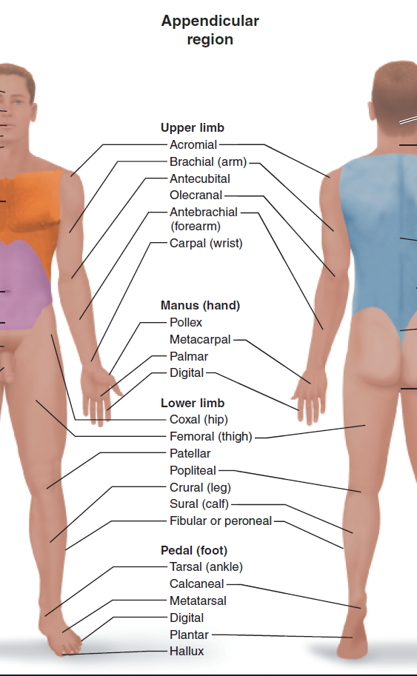


Slide 55
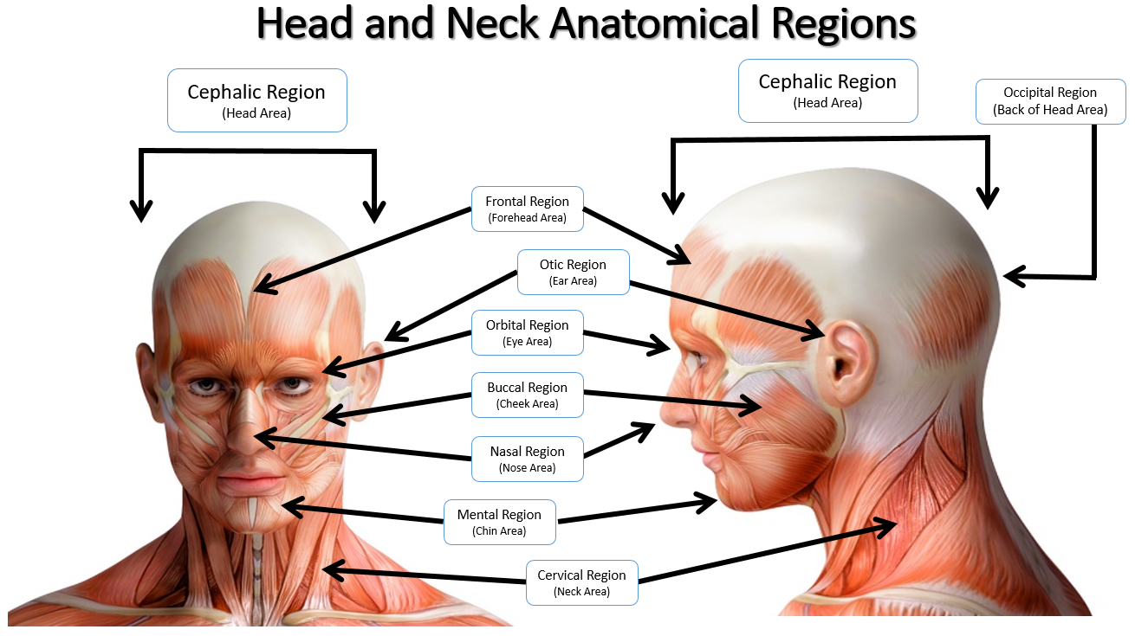

Slide 56
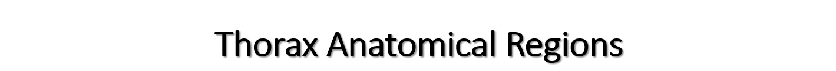
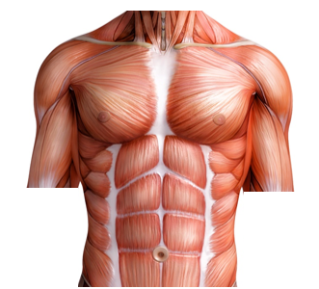
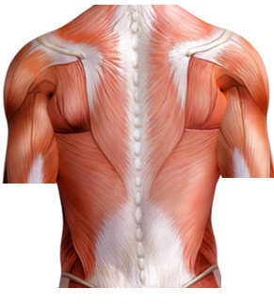
Mammary Region
(Breast Area)
Vertebral Region
(Spine Area)
Acromial Region
(Shoulder Area)
Scapular Region
(Shoulder Blade Area)
Axillary Region
(Armpit Area)
Sternal Region
(Breast Bone)
Abdominal Region
(Stomach Area)
Thoracic Region
(Chest Area)
Axillary Region
(Armpit Area)
Umbilicus Region
(Belly Button Area)
Lumbar Region
(Lower Back Area)

Slide 57
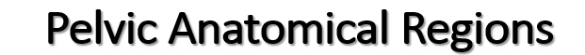
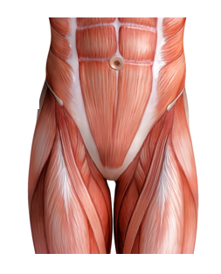
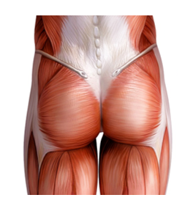

























Lumbar Region
(Area of Lower Back)
Pelvic Region
(Pelvis Area)
Sacral Region
(Area of Lower Tail Bone)
Coxal Region
(Hip Area)
Inguinal Region
(Groin Area)
Gluteal Region
(Buttocks Area)
Pubic Region
(Genitals Area)
Perineal Region
(Area Between Genitals and Anus)

Slide 58
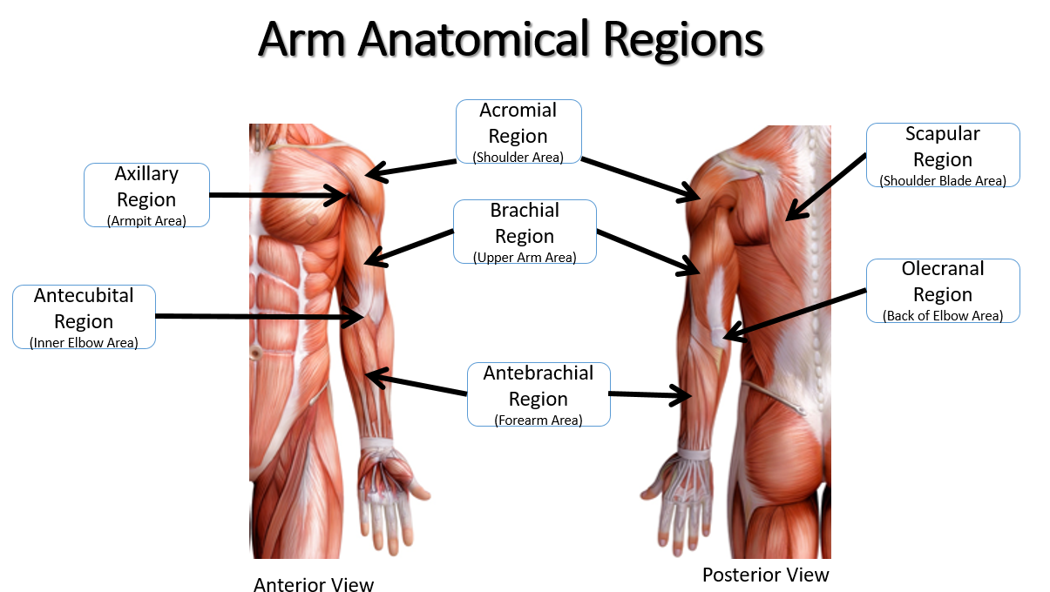

Slide 59
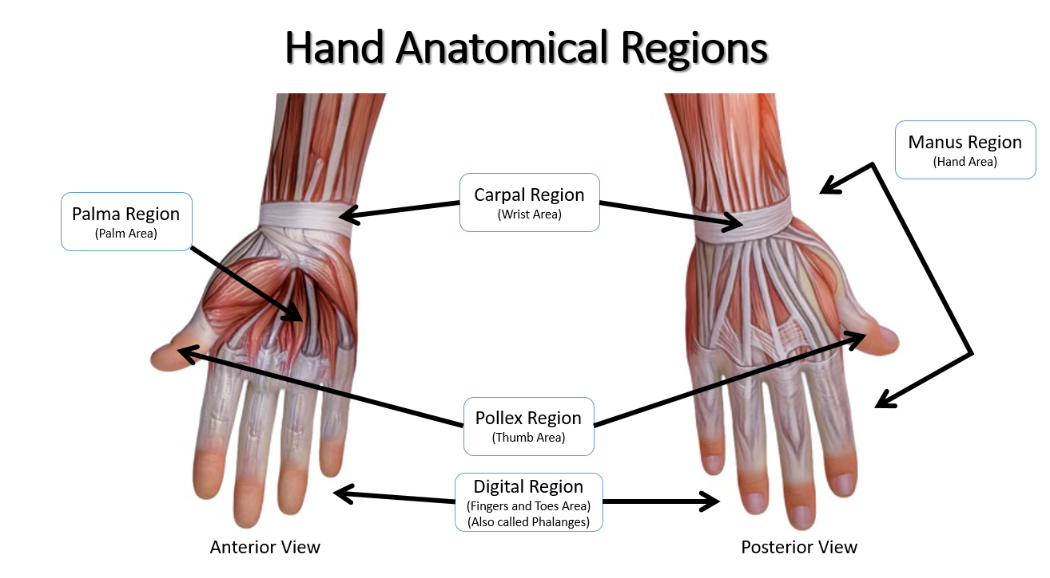

Slide 60
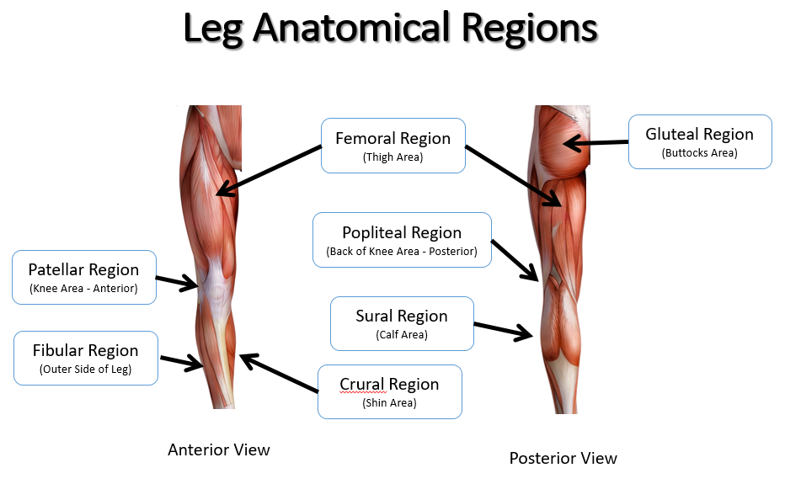
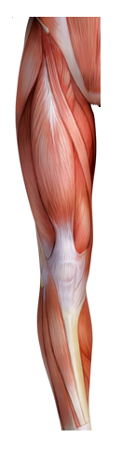
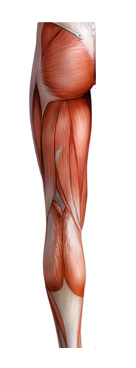
Crural Region
(Shin Area)
Crural Region
(Shin Area)

Slide 61
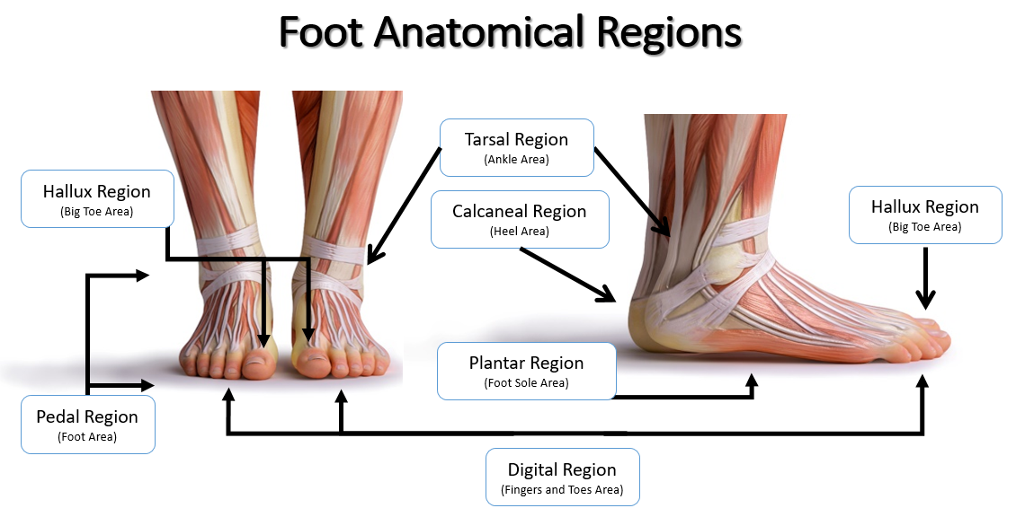

Slide 62
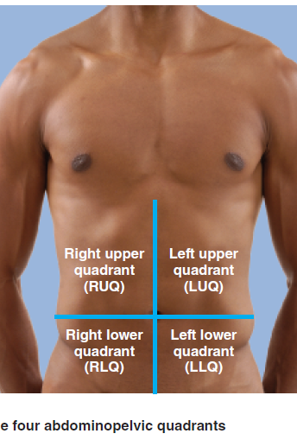
Abdominal Quadrants
The abdomen is divided into four quadrants by drawing one vertical and one horizontal plane through the navel.
  The right upper quadrant
  The left upper quadrant
  The right lower quadrant
  The left lower quadrant

