Slide 1
The Skin
by Cynthia Anderson

Slide 2
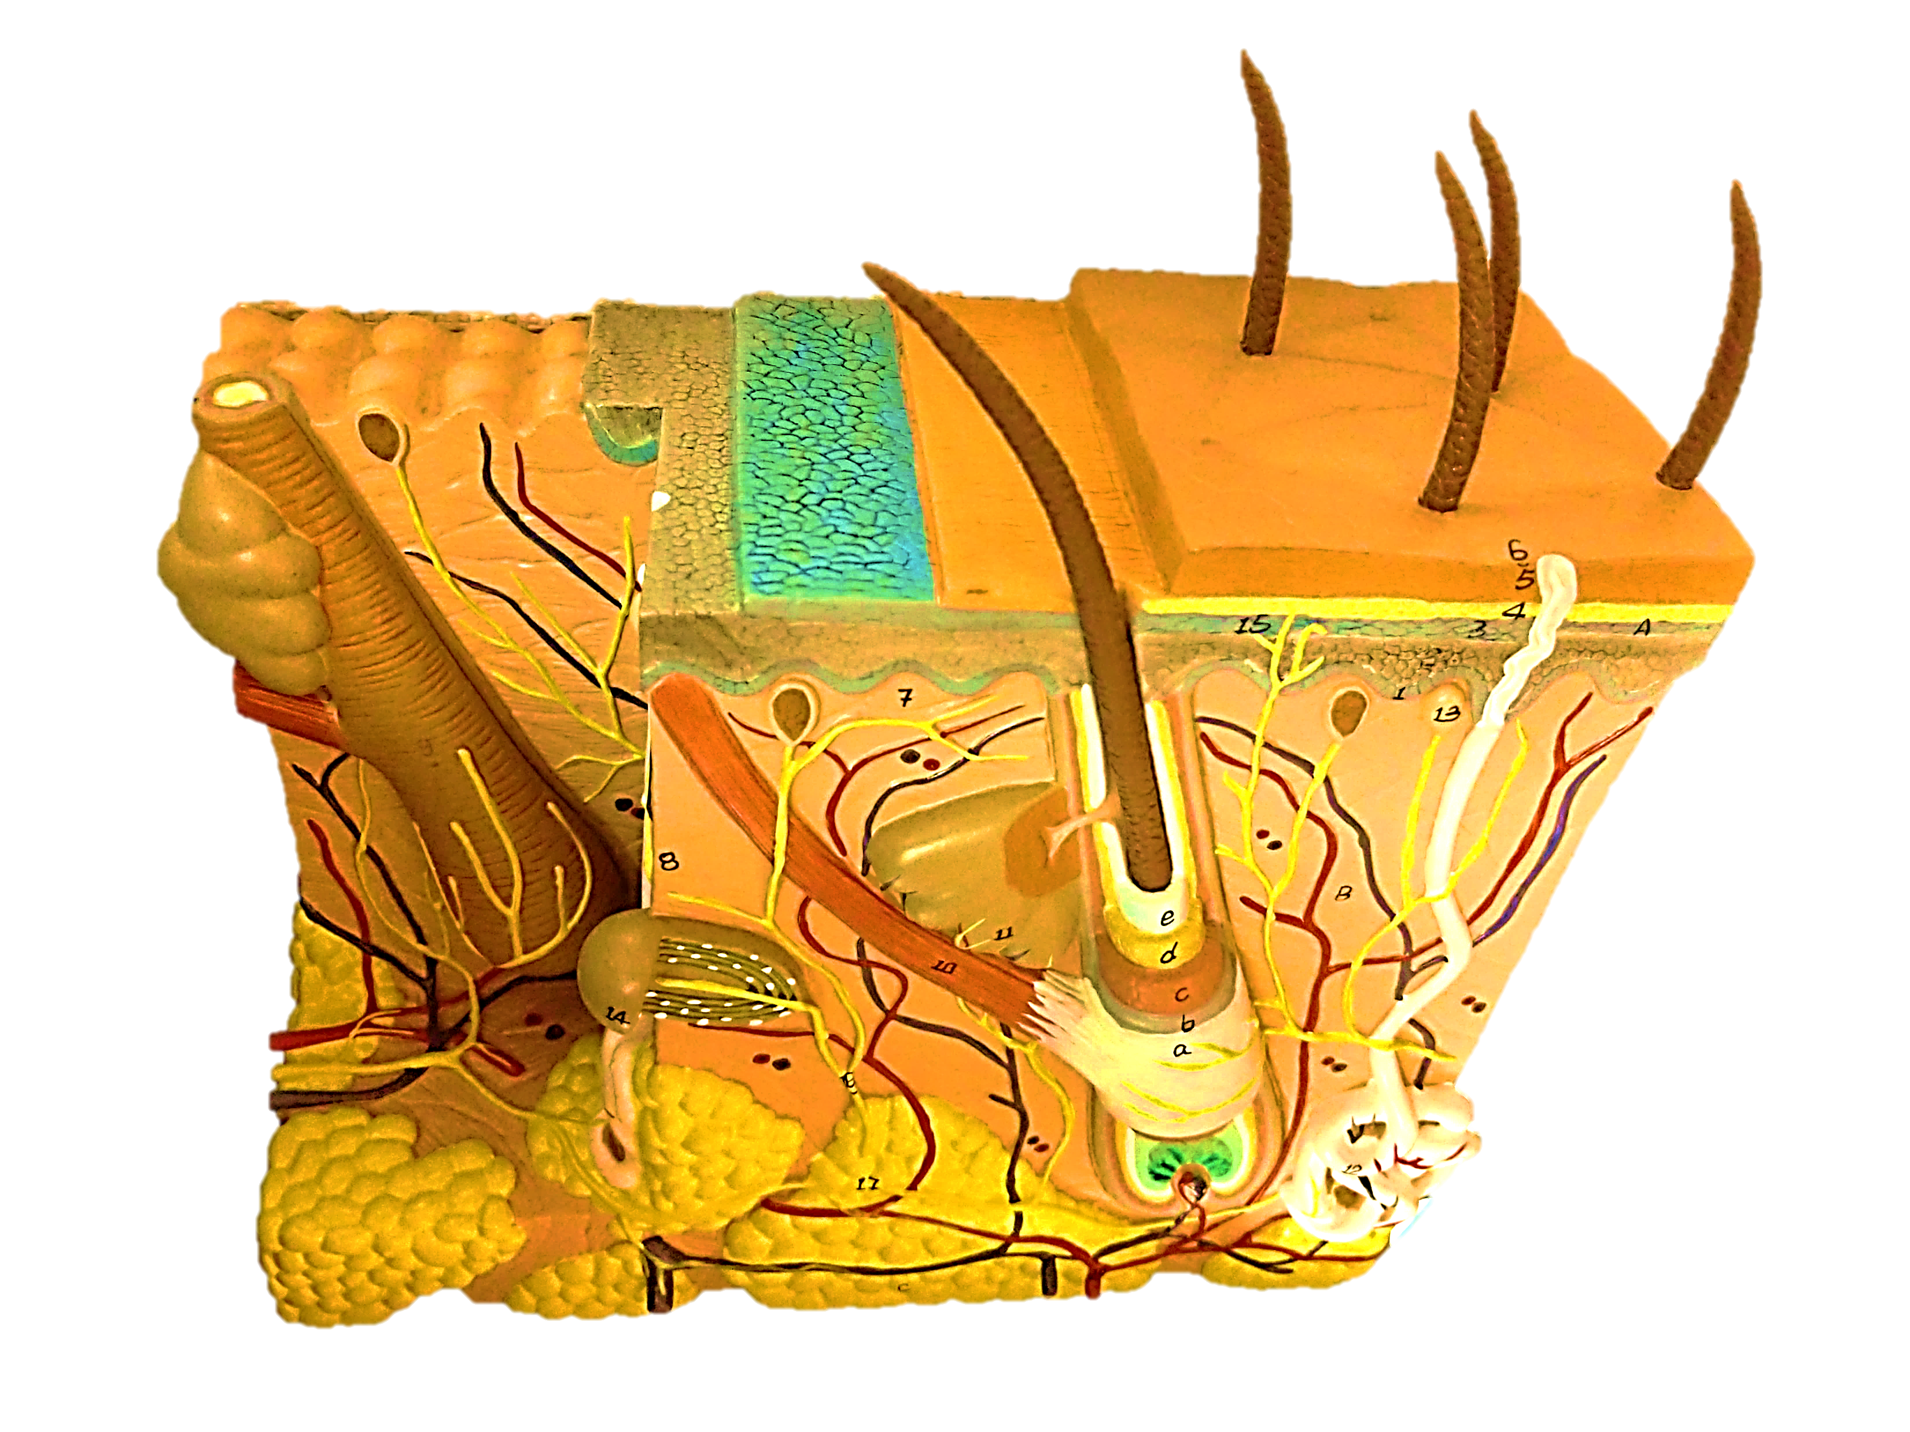
Stratum Spinosum
Stratum Granulosum
Stratum Cornuem
Stratum Lucidum
Stratum Basale
Papillae
Meissner’s Tactile Corpuscle
Sebaceous Gland
Sweat Pore
Arrector Pili
Hair Shaft
Hair Cuticle
Hair Root
Sudoriferous Duct
Sweat Gland
Sebaceous Gland
Hair Papilla
Adipose
(subcutaneous fat)
Pacinian Corpuscle
Arrector Pili

Slide 3
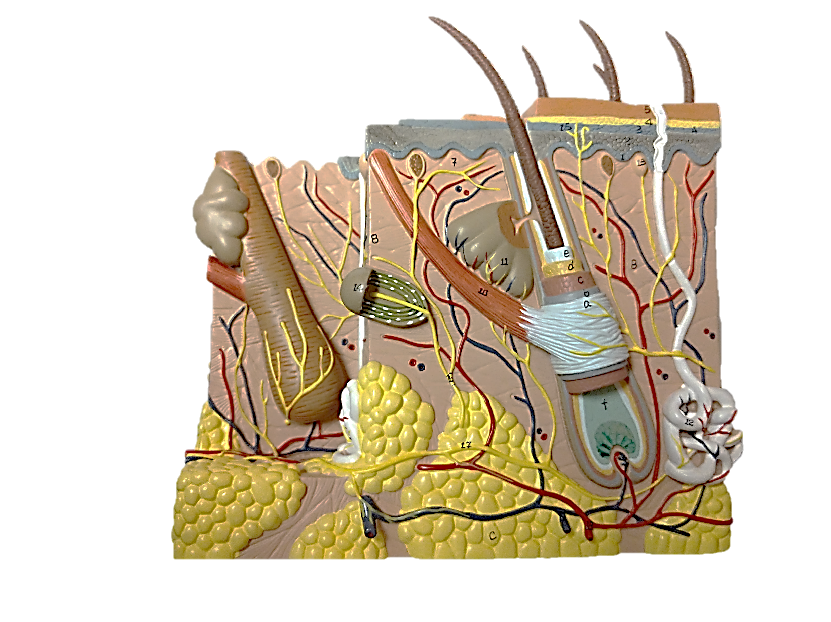
Meissner’s Tactile Corpuscle
Sweat Pore
Sebaceous Gland
Stratum Cornuem
Papillae
Stratum Lucidum
Stratum Granulosum
Epidermis
Stratum Spinosum
Stratum Basale
Sebaceous Gland
Hair Shaft
Arrector Pili
Hair Cuticle
Dermis
Sudoriferous Duct
Dermis
Arrector Pili
Sweat Gland
Hypodermis
Hair Bulb
Hypodermis
Adipose
(subcutaneous fat)
Pacinian Corpuscle
Hair Papilla
Hair Root

Slide 4
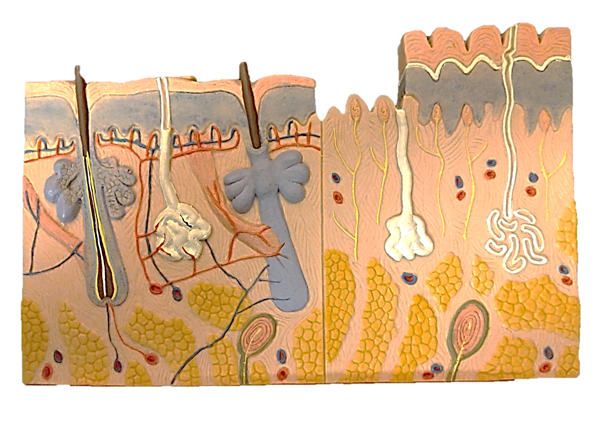
Meissner’s Tactile Corpuscle
Sweat Pore
Stratum Cornuem
Papillary Plexus
Papillae
Stratum Lucidum
Epidermis
Stratum Granulosum
Stratum Cornuem
Stratum Spinosum
Stratum Granulosum
Stratum Basale
Epidermis
Stratum Spinosum
Stratum Basale
Sudoriferous Duct
Sebaceous Gland
Dermis
Arrector Pili
Dermis
Sebaceous Gland
Sweat Gland
Hair Shaft
Hair Bulb
Arrector Pili
Hair Papilla
Hair Root
Hypodermis
Hypodermis
Adipose
(subcutaneous fat)
Pacinian Corpuscle
Pacinian Corpuscle

Slide 5
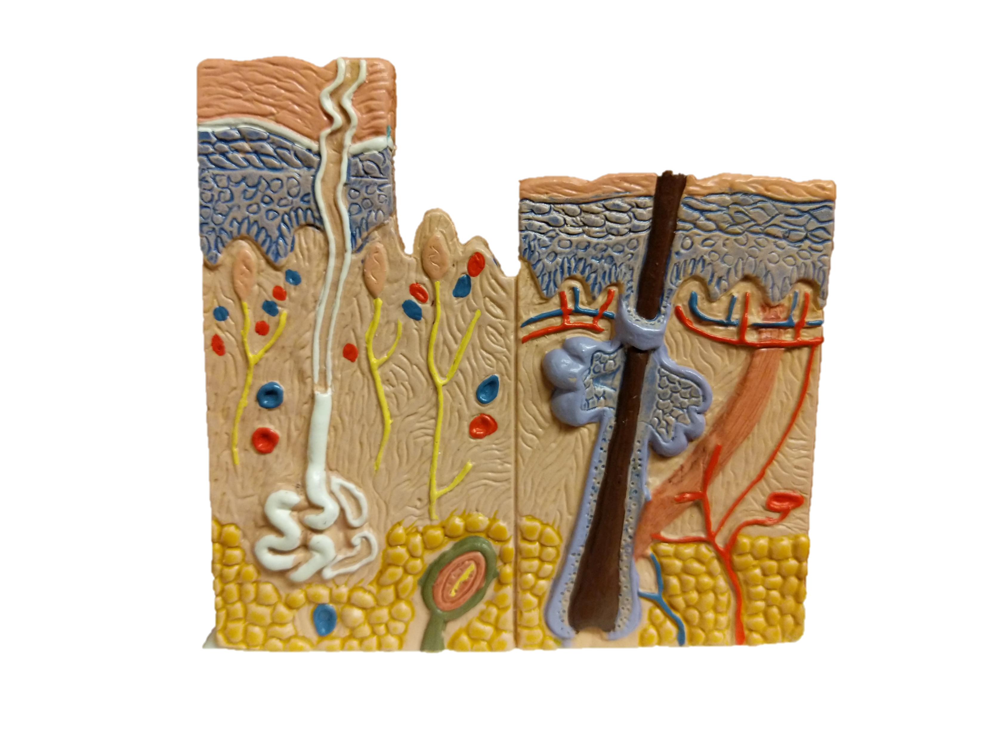
Sweat Pore
Stratum Cornuem
Hair Shaft
Papillae
Stratum Lucidum
Stratum Granulosum
Epidermis
Stratum Spinosum
Stratum Cornuem
Stratum Granulosum
Stratum Basale
Epidermis
Stratum Spinosum
Meissner’s Tactile Corpuscle
Stratum Basale
Papillary Plexus
Sudoriferous Duct
Arrector Pili
Sebaceous Gland
Sweat Gland
Free Nerve Ending
Hair Root
Hair Bulb
Adipose
(subcutaneous fat)
Pacinian Corpuscle
Hair Papilla

