Slide 1
Final Exam Study Guide

Slide 2
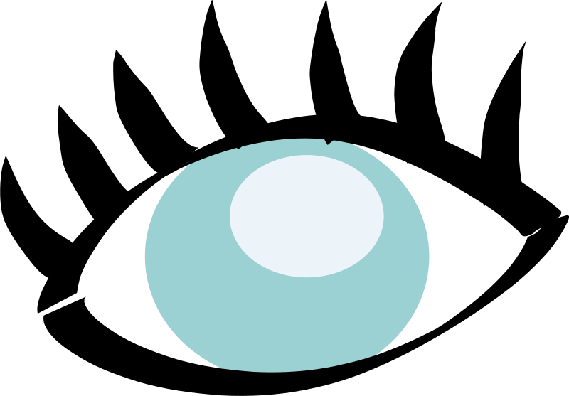
The Eye

Slide 3
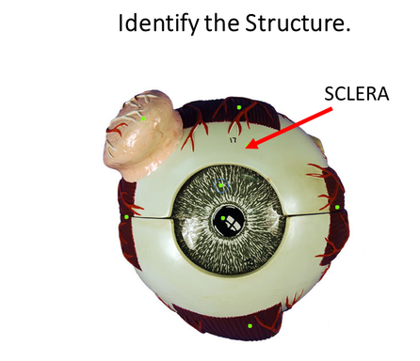
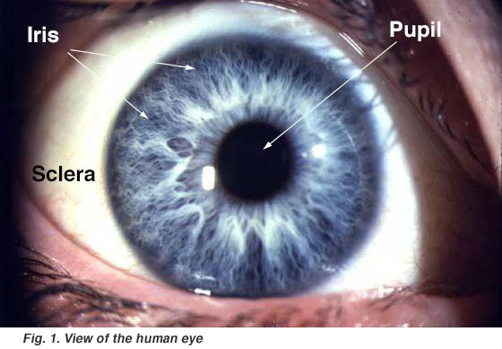
External Anatomy of the Human Eye
The sclera is the white protective outer layer of connective tissue that surrounds most of the eye (or globe).
It functions to
provide structure
protection
attachment for muscles

Slide 4
The pupil
The pupil is the dark circular part of the eye that functions to allow light to come into the eye.
The pupil is actually not black at all. In fact, it is a hole in your eye.

Slide 5
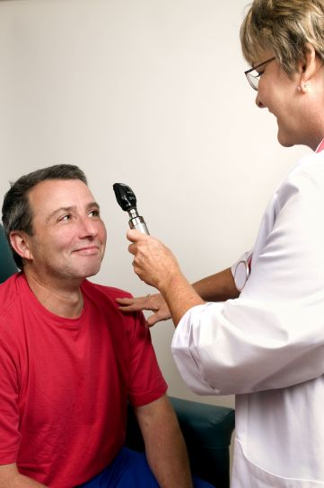
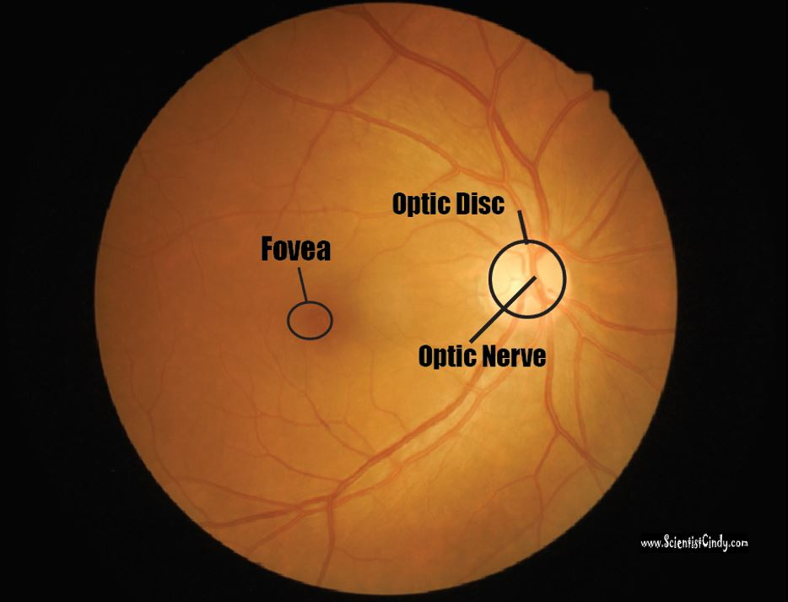
When your doctor looks into your eye either an ophthalmoscope, they are looking through your pupil and examining your retina at the back of your eye.

Slide 7
The iris is the colored portion of your eye. The iris acts as a diaphragm which becomes larger or smaller in order to adjust the amount of light going through the pupil. ​

Slide 8
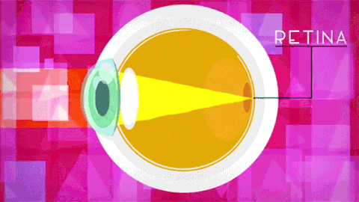
THE CORNEA
​The cornea is the clear anterior portion of the eye that is continuous with the sclera.
It covers the lens and the pupil.

Slide 9
THE CORNEA
​ The cornea and lens function to refract light, to focus the image on the retina at the back of the eye.

Slide 10
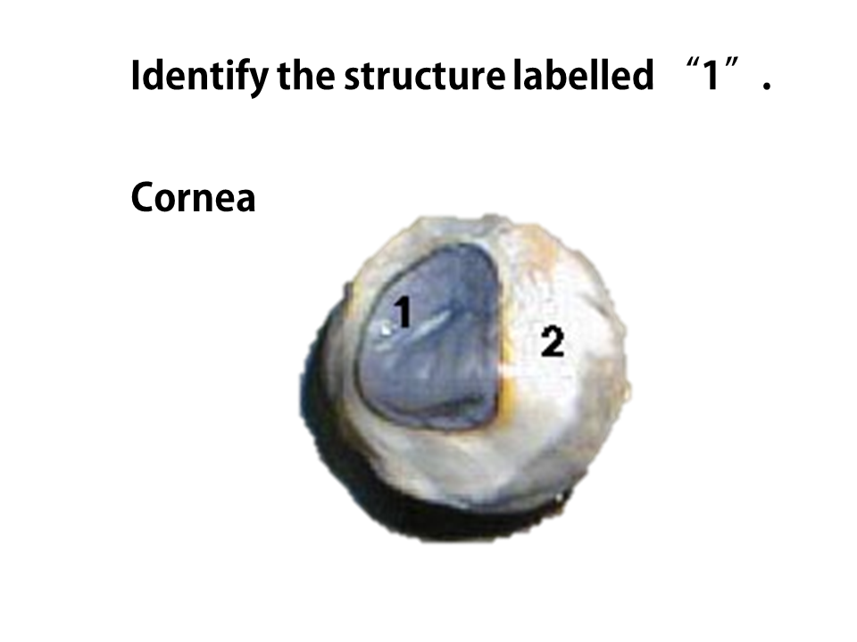
THE CORNEA
​ The cornea and lens function to refract (bend) light, to focus the image on the retina at the back of the eye.
While the cornea contributes most of the eye's focusing power, it does not have the ability to change shape, so its focusing power is 'fixed'. This means that only images that are at a certain distance will be in focus.
For this reason, the cornea functions along with the lens to accommodate images at different distances.

Slide 11
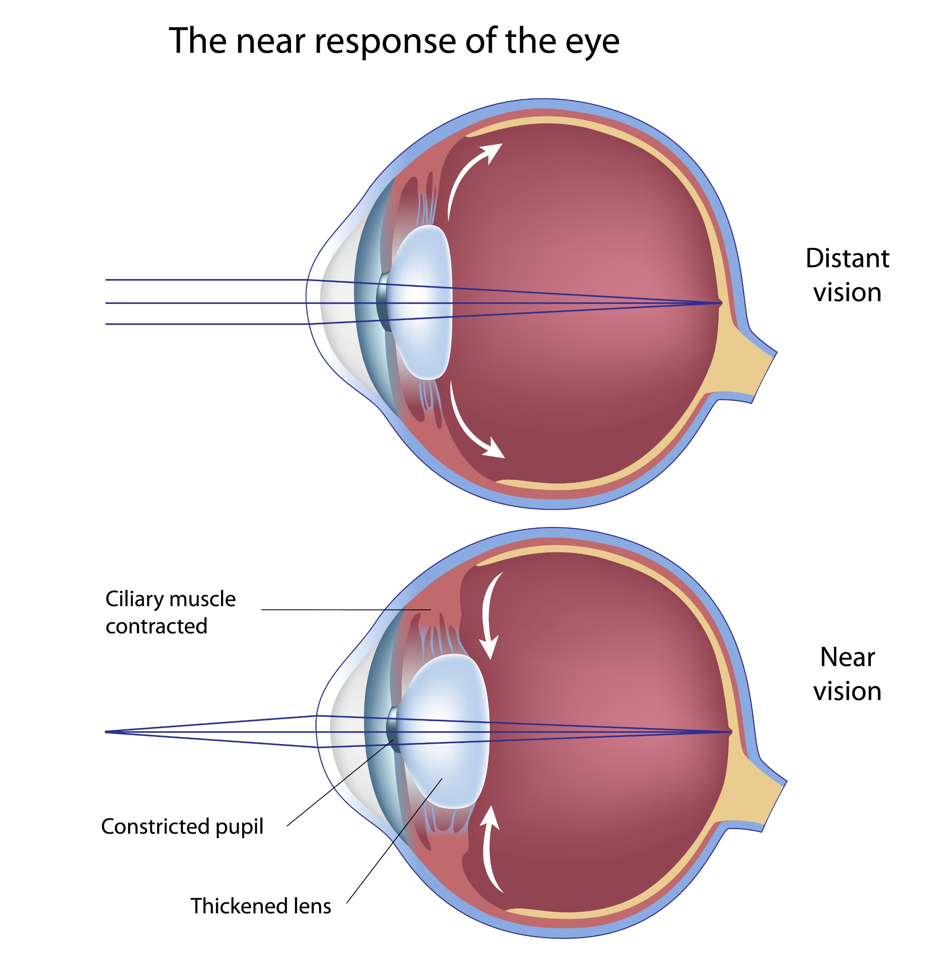
THE LENS
The lens is connected to the ciliary body, which has muscles.
The muscles of the ciliary body squeeze the lens to make it more convex.

Slide 12
Convex?
Curves
INWARD
Curves
OUTWARD
No
Curve
Neither Concave nor Convex
Concave
Convex

Slide 13
THE LENS
Less Convex Lens =
Muscles of the Ciliary Body are RELAXED.
Able to see DISTANT objects.
Light rays are bent LESS by the lens.

Slide 14
THE LENS
More Convex Lens =
Muscles of the Ciliary Body are CONTRACTED.
Able to see CLOSE objects.
Light rays are bent MORE by the lens.

Slide 15
Accommodation
https://www.youtube.com/watch?v=YcedXDN6a88

Slide 16
The Ciliary Body is a Sphincter Muscle (meaning it is ROUND).
When sphincter muscles CONTRACT, the Lens is Squeezed.

Slide 17
More Convex Lens =
Muscles of the Ciliary Body are CONTRACTED.
Able to see CLOSE objects.
Light rays are bent MORE by the lens.
Lens
Focal Point

Slide 18
The cornea a clear structure that covers the iris and pupil.
Images are upside down and reversed onto our retina.
Cornea
Focal Point
Lens

Slide 19
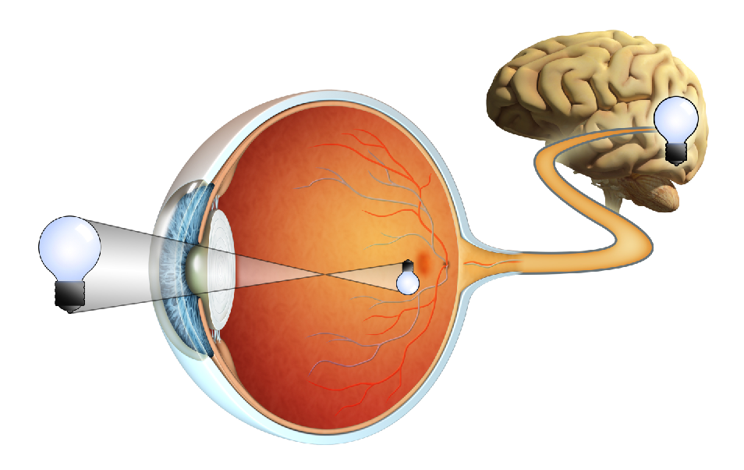
The cornea a clear structure that covers the iris and pupil.
Images are upside down and reversed onto our retina.

Slide 20
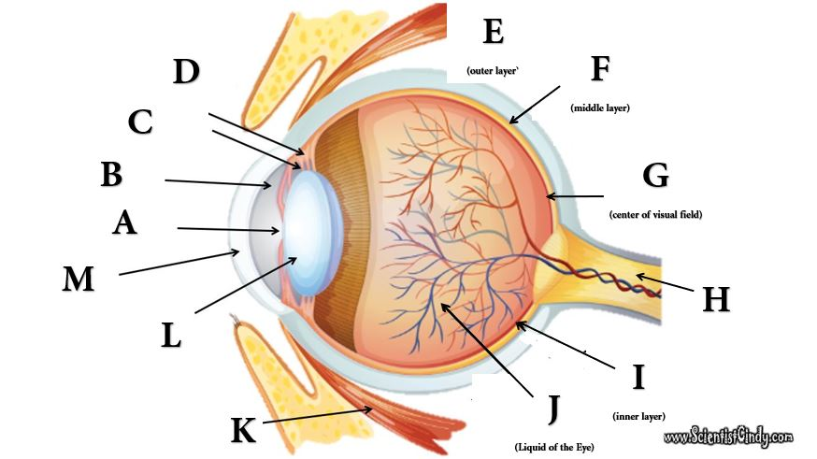
Can You Identify These Structures?

Slide 21
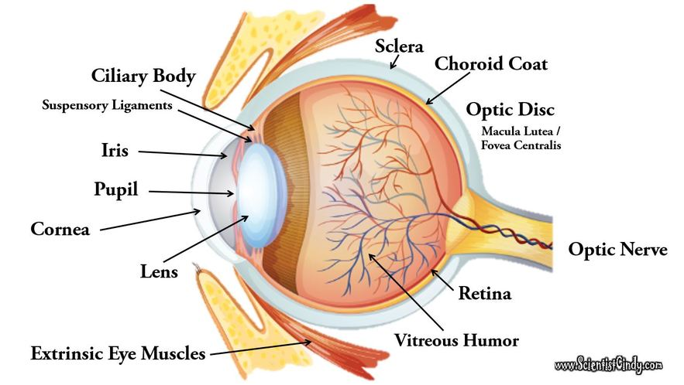

Slide 22
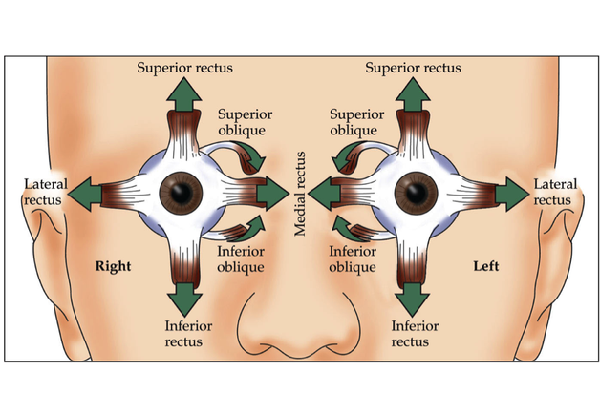
The six extrinsic eye muscles are as follows:
Superior and Inferior Rectus Muscles.
Lateral and Medial Rectus Muscles.
Superior and Inferior Oblique Muscle.

Slide 23
Muscles of the Eye
Muscle | Location | Function
Orbicularis Oris | Outer Rim | Squinting Blinking
Superior Rectus | Attached to Superior Sclera | Looking UP
Inferior Rectus | Attached to Inferior Sclera | Looking DOWN
Medial Rectus | Attached to Medial Sclera | Eye Looks Toward the Nose
Lateral Rectus | Attached to Lateral Sclera | Eye Looks Away From the Nose
Superior Oblique | Attaches to the superior medial Surface of the sclera | rotate the eyeball counter clock-wise to keep the eye from rotating when the rectus muscles are engaged
Inferior Oblique | Attaches to the superior medial Surface of the sclera | rotate the eyeball clock-wise to keep the eye from rotating when the rectus muscles are engaged

Slide 24
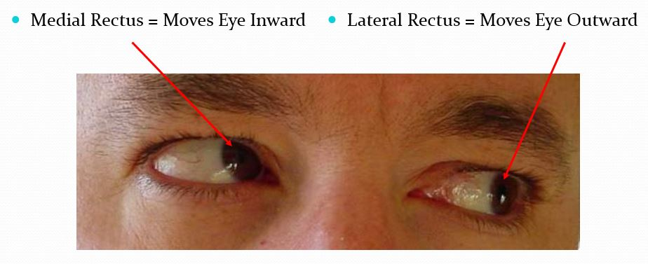
Medial and Lateral Rectus
The function of the rectus muscles of the eye allow the eye to look up, down, left and right.
The Lateral and Medial Rectus Muscles of the eyeball work in opposite ways to allow to you to look outward with one eye, while you look inward with the other eye.

Slide 25
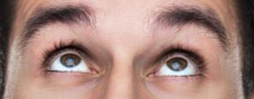
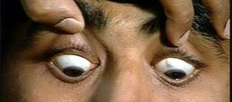
superior and inferior rectus muscles
The Superior Rectus muscles of the eyeball allow you to look UPWARDS! | The Inferior Rectus Muscles of the eyeball allow you to look DOWNWARD!

Slide 26
superior and inferior oblique muscles
The superior and inferior oblique muscles function to rotate the eyeball clock-wise and counter clock-wise to keep the eye from rotating when the rectus muscles are engaged.

Slide 27
Myopia – nearsightedness

Slide 28
Hyperopia – farsightedness

Slide 29
Color vision

Slide 30
3 kinds of cones: blue, green and red
Rods: Cones:
Can see in dim light Require more light
See in black and white See in color
Respond to movement Give best acuity
Found more in periphery More central, esp.
in fovea centralis

Slide 31
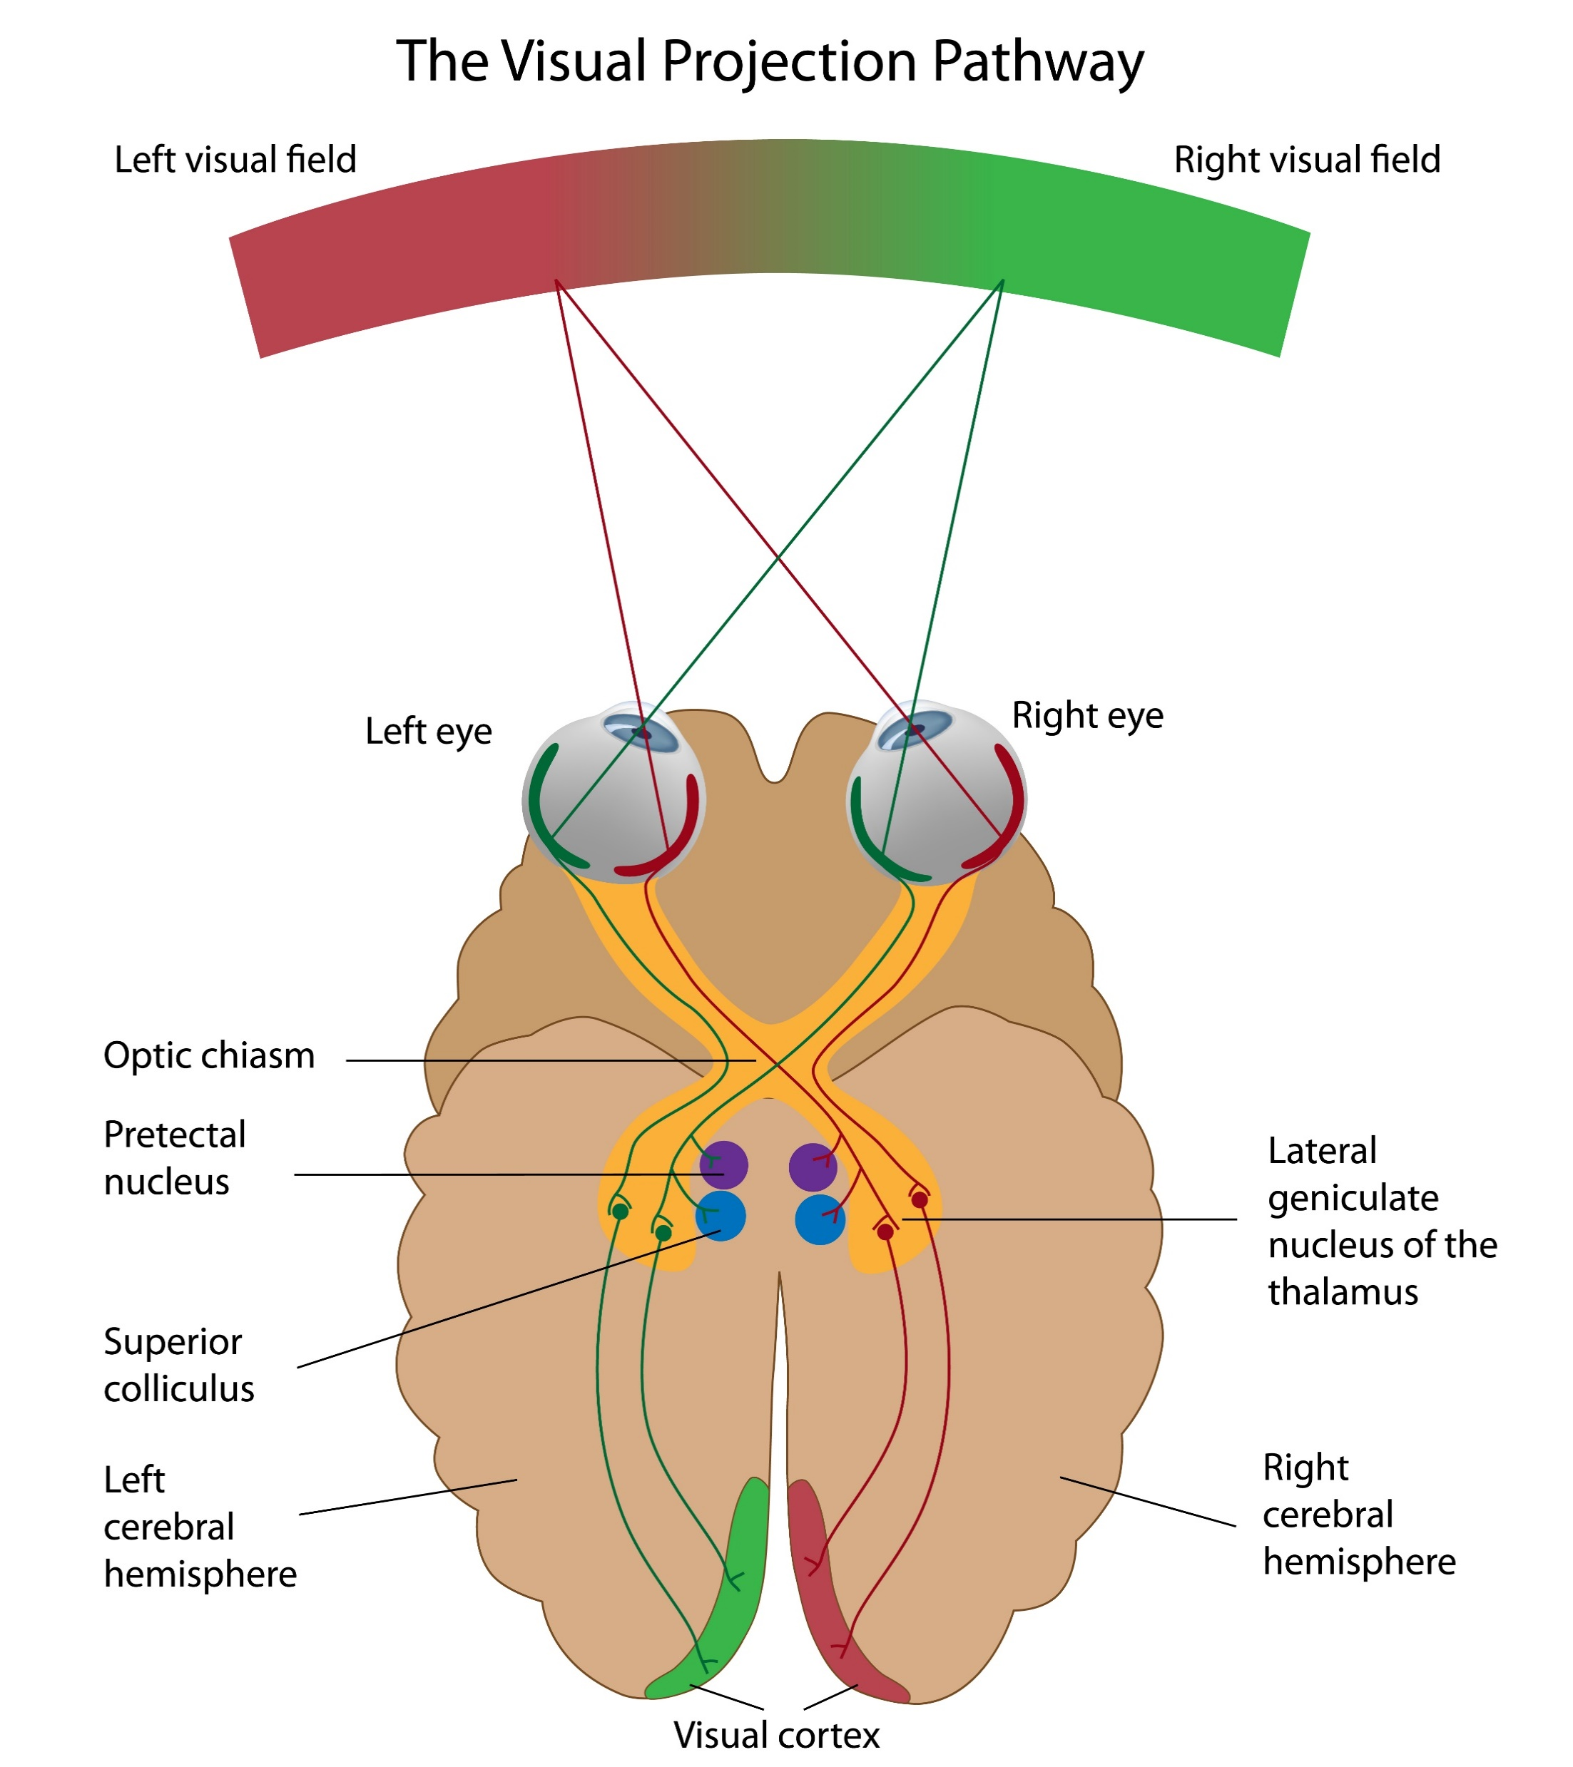
Nasal (medial) optic fibers cross at the optic chiasm
Temporal (lateral) fibers do not cross over

Slide 32
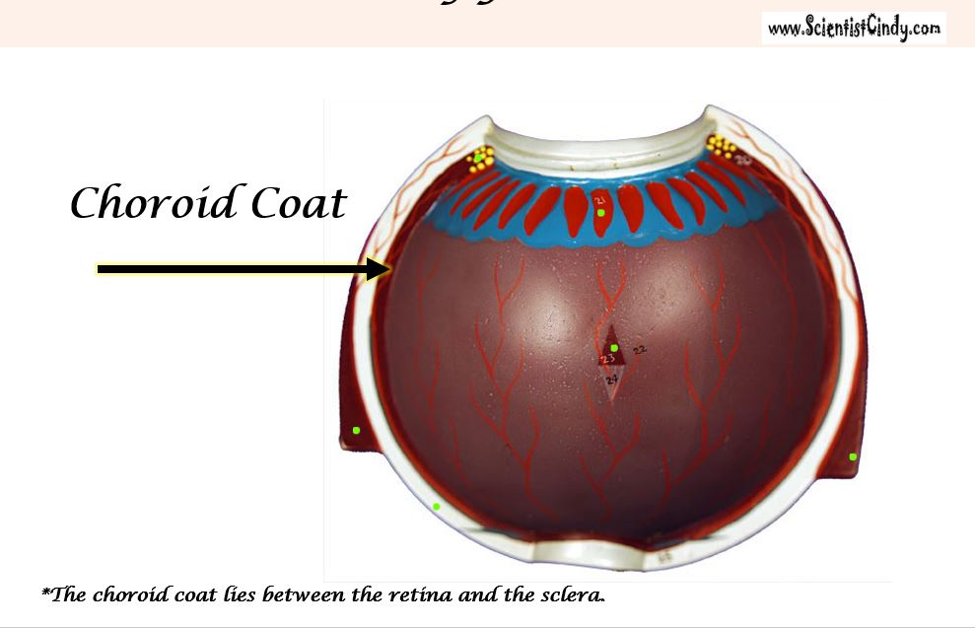
The choroid coat is a highly-vascularized layer of connective tissue that surrounds the eye. The choroid coat lies between the retina and the sclera. The function of the choroid coat is to provide oxygen and nourishment to the retina.

Slide 33
The Retina
The word 'retina' comes from the Latin word for 'net’.
The retina is the innermost layer located at the back of the eye.
The function of the retina is hold the photoreceptors.
The photoreceptors contain pigments that change shape when light hits them.

Slide 34
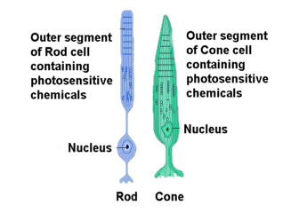
There are two types of photoreceptors; rods and cones.
Photoreceptors convert visual information into action potentials (nerve impulses) that will travel to the brain via the optic nerve.

Slide 35
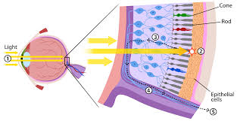
Rods are photo receptors that respond to levels of light (shades of black and white) and do not process any color information.
The rods make up the major portion of your peripheral vision and are very useful in low-light situations, such as driving at night.

Slide 36
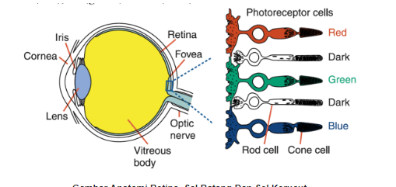
Your cones, however are able to process color information.
Cones dominate the central portion of your vision which focuses on the fovea.

Slide 37
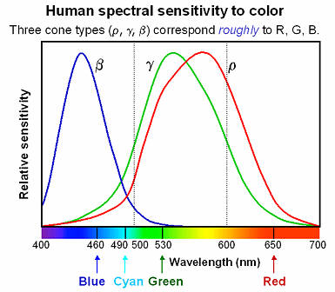
You have 3 types of cones, each specializing in either the RED, GREEN or BLUE, electromagnetic waves of the visible spectrum. -The combination of stimulation of these 3 cone types are able to give you all of the colors you see!

Slide 38
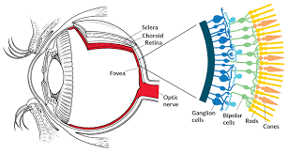
Layers of the Retina photoreceptors (rods and cones) , bipolar cells and ganglion cells

Slide 39
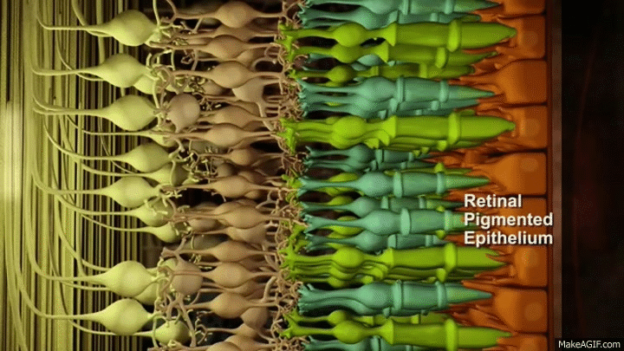
The optic nerve is made up of axons of the ganglion cells that make up the last layer of the retina.

Slide 40
The Optic Nerve
The visual information is gathered by the photoreceptors (the sensory cells of the retina), and processed and sent through the layers of the retina. The outermost part of the retina is made up of ganglion cells.
The axons of the ganglion cells make up the optic nerve.
The optic nerve functions to send the visual sensory information from the retina to the brain.

Slide 41
The point at which the optic nerve leaves the eye (globe) it forms the optic disc.
The optic disc is devoid of photoceptor so it forms our blind spot.

Slide 42
The Optic Disk
The point at which the axons of the ganglion cells leave the eye to form the optic nerve, is called the Optic Disc.
The Optic Disc is essentially a pathway from the eye to the brain.
This pathway is devoid of photoreceptors and creates a small "blind spot" in our visual field that we are normally completely unaware of!

Slide 43
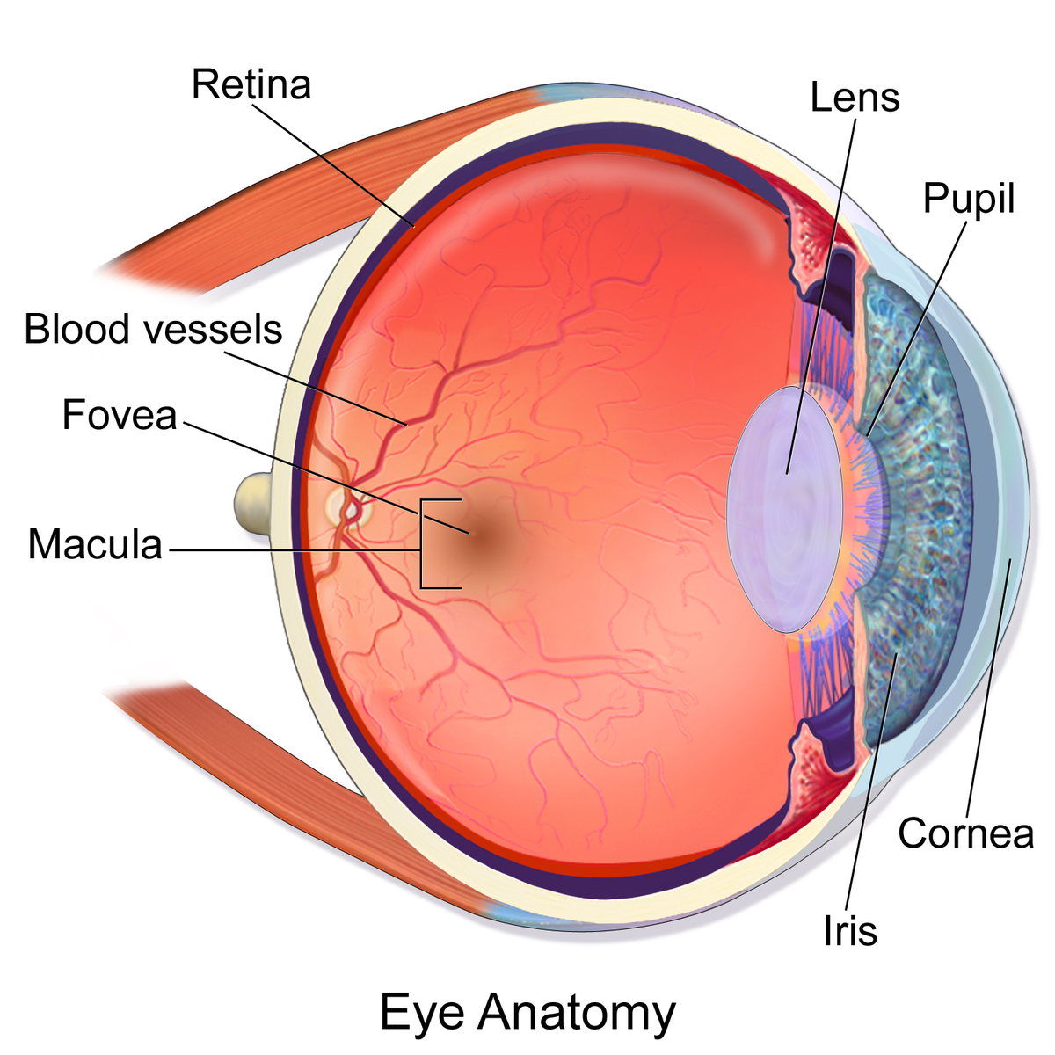
The center of your field of vision is the most clear. This is due to a part of the retina called the Fovea Centralis (which lies within a slightly larger region called the Macula Lutea)

Slide 44
The Fovea Centralis has the highest concentration of cones (cells that code for colored vision) than anywhere else in the retina.

Slide 45
The Ear

Slide 46
F
C
D
G
E
B
H
A
I
L
C
K
J

Slide 48
Your ear is the receptor organ responsible for the sensing auditory (hearing) and vestibular (equilibrium) information.
The ear has 3 main regions; the outer ear, the middle ear and the inner ear.

Slide 49
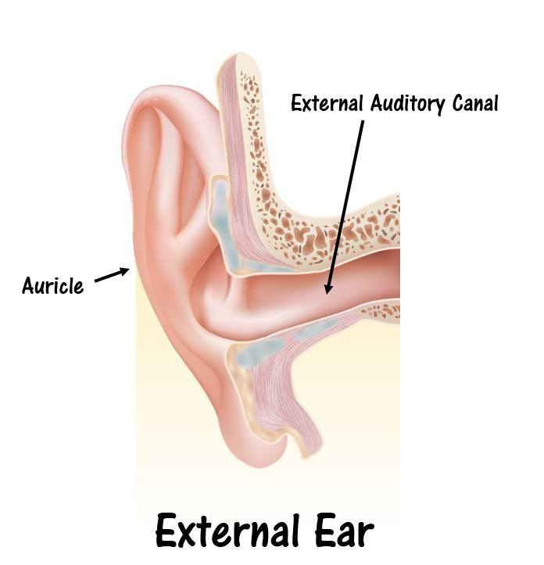
THE EXTERNAL EAR The outer ear (or the external ear) includes…
the auricle (pinna)
the external auditory canal (also known as the external auditory meatus) ​
Auditory sensory information is sensed by the outer and middle ear, whereas vestibular sensory information is sensed by the inner ear.

Slide 50
THE AURICLE, OR PINNA
It is the outward visible portion of the ear
The auricle of the ear is composed of elastic cartilage which gives it its unique flexibility.
The function of the auricle is to
gather auditory information from the outside world
funnel sound information into the external auditory canal (external acoustic meatus).

Slide 51
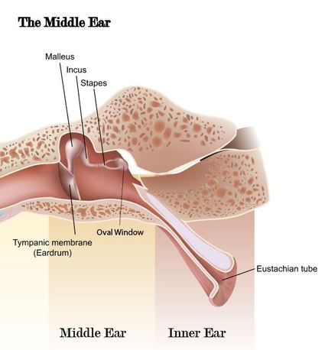
The Middle Ear
THE MIDDLE EAR The outer ear is separated from the middle ear by the ear drum or the tympanic membrane.
The middle ear begins at the tympanic membrane and ends at the oval window of the inner (or internal) ear.
The primary function of the middle ear is to transfer sound wave information from the air, to liquid waves in the cochlea.

Slide 52
The Middle Ear
The middle ear contains the 3 smallest bones of your body, called the ossicles, that lie in the hollow chamber of the middle ear, called the tympanic cavity. The term "ossicle" literally means "tiny bone".

Slide 53
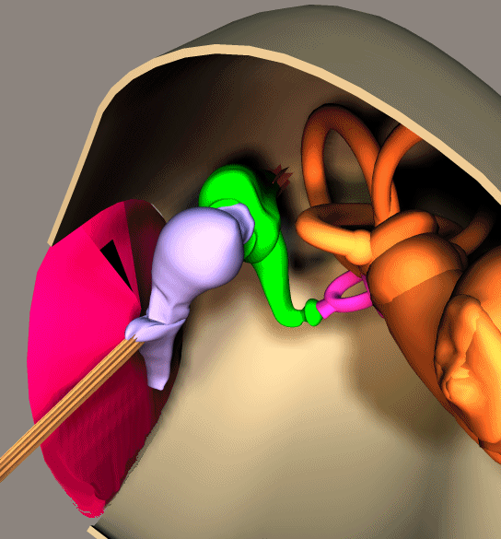
The middle ear
Tympanum is Latin for "drum".
It consists of a thin, translucent membrane.
Sound waves traveling through the external auditory canal reach the tympanic membrane, causing the membrane to vibrate.
These vibrations are transferred to the tiny bones (incus malleus and stapes) of your middle ear.

Slide 54
The middle ear
​ You have 3 auditory ossicles; the malleus (or hammer), the incus (or anvil) and the stapes (or stirrup). ​The middle ear thus serves to convert the energy from sound pressure waves to a force upon the liquid of the inner ear. The oval window is much smaller than the tympanic membrane, so the pressure induced by the stapes moving the oval window, causes the increase in pressure necessary to move the inner ear liquid. ​

Slide 55
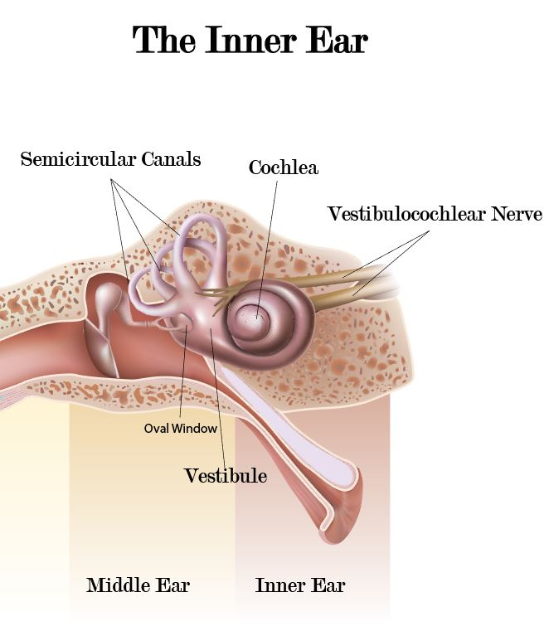
As the stapes moves the membrane of the oval window, the oval window, pushes against the liquid of the inner ear (called perilymph), which causes the liquid of the inner ear to move.

Slide 56
Eustachian tube
The middle ear also contains the auditory tube (or Eustachian tube).
The function of the auditory tube is to allow pressure to equalize between the middle ear and throat.
Eustachian tube

Slide 57
The inner ear (or internal ear) detects sensory information for sound and balance.
The inner ear has organs dedicated to sensing sound information and organs dedicated to balance or equilibrium.

Slide 58
The inner ear is composed of the vestibule, the semicircular canals, and the cochlea.

Slide 59
As the liquid of the cochlea is disturbed by movement of the round window, specialized hair cells pick up specific information about the tone, pitch and amplitude of the sound.

Slide 60
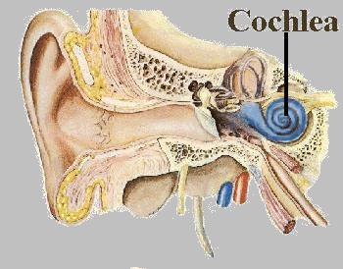
The cochlea's main function is to convert sound pressure patterns into electrochemical impulses to the brain via the auditory nerve (part of the vestibulocochlear nerve - Cranial Nerve XIII).
This Photo by Unknown Author is licensed under CC BY-SA

Slide 61
The Path of Sound Information
Sound waves are directed into the auditory canal via the pinna.
The sound waves travel through the external auditory canal and hit the tympanic membrane of the middle ear, causing it to vibrate.
In the middle ear, the vibrations of tympanic membrane cause vibrations of the three auditory ossicles.
The pressure waves move the malleus, which moves the incus, which then moves the stapes.
A portion of the stapes is connected to the oval window, so that as the stapes moves, the thin membrane of the oval window which connects to the inner ear. The middle ear essentially functions to convert the energy from sound pressure waves to a physical force on the fluid of the inner ear. In other words, it AMPLIFIES the signal!.
Hair cells in the cochlea send this sound information to the brain via the auditory nerve, which is part of the vestibulocochlear nerve (cranial nerve XIII).

Slide 63
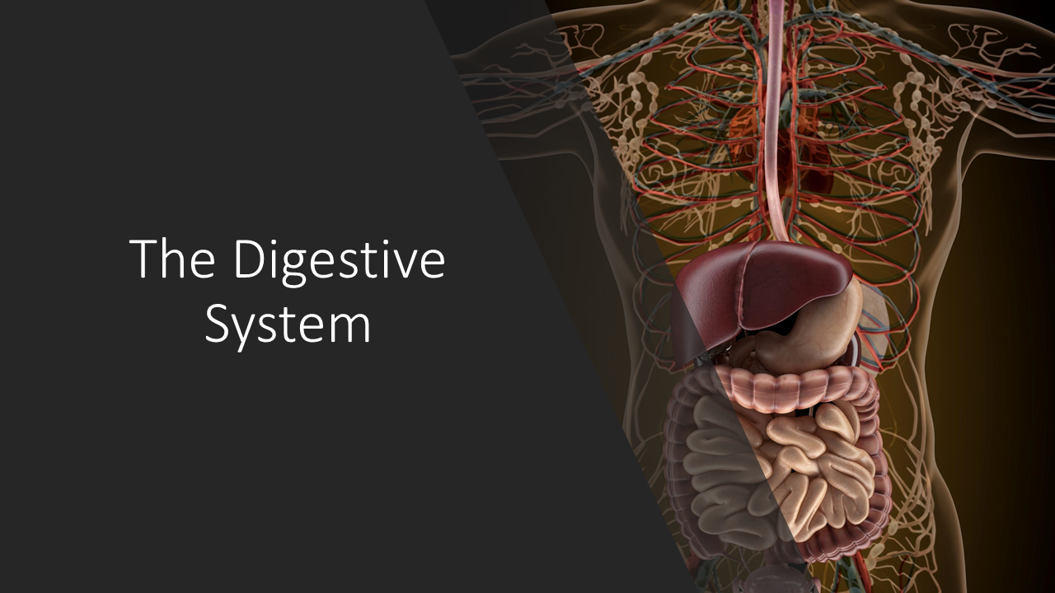
With Scientist Cindy

Slide 64
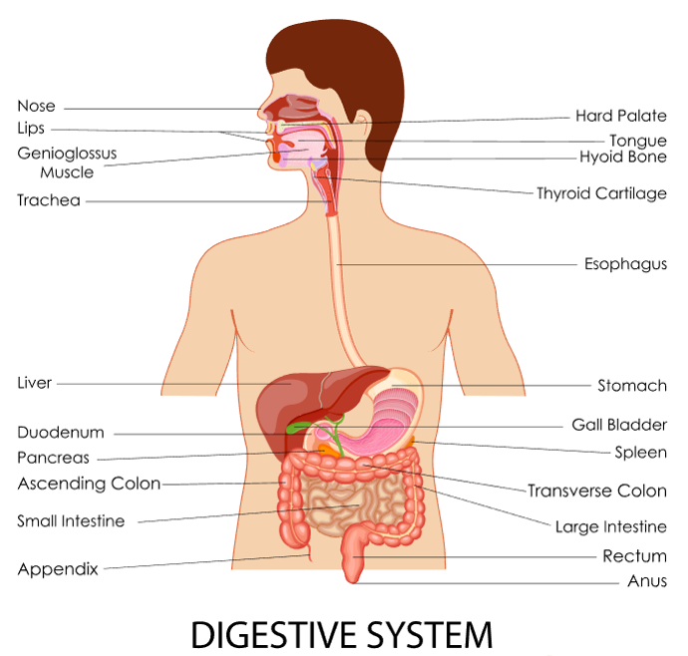
Your body is organized as a tube.
The inside of the alimentary canal is considered to be OUTSIDE of the body!

Slide 65
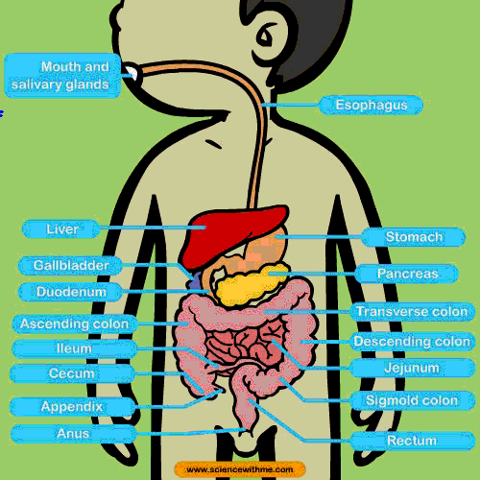
Functions of the Digestive System
Take in food
Break food up into nutrient molecules
Absorbing nutrient molecules into the circulatory system
Eliminating the indigestible waste

Slide 66
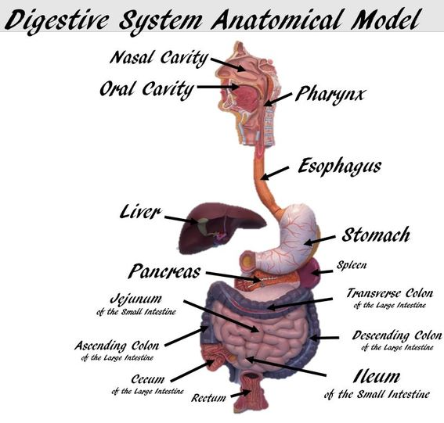
Anatomy of the Digestive System
The alimentary canal gets its names from a word meaning "nourishment". The alimentary canal is better known as the gastrointestinal (or G.I.) tract. The alimentary canal is a continuous tube lined with smooth muscle that extends from the mouth to the anus.

Slide 67
The organs that make up the alimentary canal are as follows:
Mouth
Pharynx
Esophagus
Stomach
Small Intestine (small bowel)
Large Intestine (large bowel)

Slide 68
The organs of the digestive system perform the following six activities:
Ingestion - taking of food into the mouth.
Propulsion - movement of food through the alimentary canal
Swallowing (voluntary)
Peristalsis - moves food through the alimentary canal by waves of involuntary contraction and relaxation of smooth muscle
Mechanical - the physical processes that break up larger pieces of food into smaller pieces.
Chewing
Churning - processes of the stomach
Peristalsis - Rhythmic contraction and relaxation (peristalsis) of smooth muscle of the small intestine.

Slide 69
The organs of the digestive system perform the following six activities:
Digestion - the chemical decomposition of carbohydrates, proteins, and lipids into their simpler building blocks (simple sugars, amino acids, and fatty acids or glycerol, respectively).
Digestion is carried out by digestive enzymes and other substances secreted by the accessory organs.
The processes of digestion take place in the lumen of the alimentary canal.
Absorption - the transportation of digested food from the lumen of the alimentary canal into the blood and lymphatic capillaries located in the wall of the canal.
Defecation - the elimination of indigestible substances (wastes) from the body as feces.

Slide 70
The digestive system is divided into two main groups: the alimentary canal and the accessory digestive organs.

Slide 71
ACCESSORY DIGESTIVE ORGANS
The digestive system includes the accessory digestive organs which are as follows:
Teeth
Tongue
Gallbladder
The Large Digestive Glands
The Salivary Glands
The Liver
The Pancreas
The accessory digestive organs function to secrete saliva, bile, and digestive enzymes, that assist to breakdown food. ​

Slide 72
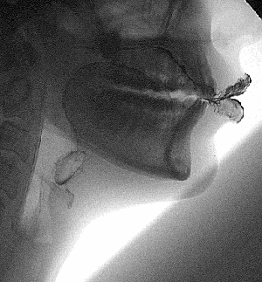
Food Enters the Body Through the Oral Cavity
​The oral cavity (or mouth) contains
The teeth, the cheek, the palate and the anterior portion of the tongue.
The opening of the mouth is referred to as the oral orifice.
The mouth functions to take in food and to contain structures needed for mastication.
It also houses the tongue to sense, taste and it assists in the formation of words and sounds for speech.

Slide 73
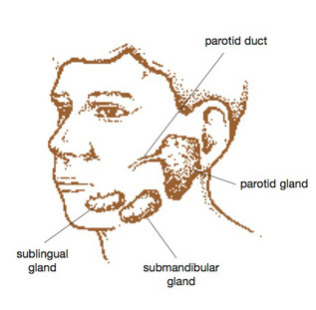
THE SALIVARY GLANDS
The salivary glands produce saliva. Saliva is necessary to moisten food to create a bolus (moist ball of food that can be swallowed). ​ The parotid gland is found outside of the cheek, the sublingual gland lies under the tongue and the submandibular gland lies under the mandible (jaw).

Slide 74
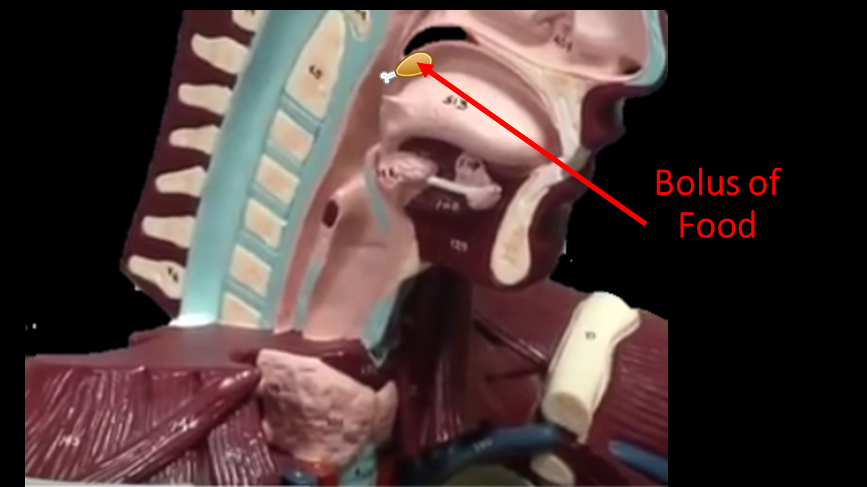
Bolus
Saliva is necessary to moisten food to create a bolus (moist ball of food that can be swallowed).

Slide 75
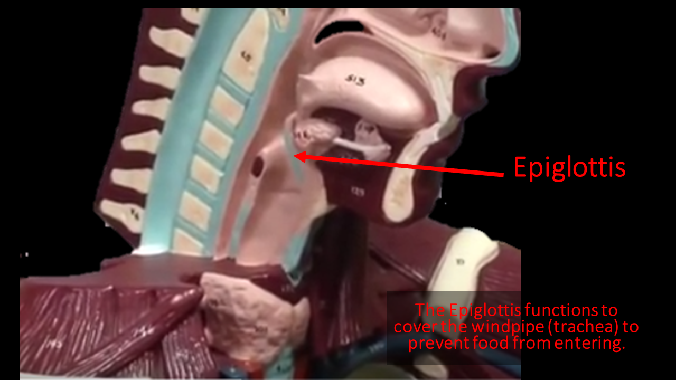
EPIGLOTTIS
. The epiglottis is a small flap of tissue that covers the trachea when you swallow to prevent food from entering the airways!

Slide 76
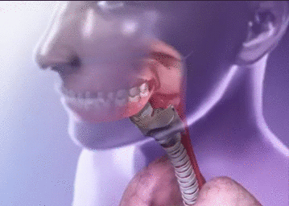
EPIGLOTTIS

Slide 77
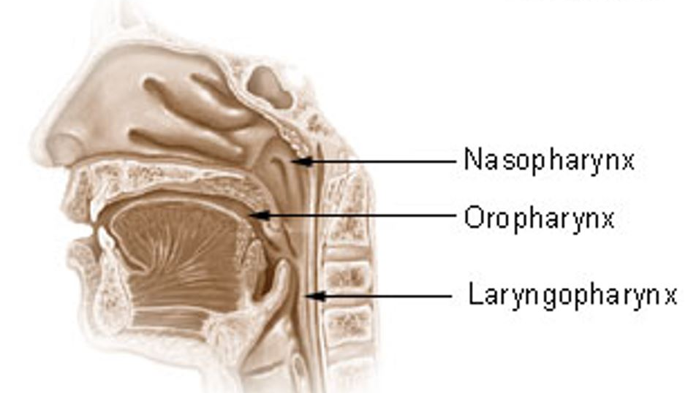
The 3 Regions of the Pharynx

Slide 78
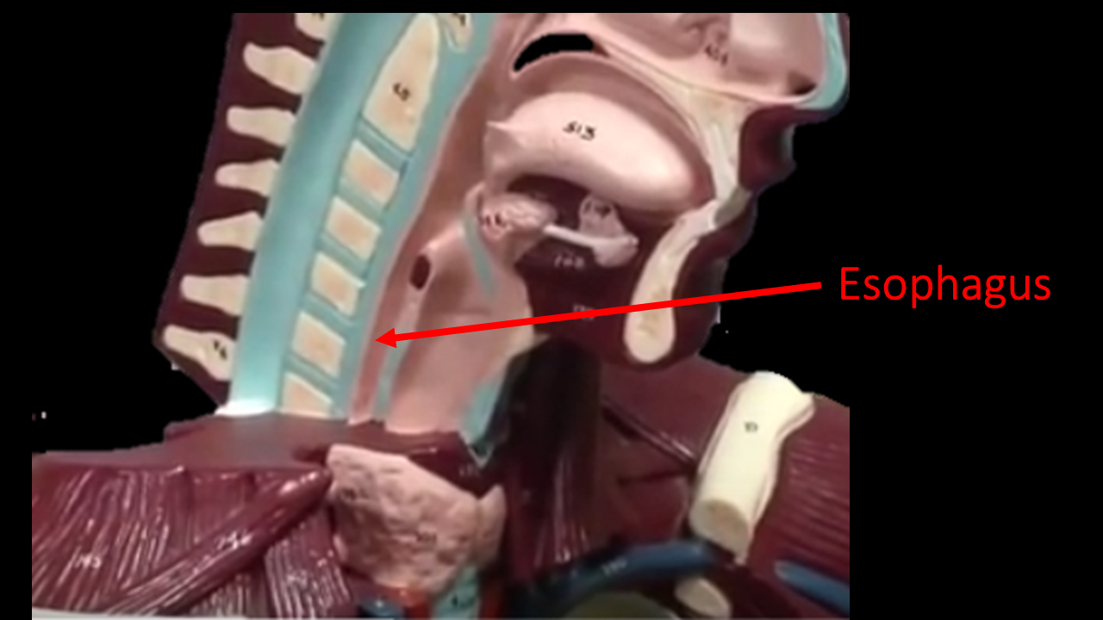
Esophagus
The esophagus is lined with smooth muscle that propels swallowed food to the stomach.
The function of the esophagus is deliver food from the pharynx to the stomach.

Slide 80
The Stomach

Slide 81
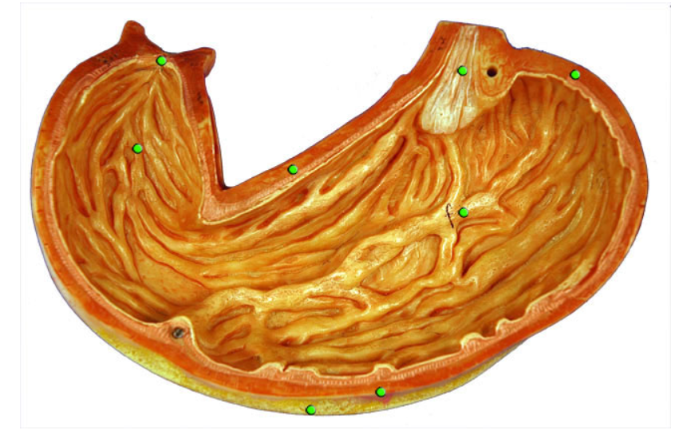

Slide 84
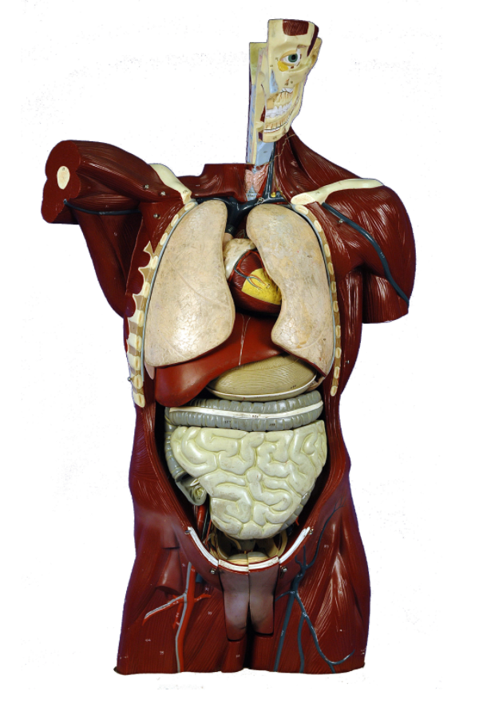
Lungs
Heart
Liver
Stomach
Large Intestines
Small Intestines

Slide 86
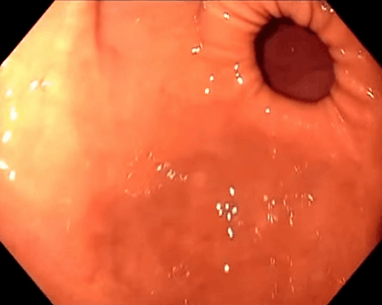
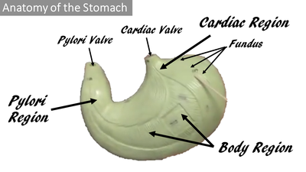
Sphincter Muscles of the Stomach

Slide 88
From the esophagus, the bolus of food will pass through the cardiac sphincter of the stomach.

Slide 89
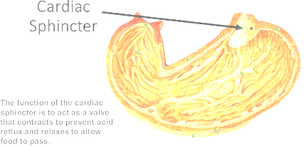
THE CARDIAC SPHINCTER/VALVE
The function of the cardiac sphincter is to act as a valve that relaxes to allow food to enter the stomach from the esophagus.
The cardiac sphincter also functions to prevent stomach acid from traveling upward from the stomach into the esophagus.
When the cardiac sphincter fails to prevent this from happening, the result is acid reflux or heart burn.

Slide 90
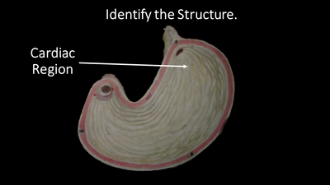
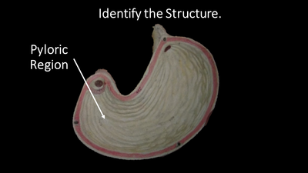
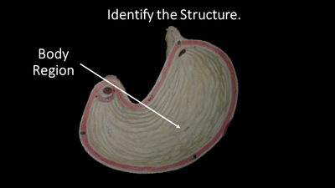

Slide 91
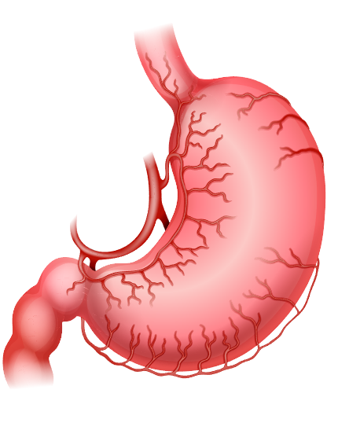
Anatomy of the Stomach
The stomach begins at the cardial sphincter that connects the esophagus to the stomach.
Food enters the first portion of the stomach, called the cardial region.
The fundus of the stomach is the superior "dome-shaped" region of the stomach that lies just inferior of the diaphragm.
The large midportion of the stomach is called the body.
As you travel through the stomach, the body becomes the pyloric region (which includes the pyloric antrum and pyloric canal) which looks like a funnel. The terminal end of the stomach contains the pyloric sphincter.
The word pylorus means “gatekeeper”. Living up to its name, the pyloric sphincter controls the entry of partially digested food into the small intestine.

Slide 94
THE PYLORIC SPHINCTER/VALVE
The function of the pyloric sphincter is to act as a valve that prevents larger chunks of food to pass onto the duodenum from the stomach.
The pyloric valve only allows food that has been broken down into relatively small parts to pass onto the duodenum.
The duodenum is considered the first part of the small intestine.

Slide 95
The stomach transforms your food into a paste-like, partially digested substance called chyme. The chyme leaves the stomach via the pyloric valve, and enters the duodenum which is the first part of the small intestine.

Slide 96
Subdivisions of the Small Intestine
The small intestine begins at the pyloric sphincter of the stomach and is divided into three sections:
The duodenum
The jejunum
The ileum.

Slide 97
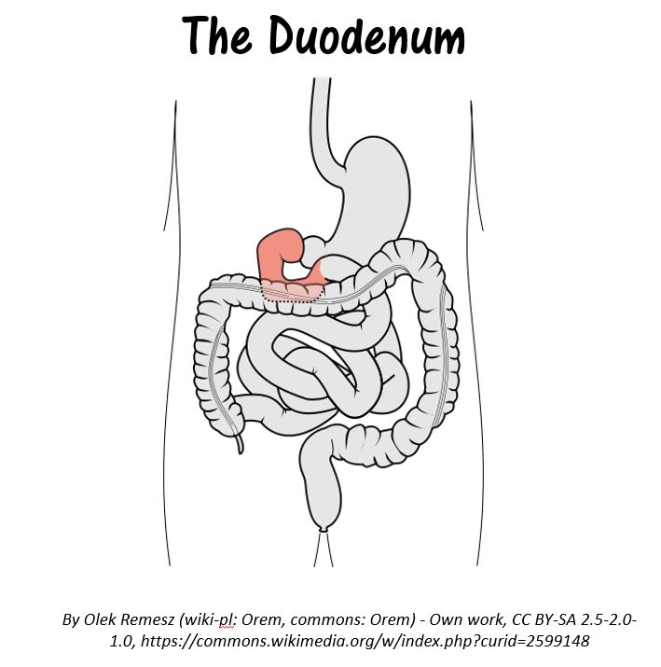
The duodenum is the1st part of the small intestine.
It is smallest portion of the small intestine.
Most of digestion occurs in the duodenum, due to enzymes and juices from the liver and pancreas.

Slide 100
The liver functions to detoxify chemicals, metabolize drugs, secrete the digestive enzymes in the form of bile, and produces blood clotting factors.
In the digestive system, the liver functions to secrete the digestive enzymes in the form of bile which helps to break down fats (lipids).

Slide 102
The ultimate destination of the bile is the duodenum of the small intestine.
The bile produced in the liver can be stored in the gallbladder which lies directly underneath the liver.
The gallbladder's function is to store and concentrate the bile that was made in the liver.
Bile from the liver can also bypass the gallbladder altogether and get secreted by a different pathway.

Slide 103
The pancreas secretes pancreatic juices, which have digestive enzymes. It secretes this into the duodenum.

Slide 104
The jejunum is the segment of the small intestine that comes after the duodenum.
Most of the nutrients present in food are absorbed by the jejunum before being passed on to the ileum for further absorption.

Slide 105
The ileum is the last part of the three part tube that makes up the small intestine.
It is where the remaining nutrients are absorbed before moving into the large intestine.

Slide 106
The appendix now functions to store immune cells and healthy bacteria (probiotics) that aid digestion.
The appendix is sometimes referred to as a vestigial organ, because early humans, the appendix carried enzymes needed to breakdown cellulose.
This organ has since lost this function due to evolution.

Slide 107
Large Intestines
As the food makes its journey, some water will be absorbed, leaving behind waste products to be eliminated from the body in the form of feces.
The main function of the large intestine (also called the colon) is to concentrate and produce waste in the form of feces.

Slide 108
The ileum is the last part of the three part tube that makes up the small intestine. It is where the remaining nutrients are absorbed before moving into the large intestine.

Slide 109
Once food has been further broken down in the cecum, it will travel up the ascending colon, across the transverse colon, down the descending colon, then through the sigmoid colon, rectum and finally, out the anus.

Slide 110
Chyme (paste of food with gastric juices) leaves the ileum of the small intestine and enter into the cecum of the large intestine through the ileocecal valve.
The ileocecal valve is a sphincter muscle valve that separates the small intestine and the large intestine. It functions to prevent substances flowing back into the ileum once they have reached the cecum.

Slide 111
The large intestine is separated into the following areas:
These are given in the order in which food travels through!
Cecum
Ascending Colon
Transverse Colon
Descending Colon
Sigmoid Colon
Rectum
Anal Canal

Slide 113
The Reproductive System

Slide 114
The Gonads
The term ‘gonads’ is a generic term that applies to the anatomical location of where the gametes are produced.
Gametes are the sex cells (eggs or sperm)

Slide 115
The Male Gonads
The male gonads are the testis.
Gametes (Sperm cells or spermatozoa) are produced in the testis.
The testis secrete the male sex hormone, testosterone

Slide 116
The Female Gonads
The Female gonads are the ovaries.
Immature oocytes / ova (eggs) are formed at birth in the ovaries
The oocytes / ova mature in the ovaries – one per month.

Slide 117
The Male External Genitalia
The male external genitalia consists of…
1) The Scrotum
The scrotum is a sac-like organ made of skin and muscles that houses the testes below the penis in the pubic region.
2) The Penis
The penis is the male external excretory and sex organ.
http://medicalterms.info/img/uploads/anatomy/scrotum.jpg
http://www.innerbody.com/image/repmov.html

Slide 118
The Scrotum
The Scrotum
The function of the scrotum is to to regulate the temperature of the sperm.
It does this by contracting and relaxing muscles to move the testis either closer to or further from the warm body.
http://medicalterms.info/img/uploads/anatomy/scrotum.jpg
http://www.innerbody.com/image/repmov.html

Slide 119
The penile opening (the urethra) is shared by the urinary tract as well as the reproductive tract. In other words, the urethra is used for urination as well as to deliver semen.

Slide 120
The Penis
The penis functions as both a reproductive organ and an excretory organ.
As a reproductive organ, the penis becomes erect during sexual intercourse in order to deliver semen more effectively into the vagina.
As an excretory organ, semen travels through the urethra to the tip of the penis where it is ejaculated out of the body.

Slide 121
Sperm Production
PHOTOGRAPH BY MANFRED KAGE, PHOTO LIBRARY
I am in control.
I am informed.
I can make informed decisions.
“How a Man Produces 1,500 Sperm a Second”
http://news.nationalgeographic.com/news/2010/03/100318-men-sperm-1500-stem-cells-second-male-birth-control/
Notes:
While most parents blush at the thought of explaining the mechanics of human reproduction to their curious 5-yr old child asking where babies come from, there is a lot more to human reproduction than the act of intercourse itself.

Slide 122
Male Reproductive System
Testis – male gonad
Makes sperm
Secretes male hormone testosterone
Epididymis
Sperm go here to mature after being created in the testes
Ductus (vas) deferens
Tube connecting epididymis to the urethra
Seminal vesicles, Prostate gland and Bulbourethral (Cowper’s) gland
All create seminal fluid
When sperm are combines with seminal fluid, it is called semen.
Urethra
Tube that carries both urine and semen in males (not at the same time)
Allows urine and semen to leave the body

Slide 123
Semen – designed to survive the female reproductive tract
Semen is a mixture of sperm and seminal fluid (accessory gland secretions)
Advantages of additive secretions:
Fructose provides energy for sperm cells
Alkalinity of semen helps neutralize the acidic environment of vagina
Semen inhibits bacterial growth
Enhances sperm motility

Slide 125
The Sperm’s Journey Through the Male Reproductive Anatomy

Slide 132
The Ovary
Women are born with as many immature eggs (oocytes) as they will ever have in their lifetime.
The ovaries are full of follicles.
Each follicle has one oocyte that is able to mature into a mature ovum (egg).
Follicles

Slide 133
The Ovary
The ovaries play two central roles in the female reproductive system
The ovaries act as glands by secreting important sex hormones including estrogen and progesterone.
Progesterone
Estrogen

Slide 134
The Ovary
The ovaries play two central roles in the female reproductive system
The ovaries act as glands by secreting important sex hormones including estrogen and progesterone.
The ovaries act as gonads by housing the follicles that develop into mature ova (eggs).
Follicles

Slide 135
The female has two ovaries; one on the left side and one on the right side.
The ovary that participates in each cycle changes. They basically take turns. For example, one month the right ovary will release the oocyte and the next month the left ovary will release an egg.
This is why women who have damage or loss to one ovary are still fertile and able to have healthy offspring.
Right Ovary
Left Ovary

Slide 136
Fertility Window
From puberty to menopause, women are only able to conceive during a 6-day window of time out of their monthly cycle.
Women can only get pregnant on the day of ovulation, or the five days immediately prior.

Slide 137
Fertility Window
Ovulation usually starts about 14 days after the onset of the woman’s last menstruation.
Having intercourse from about day 10 to about day 14 of the cycle, increases the chance of pregnancy.

Slide 138
Females are born with as many follicles as they will ever have in their lifetime.
The female is born with hundreds of thousands of follicles in each ovary.
Each of these follicles houses a single immature egg (ovum).

Slide 139
Females are born with as many follicles as they will ever have in their lifetime.
Fallopian Tube
Once the ovum has matured, ovulation occurs.
Ovulation is when the mature egg is released from the ovary and enters the fallopian tube.
Ovum
{
Ovary

Slide 140
The Fallopian Tubes
Fallopian Tubes
The Fallopian tubes connect the ovaries to the uterus.
Ova (egg cells) are carried to the uterus through the fallopian tubes following ovulation.
https://ccbbiology10.wikispaces.com/file/view/Reproductive-System-Pattonville-High-School-News.jpg/404807362/286x307/Reproductive-System-Pattonville-High-School-News.jpg

Slide 141
The Fallopian Tubes
Fallopian Tubes
Fertilization of the egg occurs in the Fallopian tube!
https://ccbbiology10.wikispaces.com/file/view/Reproductive-System-Pattonville-High-School-News.jpg/404807362/286x307/Reproductive-System-Pattonville-High-School-News.jpg

Slide 142
The Fallopian Tubes
Fallopian Tubes
If the egg is not fertilized, it will break down and it will be expelled from the uterus, along with the uterine lining, during menstruation.
https://ccbbiology10.wikispaces.com/file/view/Reproductive-System-Pattonville-High-School-News.jpg/404807362/286x307/Reproductive-System-Pattonville-High-School-News.jpg

Slide 143
The Menstrual Cycle
Fallopian Tubes
“Day 1” of the menstrual cycle is defined as the first day of “bleeding” or menstruation.
If you are female, you may have noticed your doctor or nurses asking you, “when was the first day of your last period.”
This let’s your medical provider know where you are at in your cycle!
https://ccbbiology10.wikispaces.com/file/view/Reproductive-System-Pattonville-High-School-News.jpg/404807362/286x307/Reproductive-System-Pattonville-High-School-News.jpg

Slide 144
The Menstrual Cycle
Thickening of the Uterine Wall
Why do women bleed?
Every 28 days or so, a woman’s body prepares itself for pregnancy JUST IN CASE, by thickening the walls of the uterus.

Slide 145
The Menstrual Cycle
Breakdown and Release of Uterine Lining During Menstruation
Why do women bleed?
When the egg does not get fertilized, hormones trigger the thickened lining of the uterus to break down and leave the body in the form of a blood-like secretion.

Slide 146
The Uterus
The UTERUS is also known as the WOMB.
If a woman becomes pregnant, this is where the fetus will grow and develop.

Slide 147
The Cervix
NOT TO SCALE!!!
The cervix is the opening from the uterus to the vagina.
When a woman is ready to give birth, a doctor will check to see if the cervix has dilated.
The cervix must dilate (get bigger) to allow the baby to pass through.

Slide 148
The Vagina
The Vagina is the birth canal for the baby.
It is also the receptacle for spermatozoa during sexual intercourse.

