Slide 1
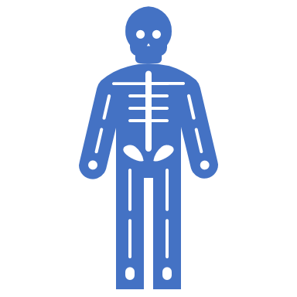
Anatomical BASICS

Slide 2
The importance of Anatomical Positions, Directions and Planes
Nowadays, humans can use GPS to get around. The global positioning device (GPS) technology calculates your location and the location of your destination by calculating the time of the signal with the known position of satellites orbiting Earth! However, this was not always the case.

Slide 3
The importance of Anatomical Positions, Directions and Planes
Could you image a time before GPS, or even before maps? Getting around would have been a challenge. A traveler would have to depend on the verbal instructions of others to get from one place to another. Clear instructions would be very important.
For example, "Go 3 miles, then turn left at Cherry Avenue, then go 2 miles and turn Left on Montgomery Street." is abundantly more clear than "Go up the hill a ways 'til you get to the old willow tree and go left 'til you pass the old wooden mill, until you get to the Baker's farm."

Slide 4
Medical Mistakes due to NOT understanding or clearly explaining anatomical positions, directions or planes!

Slide 5
https://youtu.be/-BVErD8WWKM

Slide 6
When anatomical positioning is discussed, we must have a standard position (see image) that we refer to as a "frame of reference".
In anatomy, whenever we use positional terminology, we ALWAYS refer to the position AS IF the patient was in the "anatomical position"

Slide 7
In the anatomical position, the body is
upright, directly facing the observer
feet flat and directed forward
upper limbs are at the body’s sides
palms facing forward

Slide 8
Also, the “right side” of the body, refers to the patient’s right side. The “left side” of the body, refers to the patient’s left side.

Slide 9
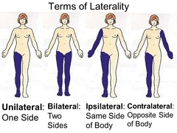
Laterality Terms
Ipsilateral = same side​
Contralateral = opposite side
Unilateral – one side
Bilateral – both sides / 2 sides

Slide 10
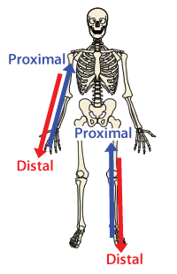
Proximal and Distal
Proximal means towards the trunk of the body.
Distal means away from the trunk.
Proximal and distal are usually used when describing structures in the extremities.

Slide 11
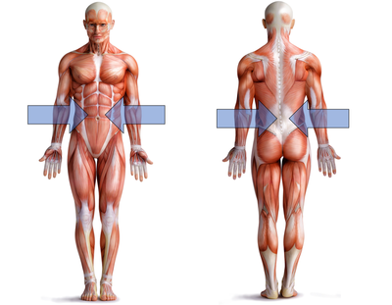
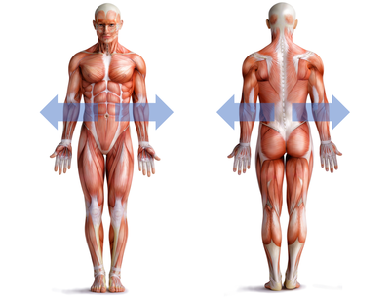
Medial = Towards the MIDDLE
Lateral = Towards the SIDES

Slide 12
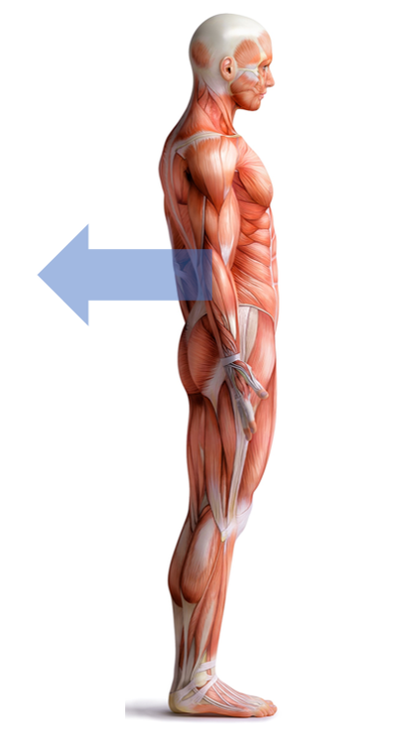
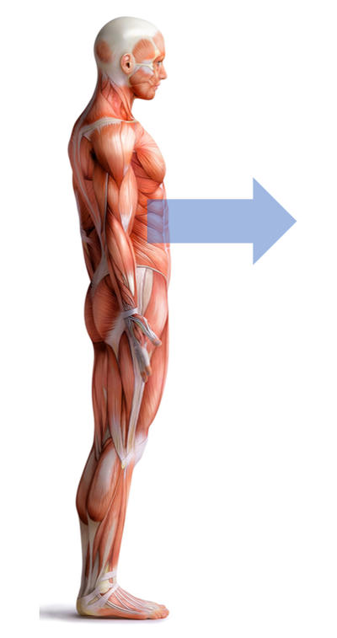
Posterior or Dorsal = Towards the BACK
Anterior or Ventral = Towards the FRONT

Slide 13
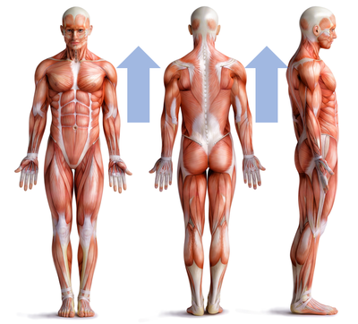
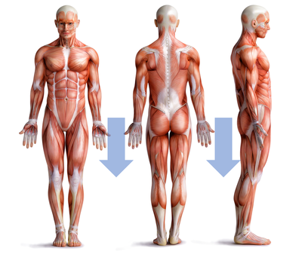
Inferior = Downward
Superior = Upward

Slide 14
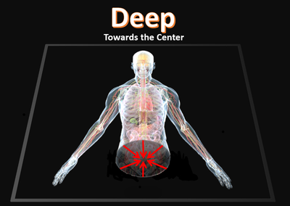
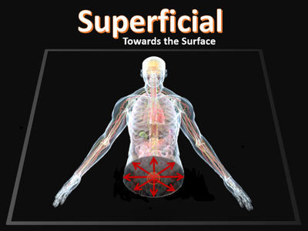
DEEP – Far INSIDE / Far BELOW THE SURFACE of the body
SUPERFICIAL – Shallow / NEAR theSURFACE of the body

Slide 15
Midline – The imaginary line that runs down the center of the body
MIDLINE

Slide 17
Anatomical Planes

Slide 18
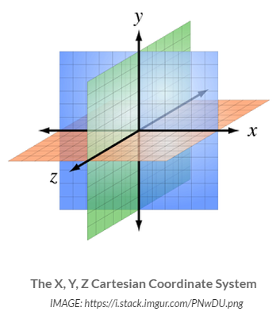
Anatomical Planes
Since humans (and all tangible matter humans know of) are not flat, we need to add a 3rd dimension to our Cartesian Coordinate system. Adding the 'Y' dimension, gives us depth.
This is important because we can superimpose the human form on this 3-dimensional grid and pinpoint with utmost accuracy any point inside the human body.

Slide 19
Anatomical Planes
https://youtu.be/Xk_sAi9mgxg
Sheldon Expresses his Favorite Spot as a Position on a 4-Dimensional Cartesian Coordinate System. ​(The 4th Dimension, for those of you wondering, is the dimension of time.)

Slide 20
How are anatomical planes used?
Being able to pinpoint any specific point in a person's body is necessary for such advances in cancer treatments such as tomotherapy.
MRI and CT Scan images are used along with sophisticated computer software to accurately calculate the precise location in need of attention. Afterwards, a computer can guide and direct electron beams (or other radiation) to kill the affected tissue while preserving the healthy surround tissue. These advances have not only increased the survival rate of cancer patients, but have drastically reduced the unpleasant, and often debilitating, side effects of chemotherapy or traditional radiotherapy techniques.

Slide 21
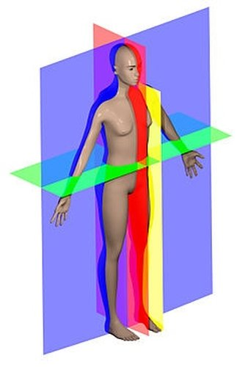
Anatomical Planes
If we orient our human on the grid, in the anatomical position, the body would be facing forward, the head and feet would be located along the 'Y' axis and the arms would be located along the 'X' axis.

Slide 22
Anatomical Planes
The plane shown in BLUE/PURPLE is the coronal plane. The plane shown in GREEN is the transverse plane (also called a cross section). The plane shown in RED and the plane shown in YELLOW are both sagittal planes, but they can also be referred to as... The plane shown in RED is the sagittal plane that is exactly at the midline and it can be more specifically referred to as the midsagittal plane. The plane shown in YELLOW is called a parasagittal plane. When a sagittal plane is moved either right or left from the midline, it is considered a parasagittal plane.

Slide 23
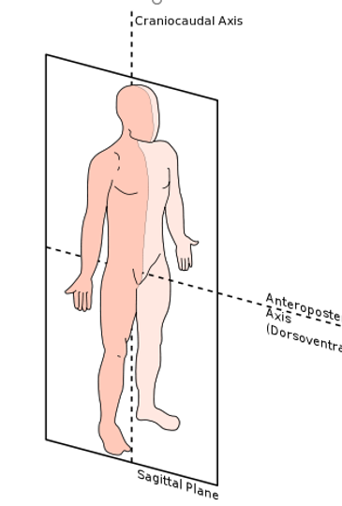
The Sagittal Plane
The sagittal plane runs vertically through the body dividing the body into the left (sinister) and right (dexter) sides .

Slide 24
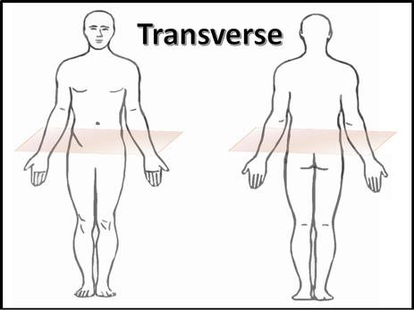
The Transverse Plane
The transverse plane separates the body horizontally. A "transverse section" can also be called a "cross-section" of the body. This plane separates the superior (or upper) part of the body from the inferior (or lower) part of the body.

Slide 25
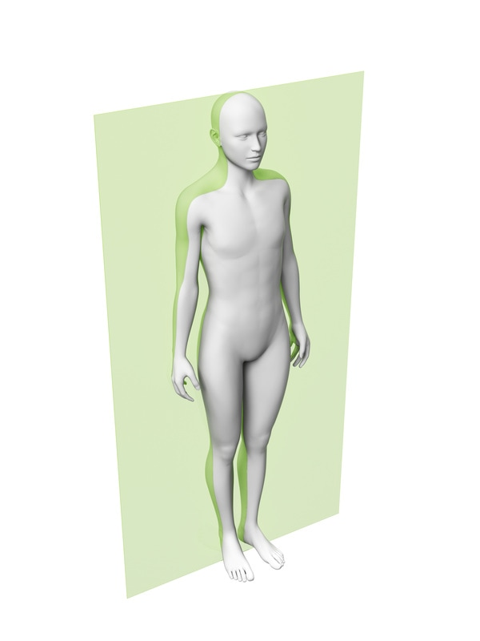
The coronal plane
The coronal plane (also known as the frontal plane) divides the body into front (ventral or anterior) portion of the body) and back (posterior or dorsal) portion of the body.

Slide 26
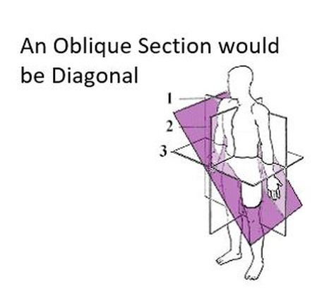
Oblique sections
Oblique sections are not very useful in most situations in medicine.
It is rare to see this type of section done in histology or when using imaging techniques. However, this term can be used to characterize the angle of a wound.

Slide 27
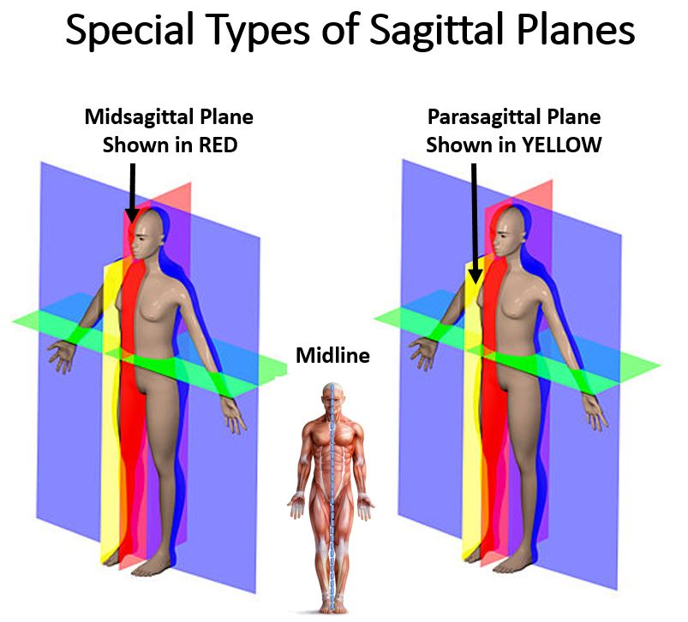

Slide 28
Body Cavities and Membranes
What Do We Mean By "Body Cavity"?
Before we begin our discussion of body cavities and membranes, it is important to know what a cavity is in the first place!
In anatomy you learn that the human body is, in a sense, a glorified tube. ( I can almost hear you GASP! ) OK, a tube is an over simplification, but the premise holds true.
The inside and the outside of your tube is covered with epithelial tissue.
This tube has some specialized regions that are made up of concave regions (also lined with epithelium) that are connected to the outside.
You also have fluid-filled chambers inside of your body that is NOT connected to the outside.
All of these regions are considered CAVITIES.

Slide 29
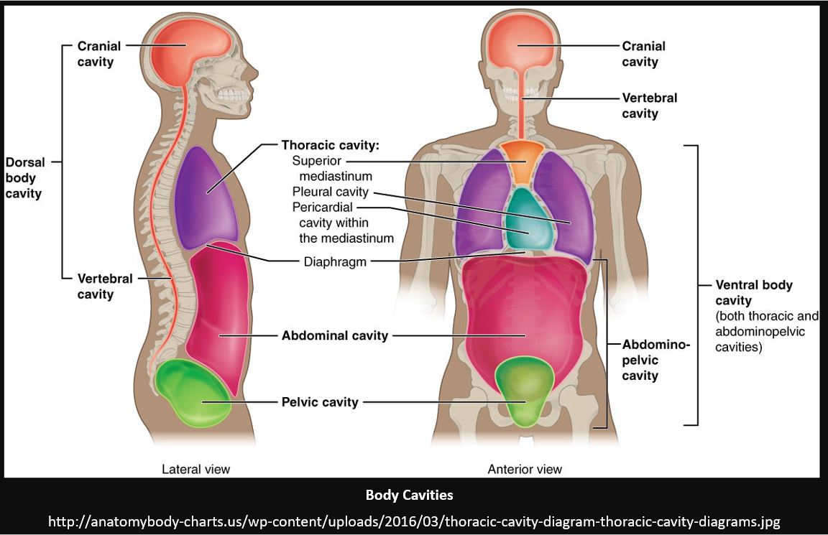
Body Cavities
The definition of a body cavity - a body cavity is considered to be any fluid-filled space in the body, other than vessels (blood and lymph).
The human body has 2 main body cavities.
the dorsal (or posterior) cavity
The ventral (or anterior) cavity

Slide 30
The Dorsal Cavity
The dorsal cavity consists of the cranial cavity that houses the brain and the vertebral (or spinal) cavity which contains the spinal cord. There is no physical separation between the cranial cavity and vertebral cavity.
This cavity is a continuous chamber filled with cerebrospinal fluid that surrounds the brain and the spinal cord.
"Cerebro-" means "brain" and "spinal" means "of the spine", so the liquid cerebrospinal fluid is named after what it essentially bathes, which is the brain and spine.

Slide 31
The Ventral Cavity
The ventral (or anterior) cavity contains the body's visceral organs. The visceral organs are your body's internal organs, including the heart, the lungs, the liver, the pancreas and the intestines. The ventral cavity of the human body is divided into two main regions; the thoracic cavity, and the abdominopelvic cavity, each of which have additional subdivisions. ​ ​ The thoracic cavity and the abdominal cavity are separated by the diaphragm.

Slide 33
Subdivisions of the Thoracic Cavity
The thoracic cavity is separated into three chambers; the left and right pleural cavities and the mediastinum.

Slide 34
Subdivisions of the Thoracic Cavity
The thoracic cavity is the cavity of the chest area. This cavity lies underneath the rib cage and houses many important organs and structures of cardiovascular, respiratory and lymphatic systems.
The two arguably most notable organs of the thoracic cavity are the heart and the lungs.

Slide 35
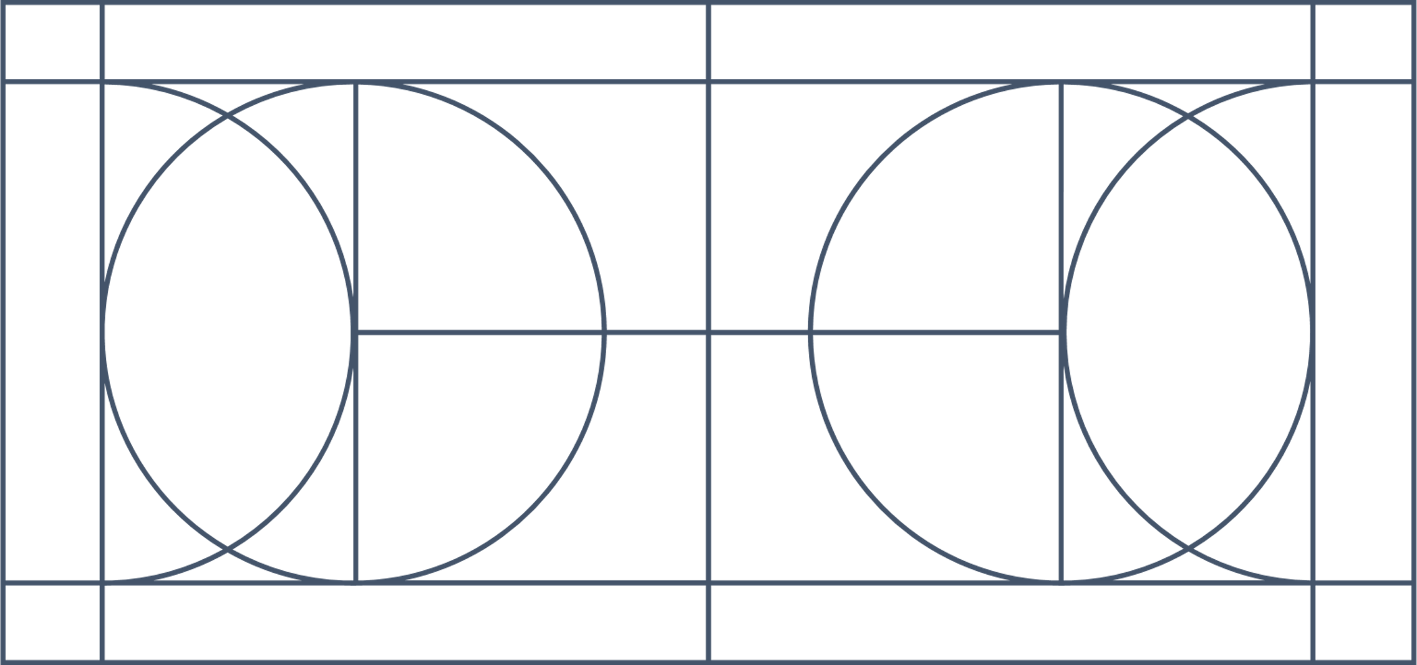
Subdivisions of the Thoracic Cavity
The Pleural Cavity The left lung is in the left portion of the pleural cavity and the right lung is in the right portion of the pleural cavity.

Slide 36
Subdivisions of the Thoracic Cavity
The Mediastinum Cavity is space between the 2 pleural cavities.
It holds the pericardial cavity which contains the heart.

Slide 37
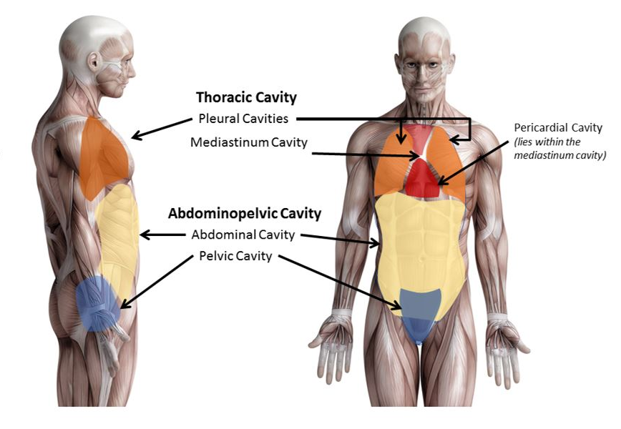
Subdivisions of the Abdominopelvic Cavity
​The Abdominopelvic Cavity The abdominopelvic cavity is divided into 2 areas; the abdominal cavity and the pelvic cavity. ​ ​​​The Abdominal Cavity The abdominal cavity contains digestive organs., including the stomach, the liver, the kidneys, the small intestines, etc. ​ ​​The Pelvic Cavity The pelvic cavity contains the internal reproductive organs, the urinary bladder and the rectum.

Slide 38
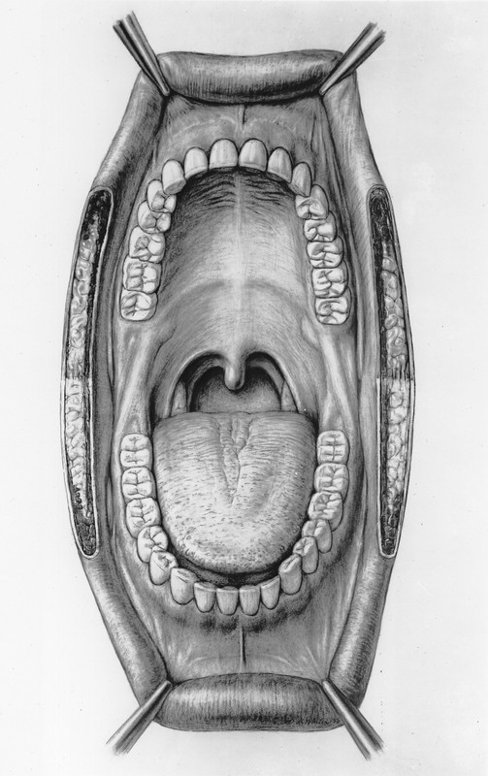
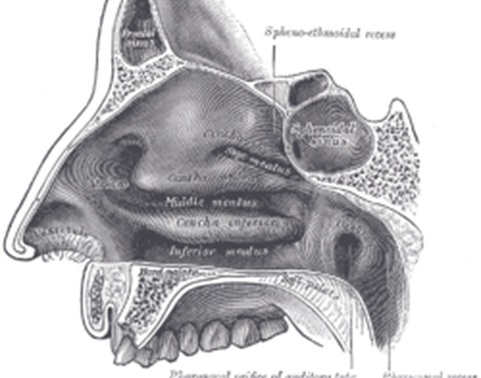
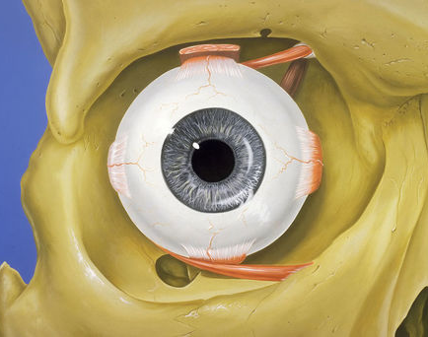
Other Body Cavities
oral cavity
the nasal cavity
​There are other body cavities in addition to the dorsal and ventral cavities. These other cavities, however, are accessible from the outside of the body.
This includes the
oral cavity – the cavity of the mouth
the nasal cavity – the cavity of the nose
the orbital cavity – the cavity of the eye
the orbital cavity

Slide 39
Body Cavities
The Dorsal (or Posterior) Cavity
The Cranial Cavity
The Vertebral (or Spinal) Cavity
The Ventral (or Anterior) Cavity
The Thoracic Cavity
The Abdominopelvic Cavity

Slide 40
Anatomical Regions of the ​ Human Body

Slide 43
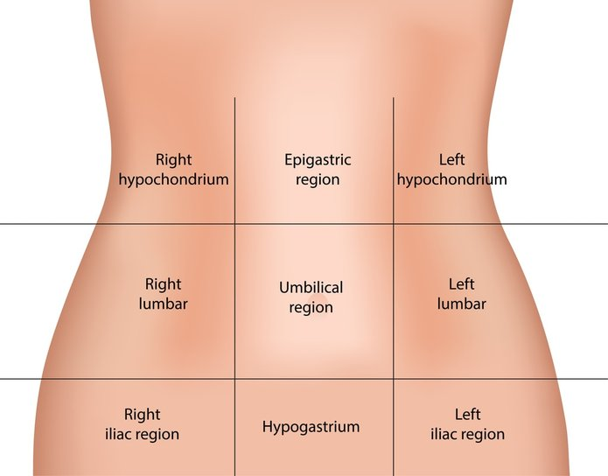
In anatomy, the regions of the abdominal area are broken up into 9 regions.
The Right and Left Hypochondriac (Hypochondrium) ( Hypochondrial) Regions Knowing the language is the best way to remember anatomical terminology.
Hypochondriac (hypochondrium) (hypochondrial) is a term derived from the Greek word hypochondros which means "abdomen" or "below the cartilage".
The right and left hypochondriac regions are the two regions of the abdomen that lie below the right and left rib cage, respectively.

Slide 45
